Slide 1

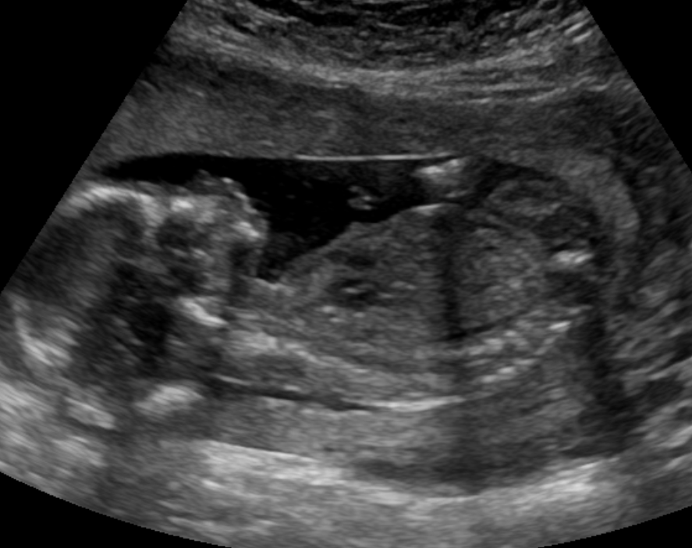
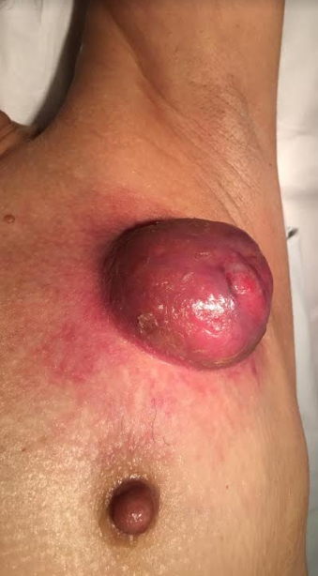

What to expect when you're expecting
Unique features of breast suspicious lesions in pregnant women
Authors: C. d. Kiebert, L. G. Martins, A. T. Yamamoto Mota, S. S. Barbosa, T. C. Tucunduva, G. B. Nobrega, A. F. TRINCONI, E. Endo, V. C. Ferreira, M. Giannotti, C. Shimizu
Faculdade de Medicina da Universidade de São Paulo

Slide 2
OBJECTIVES
briefly review physiological changes, breast image workup and bening entities that can simulate breast cancer
focus in clinical and imaging forms of PABC in association with anatomopathological aspects
highlight some of the recommendations for treatment of these tumors by illustrating this exhibit with cases from our radiology department.

Slide 3

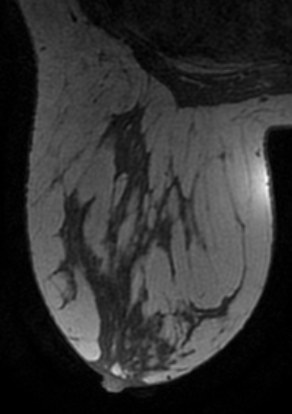
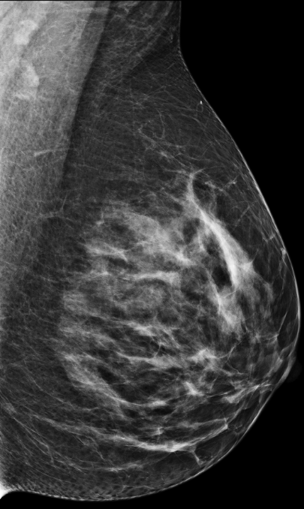
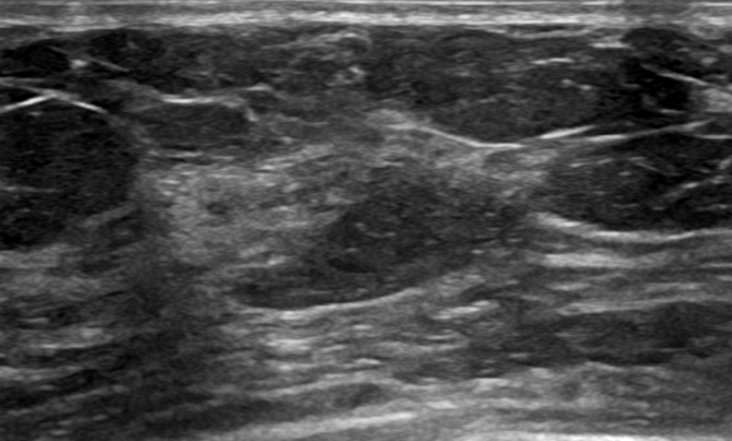
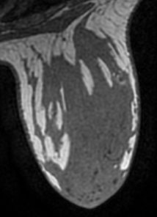

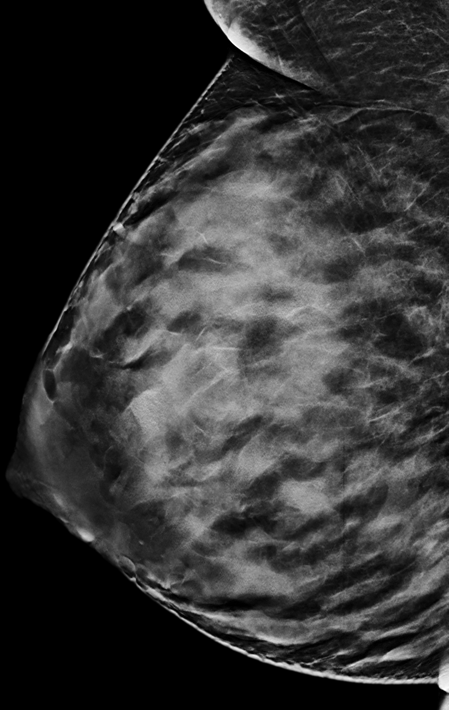
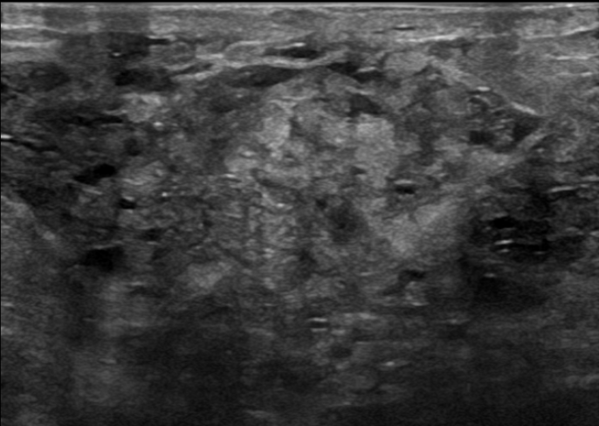
physiological changes of pregnancy and lactation
Notes:
ncreased breast volume and increased water content with associated palpable nodularity, firmness, and increased parenchymal density.
Read More: https://www.ajronline.org/doi/full/10.2214/AJR.12.9814

Slide 4
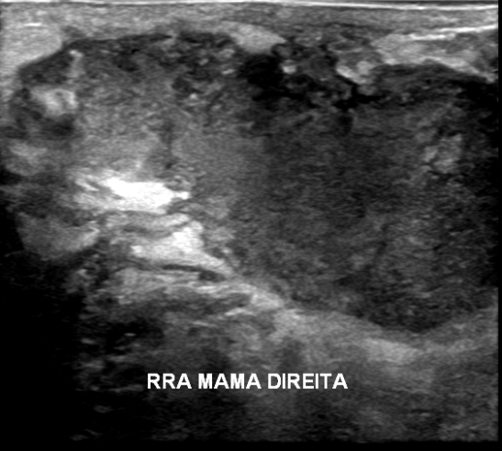
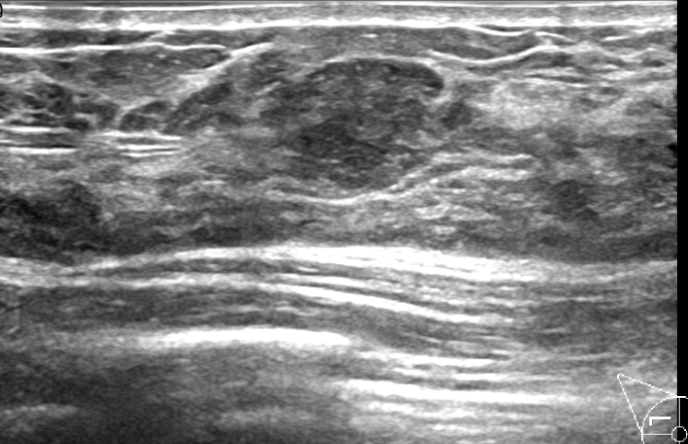
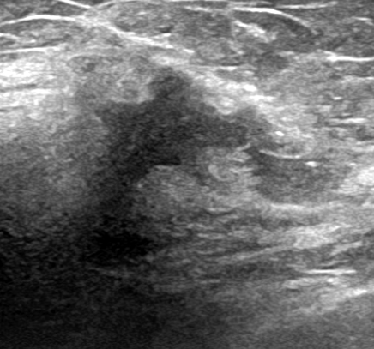
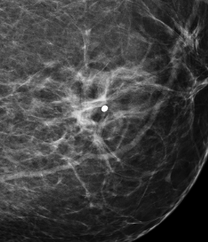
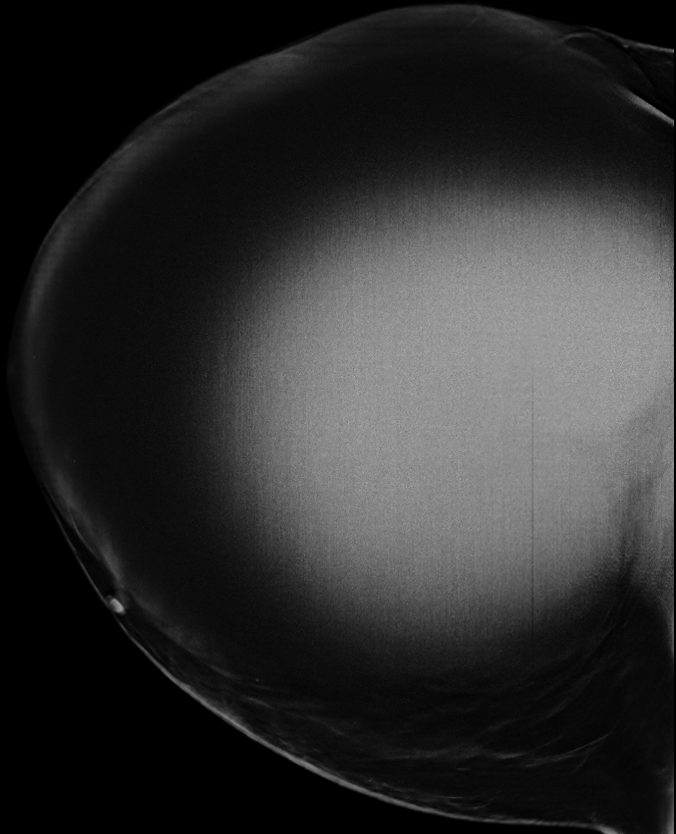
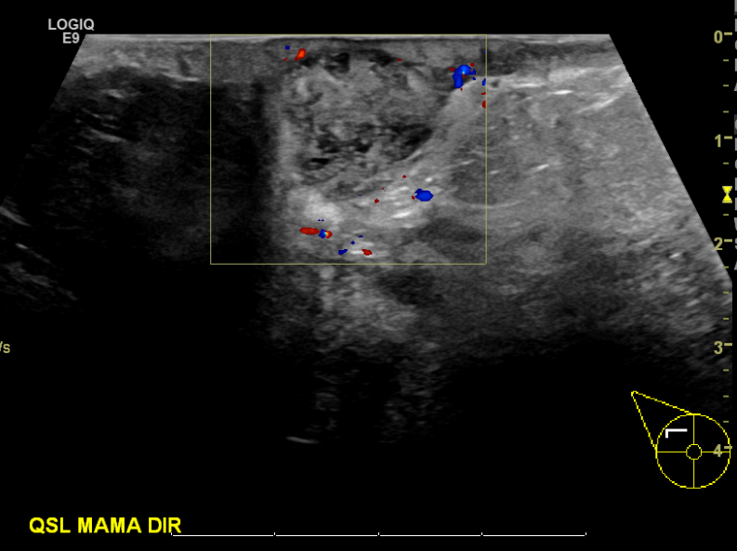
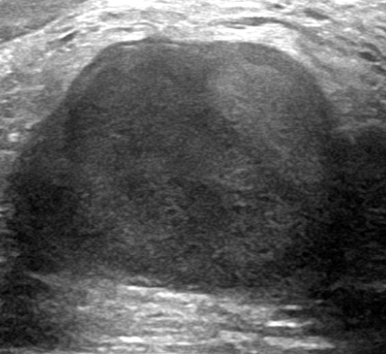
Flow chart for palpable complains in pregnant and lactant women
Benign
Biopsy and/or mammography
Palpable breast mass in pregnant and lactating women
Suspicious
Granulomatous mastitis
Lactating
adenoma
=
Malignant
Breast ultrasound
Definitively benign
Invasive ductal carcinoma with no-special-type
Invasive lobular carcinoma
Others
Mastitis
Galactocele
Notes:
The incidence of breast cancer in pregnancy is approximately 1 in 3000 and it is the second most common cancer in pregnant women.
There are many studies reviewing benign entities related to pregnancy and lactation, but there are only a few studies presenting clinical and imaging forms of pregnancy associated breast carcinoma (PABC).
The aim of this study is to:
briefly review physiological changes, breast image workup and bening entities that can simulate breast cancer presente
focus in clinical and imaging forms of PABC in association with anatomopathological aspects
highlight some of the recommendations for treatment of these tumors by illustrating this exhibit with cases from our radiology department.

Slide 5
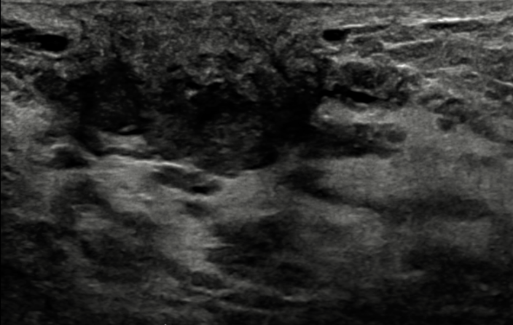
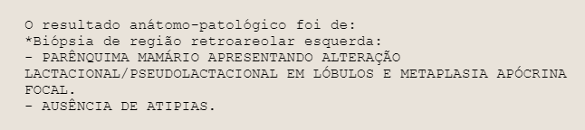
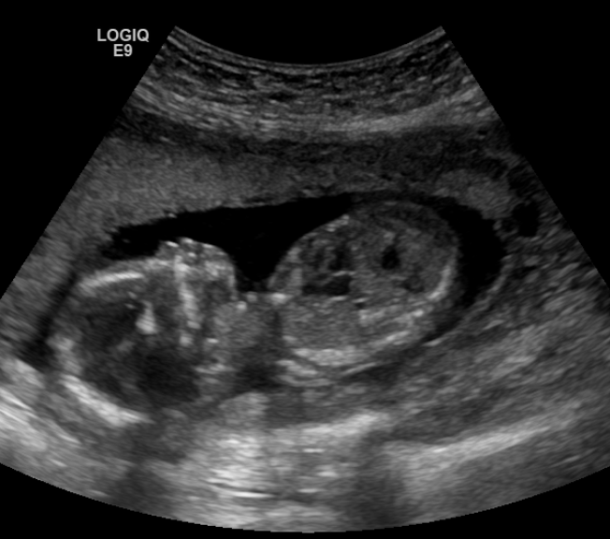
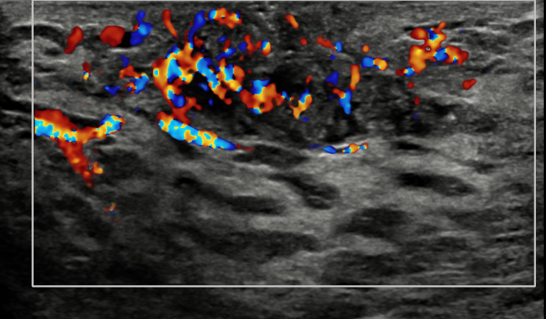
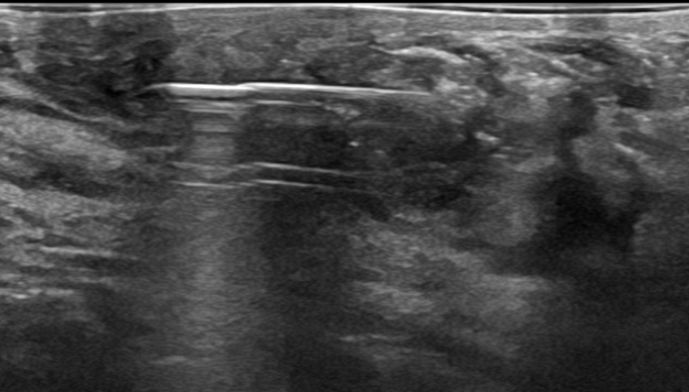
Benign - Matitis
Notes:
12785992

Slide 6
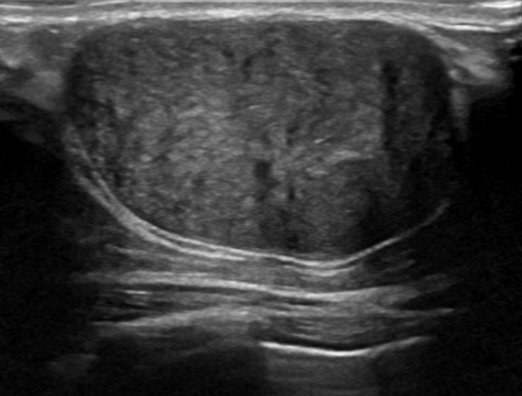
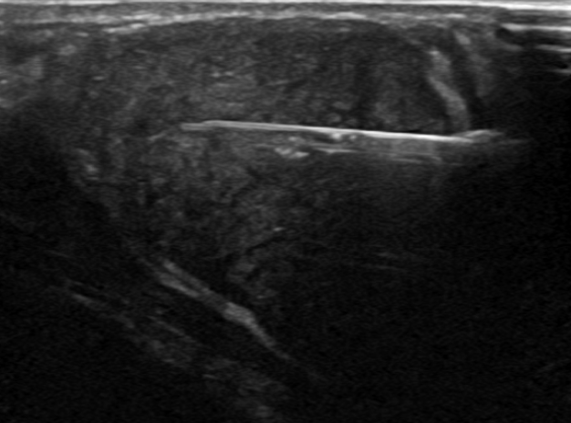
Benign - Fibroadenoma
Notes:
5635723 – fibroadenoma crescimento rapido gestante

Slide 7
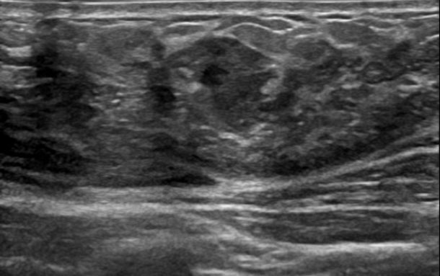
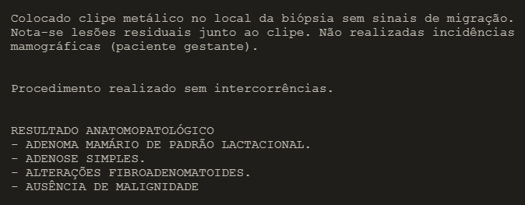
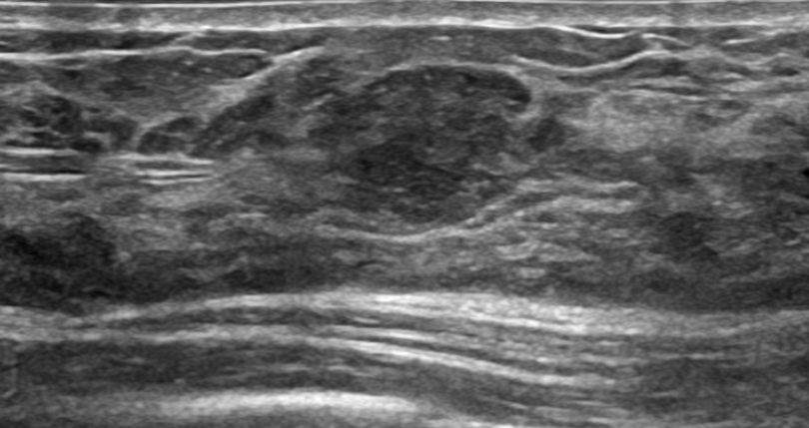
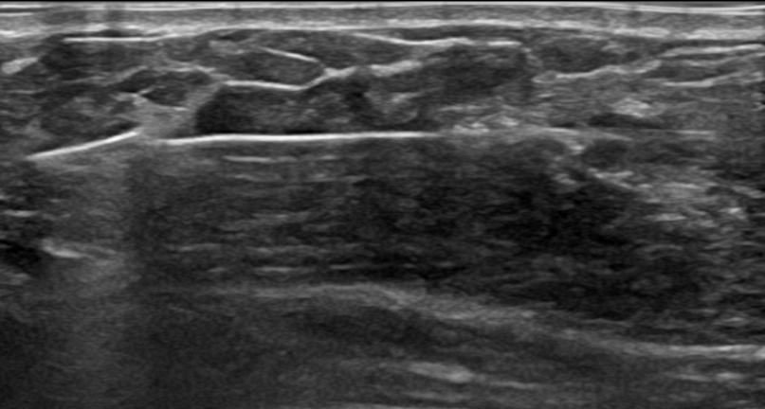
Benign – Lactational adenoma
Notes:
5635723 adenoma lactacional

Slide 8
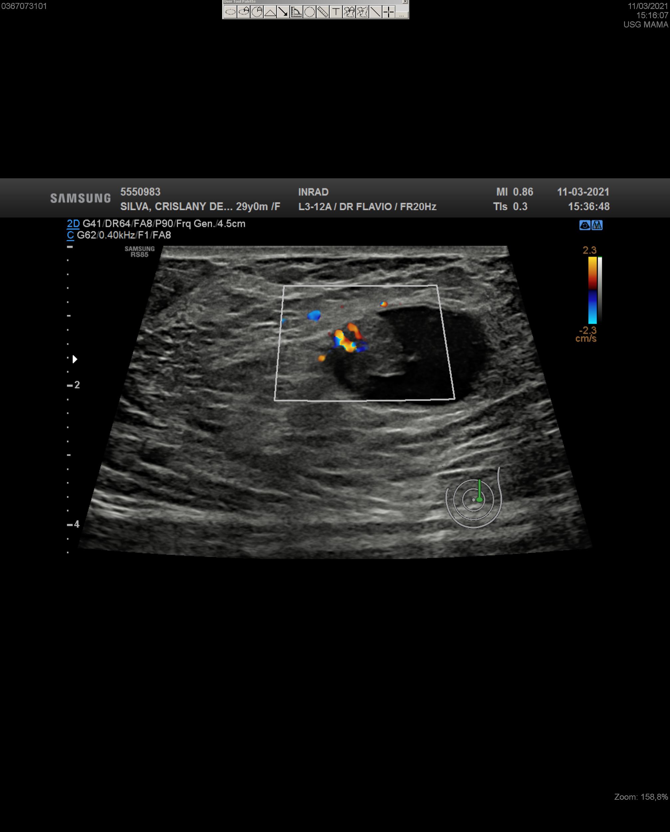
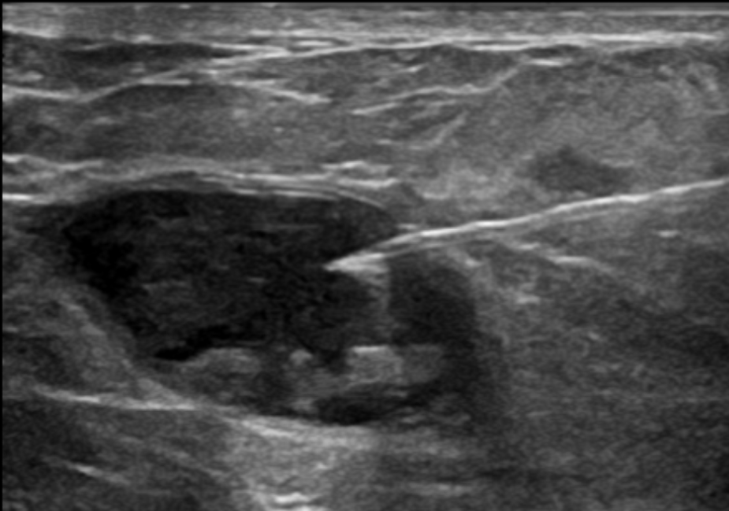
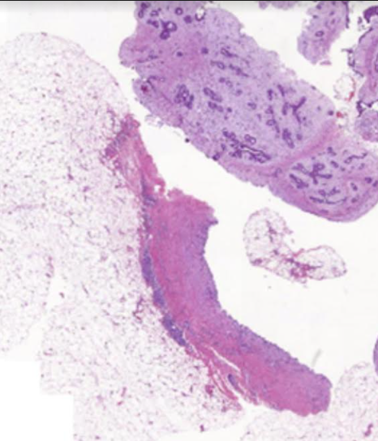
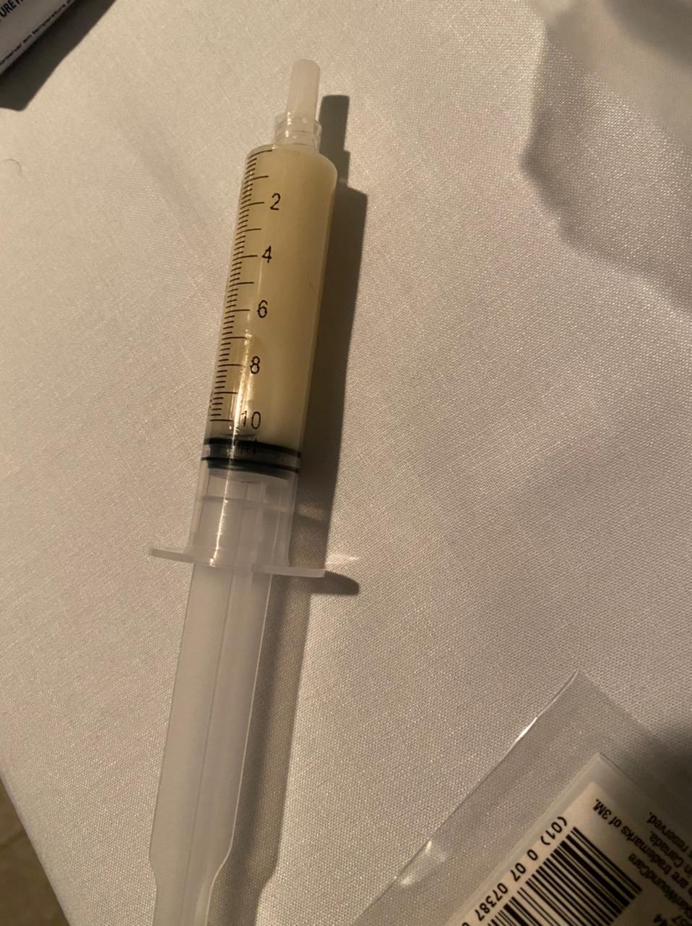
Benign – Fibroadenoma inside a galactocele simulating a suspecius complex solid and cystic mass
Teaching point:
Benign exclusive lesions of the breast when together can simulate suspicious lesions.
A
B
C
*
*
*
*
*
*
29-year-old lactant woman with complaints of palpable left breast mass. US (A) shows an oval, circumscribed, complex solid and cystic mass with vascular internal mural nodularity (dashed line). Ultrasound-guided fine-needle aspiration (B) of the collection yielded 10 ml of creamy liquid consistent with milk consistent with galactocele (arrow). A vacuum-assisted core biopsy was performed in the complex solid and cystic component and the histopathological analysis (C) showed a fibroadenoma (*) inside a galactocele (*) simulating a suspicious complex solid and cystic mass.
Notes:
RGHC 55748746J
PACS 5550983
Benign exclusive lesions of the breast when together can simulate suspicious lesions

Slide 9
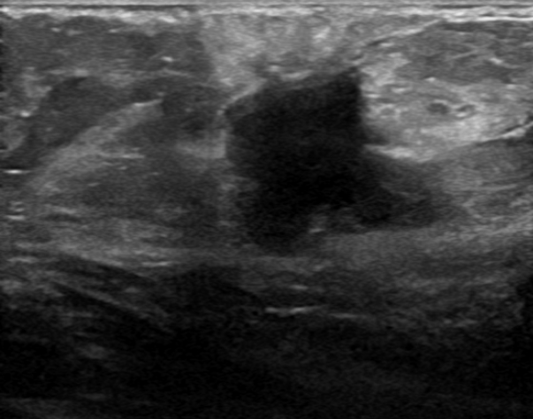
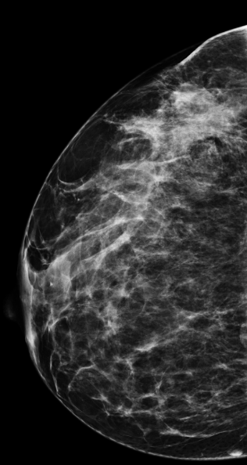
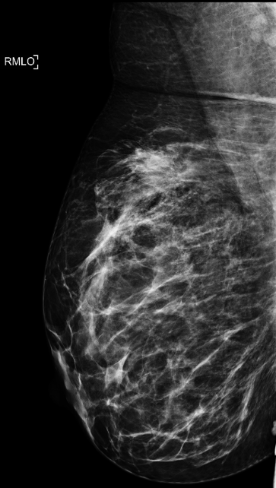
Benign - Desmoid tumor (fibromatosis of the breast)
Notes:
Tumor desmoide gestante - 7990333
"#SETOR MAMA DIREITA 25/07/2016: FIBROMATOSE DO TIPO DESMÓIDE MAMA DIREITA (MARGENS +) + polipose ---Garner?
#04.2019: Adenocarcinoma de colon transverso
#Colectomia total em 24.01.2020 Icesp
#A.P:Adenocarcinoma serrilhado moderadamente diferenciado de colon transverso
-margens livres
#pT3pN1(2/106) M0
#A IMUNOEXPRESSÃO DAS ENZIMAS DE REPARO DO DNA ENCONTRA-SE PRESERVADA EM AMBOS OS ADENOCARCINOMAS."

Slide 10
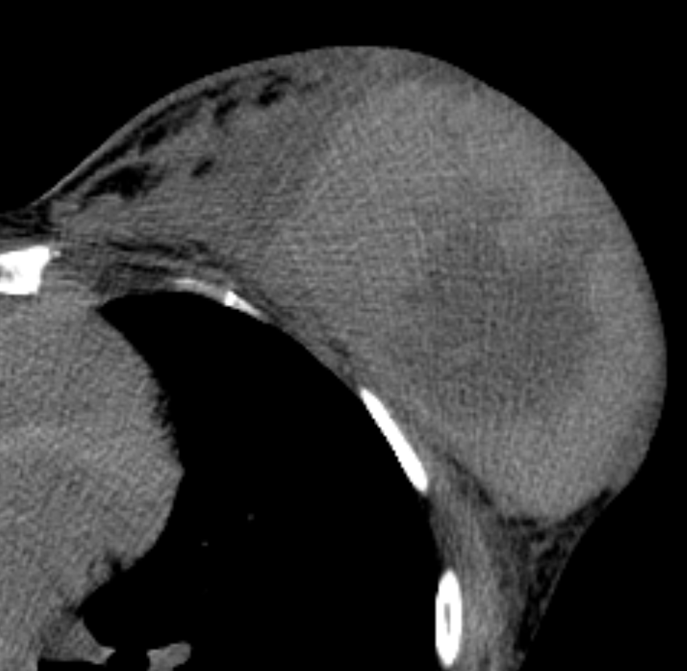
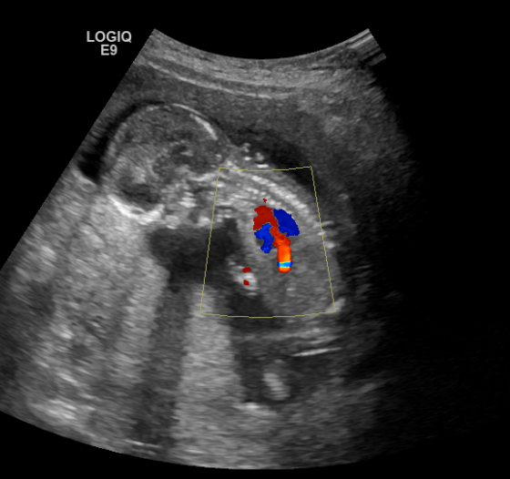
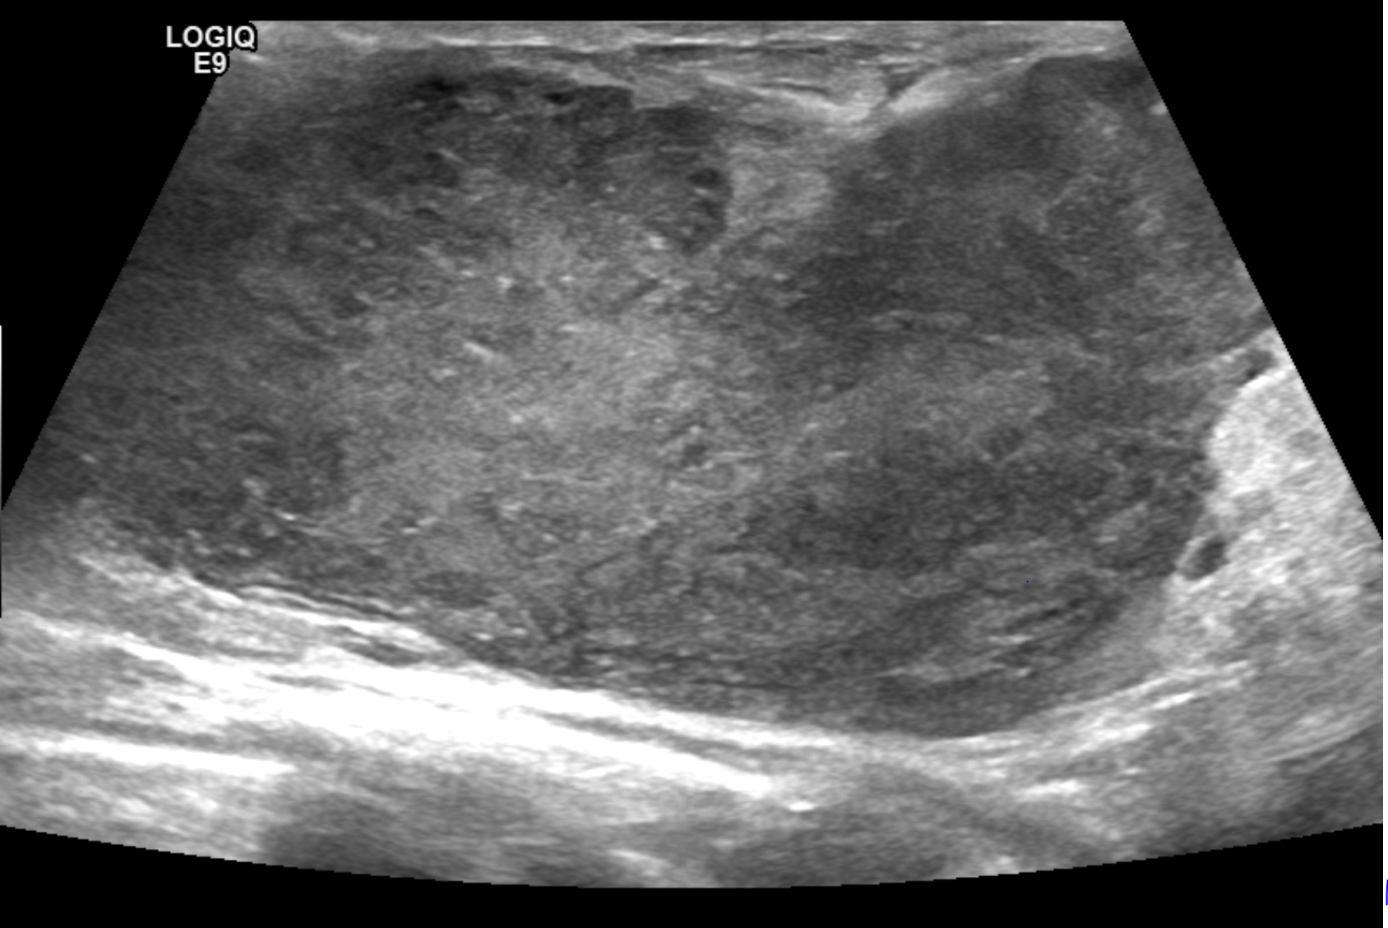
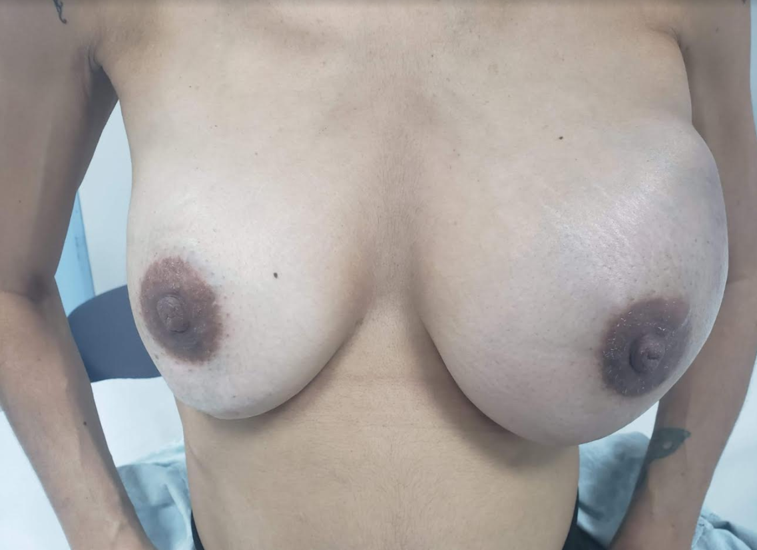
Malignant – breast large-B-cell lymphoma
Notes:
12827895
14283002J
TEREZA REGINA LOPES MACEDO
Foi internada após diagnóstico pára término da gestação (estava na época com 17 semanas e 5 dias) e iniciar tratamento com esquema com cobertura para SNC.

Slide 11
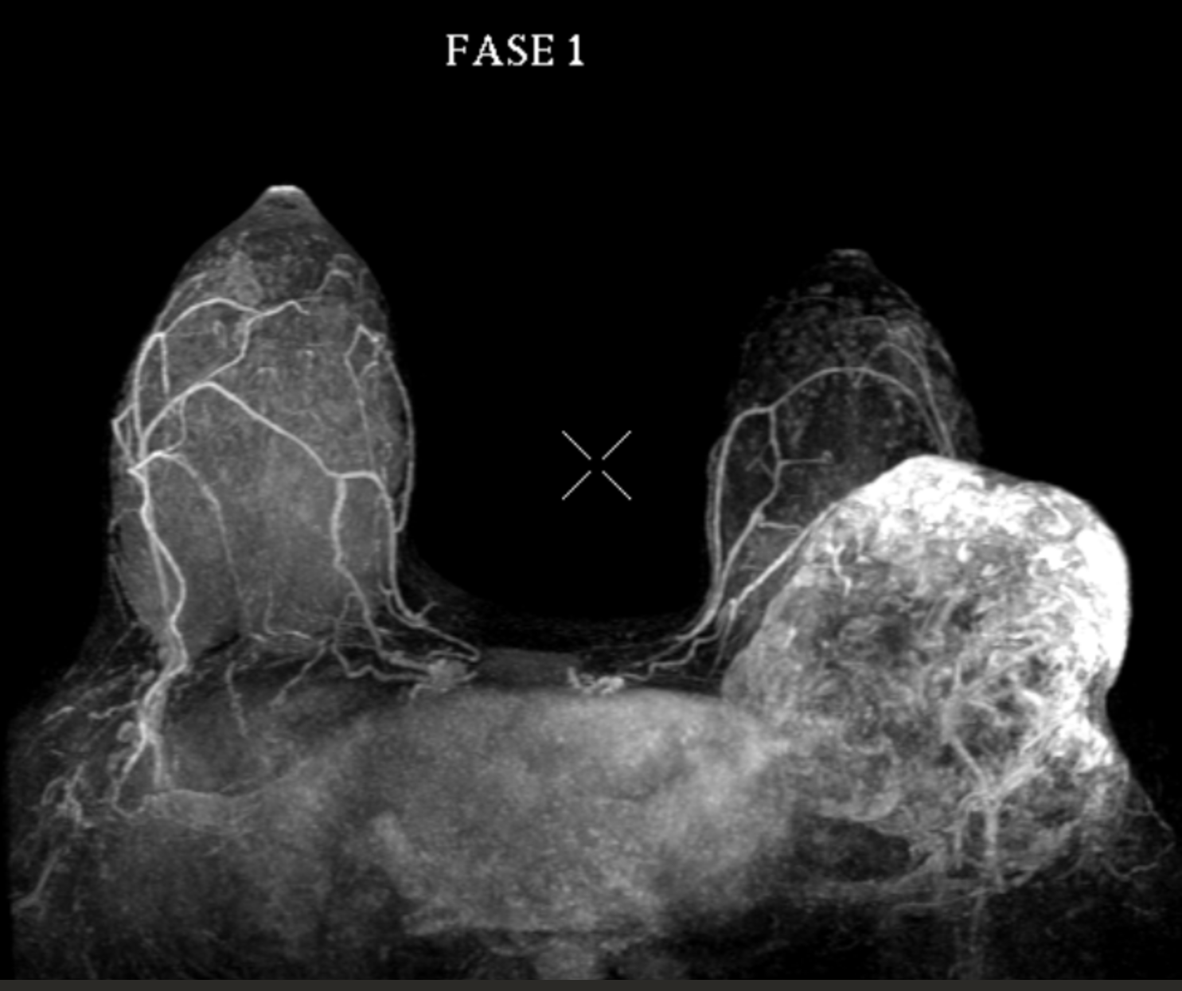
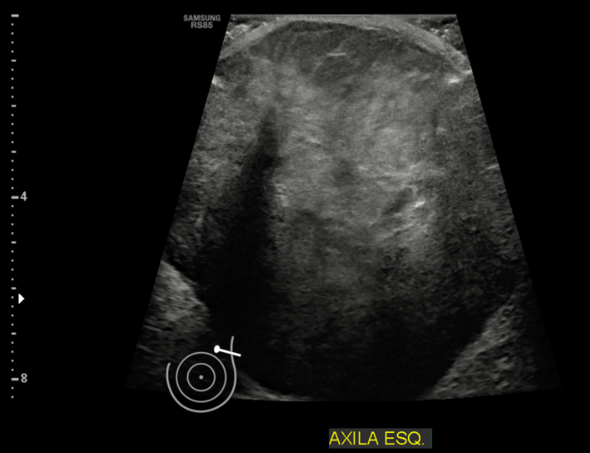
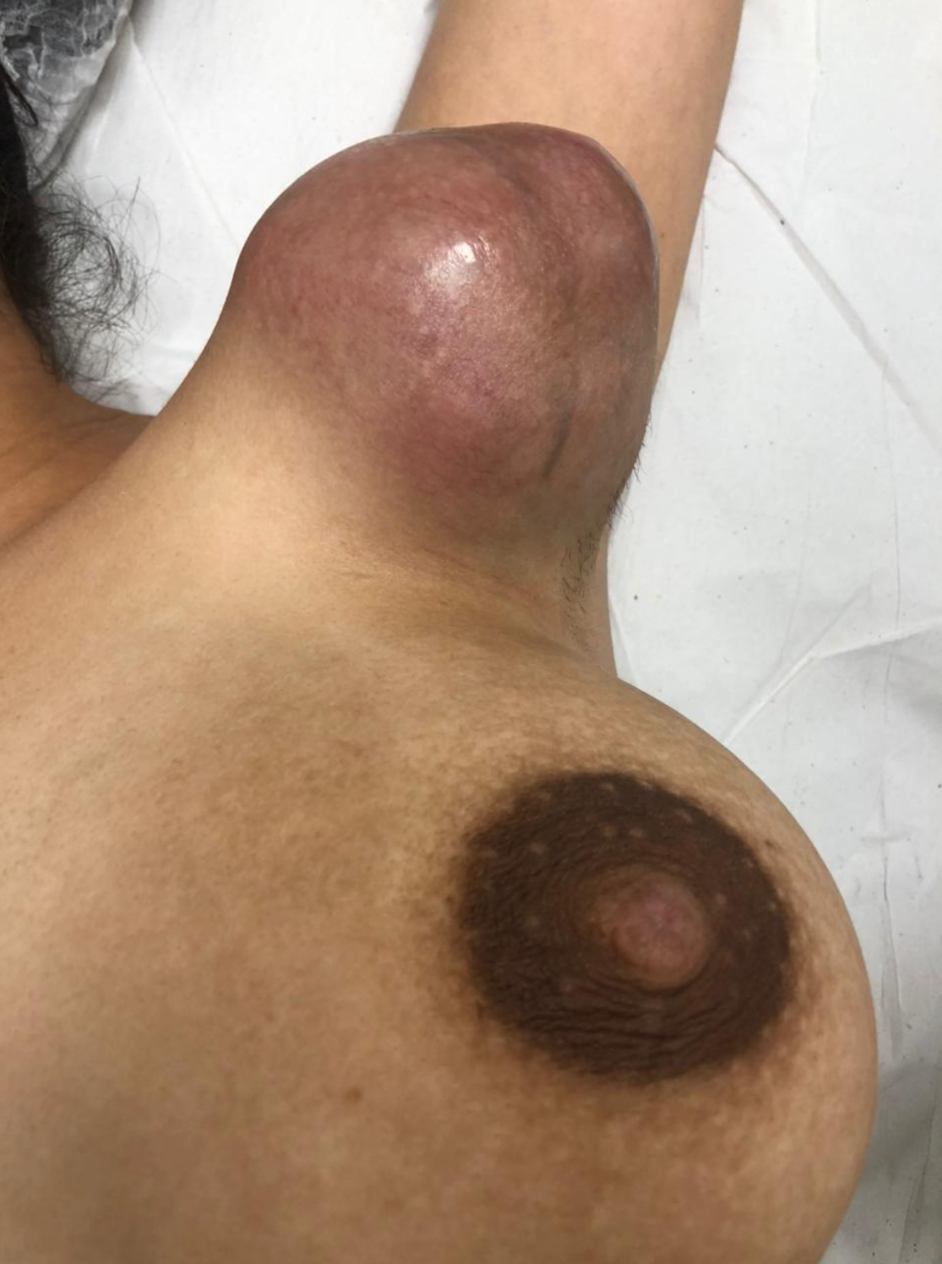
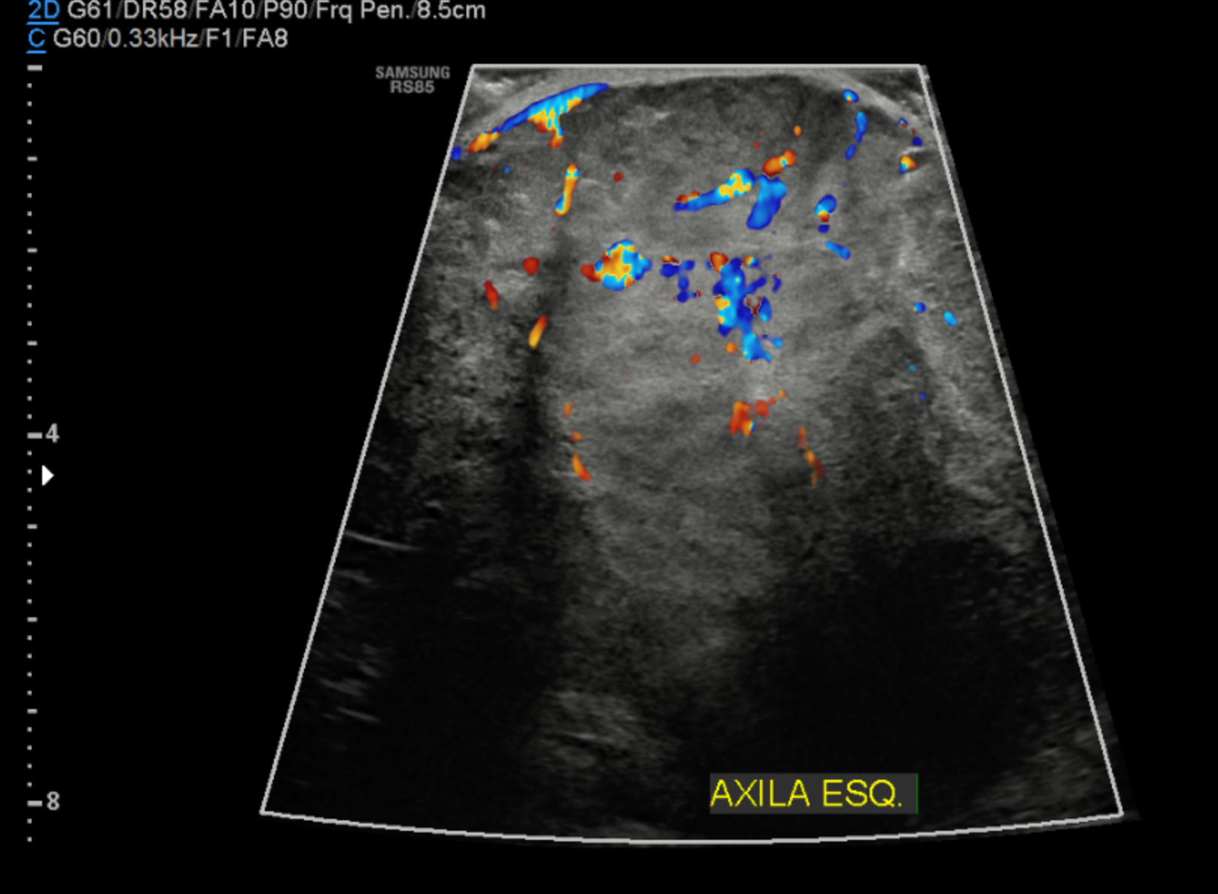
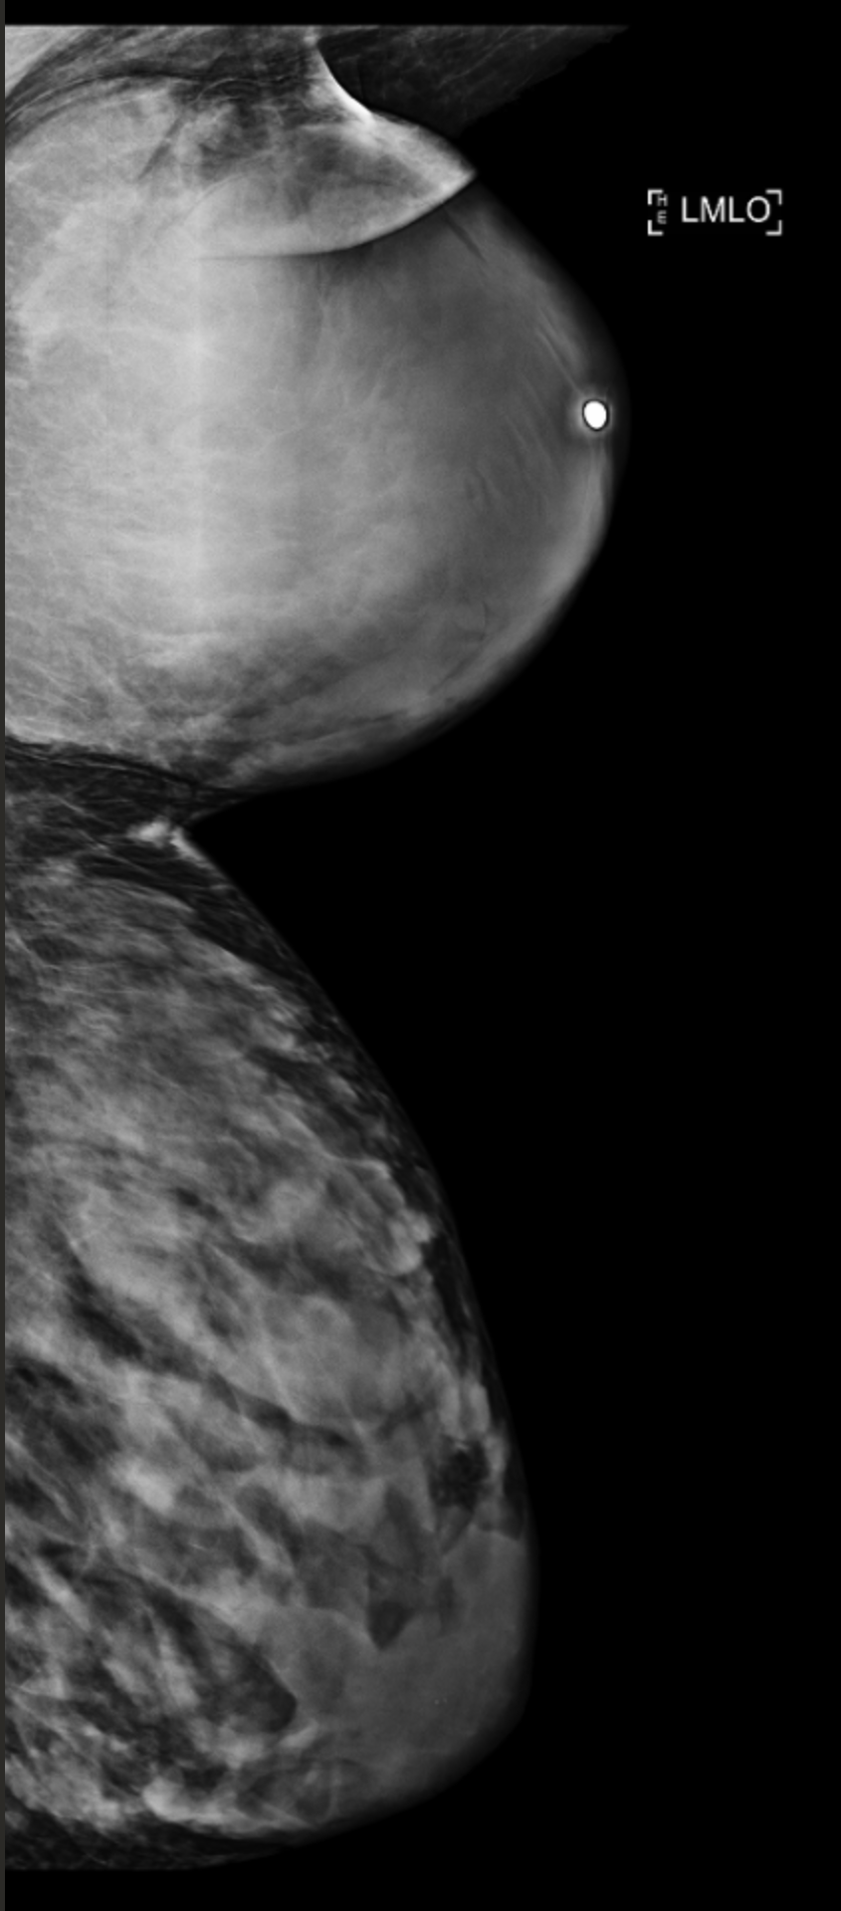
Malignant – breast sarcoma
Notes:
12789874 sarcoma axila

Slide 12
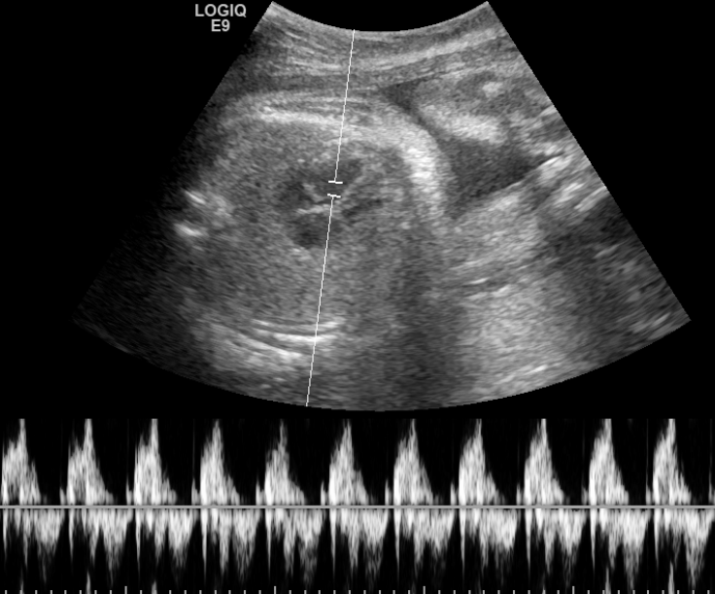
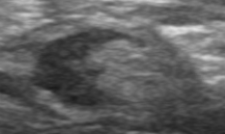
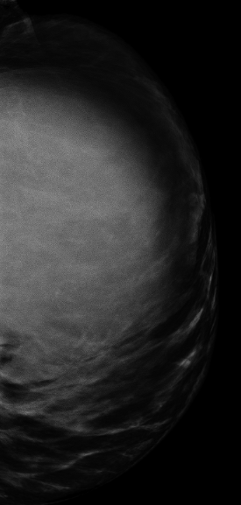
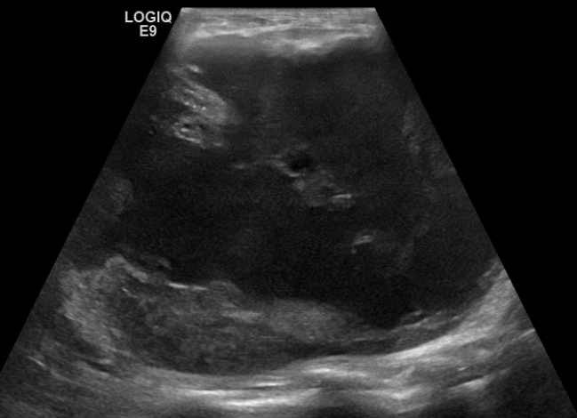
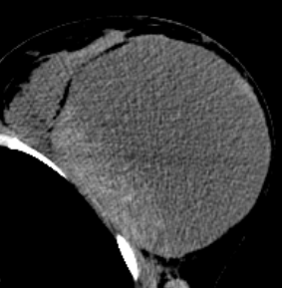
Malignant – metaplasic
B
Teaching point:
Pregnant and lactating patients usually presents with a palpable mass and have more advanced neoplasms at diagnosis.
*
A
D
C
31-year-old patient with complaints of palpable left breast mass at twenty seven weeks gestational age (A). US (B) shows a complex solid and cystic large mass (arrow) and thickening cortical lymph node (*). The tumor occupied the entire left breast as we see in mammography (MG) (dashed line) (C) and thorax computed tomographic (CT) (arrow) (D). Histological analysis evidenced a metaplastic breast cancer. The patient was submitted to neoadjuvant chemotherapy during pregnancy with partial response and after the labor she made a mastectomy with lymph node removal.
Notes:
2873666
coriocarcinoma - metaplasico
5352931G
27semanas
with final diagnosis of metaplastic breast cancer

Slide 13
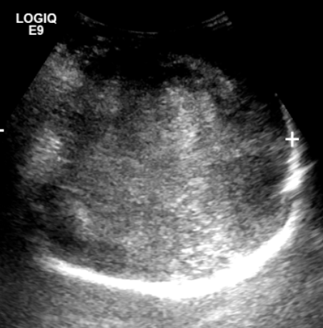
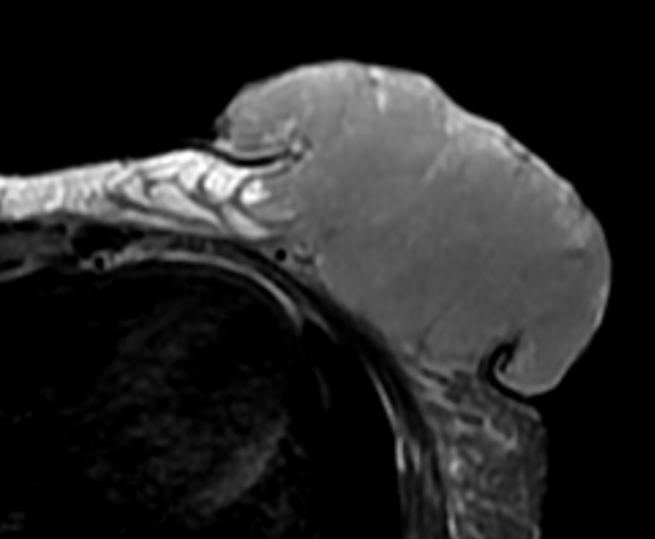
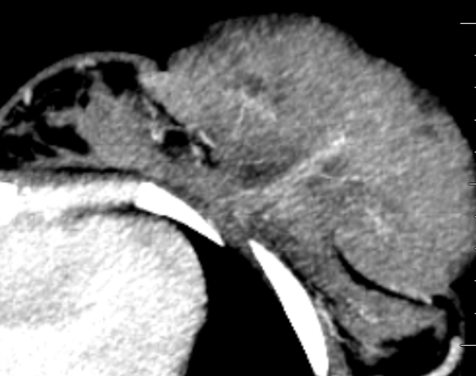

Malignant – invasive carcinoma of no special type (triple-negative) - triple negative
A
B
Teaching point:
Prognosis is poor, a fact that is thought to be partly explained by a tendency of pregnant patients to present at a more advanced stage than nonpregnant women.
C
D
25-year-old female with complaints of palpable left breast mass at twenty six weeks gestational age (arrow) (A). US (B) shows an irregular and indistinct lesion (arrow). Magnetic resonance imaging (MRI) (C) and CT (D) of the thorax depicts a irregularly contoured mass located and retromuscular space (arrow) on this side. Histological analysis evidenced an invasive carcinoma of no special type (triple-negative).
Notes:
12119255
CAMILA DA SILVA DIAS
91698028G
06/05/20: PO DE MASTECTOMIA + EA + RESSECÇÃO DE ARCOS COSTAIS + RETALHO EM LTVY EM MAMA ESQUERDA

Slide 14




Notes:
VIEIRA, DANIELLE ARAUJO : IDP: 3416986
- CDI mama GN2 GH2 triplo negativo (core-biopsy), Ki67 40% - cT4b cN3 --> ypT1b ypN2 - recidivado em ossos
- Revisão IHQ peça cirúrgica após recidiva: RE 100% (Allred 8) / RP 1-10% (Allred 4) / HER-2 neg / Ki67 40%
- IHQ de biópsia óssea (recidiva): RE + (forte e difuso) / RP + 50% / HER-2 neg / GATA 3 positivo

Slide 15





Notes:
SANTOS, FERNANDA JERONIMO DOS : PID: 12110757
1. 03/2020 e 2. 08/2020 snoll
# CDI mama E RE + (AR 5) RP+ (AR 5) HER2 3+ KI67 10% GH1 cT2cN0Mx, gestante
- Descobriu gestação não planejada após diagnóstico de câncer
- 21/10/19 (CEAC) - Core biopsy: lesão epitelial complexa - após IHQ: CDI, RE + (AR 5) RP+ (AR 5) HER2 3+ KI67 10% GH1
# CDI mama E RE 90% RP 80% HER2 3+ KI67 30% GH2 cT2cN0Mx, gestante
- Primeira consulta com Oncologia: IG 9 sem 4/7 pela DUM
- Plano de QT neoadjuvante com AC-T e realizará o Trastuzumabe na adjuvância
- Atual: AC-T neoadjuvante
- RPMO e parto prematuro
QT NEO SEM RESPOSTA – POS PARTO - CIRURGIA

Slide 16


Notes:
12835838 – triplo negativo lactante
CONFUNDIU COM COLEÇÃO/GALACTOCELE

Slide 17





Notes:
91817353H
THAIS ARTUZO ALONSO
12653029
PACIENTE REFERE QUE NO INICIO DO ANO ESTAVA AMAMENTANDO QUANDO NOTOU SAIDA DE SECREÇÃO LACTEA ASSOCIADA A SANGUE, LOGO APÓS EVOLUIU COM QUADRO DE MASTITE, COM DRENAGEM DE ESPONTANEA PELA PELE DE SECREÇÃO PURULENTA EM MAIO/2020.
APÓS ESSE EPISODIO NOTOU AREA ENDURECIDA EM PORÇÃO SUPERIOR DA MAMA, PASSOU EM AVALIAÇÃO COM A MASTOLOGIA SENDO DIAGNOSTICO NEOPLASIA DE MAMA.

Slide 18





Malignant – invasive carcinoma of no special type (triple-negative) - triple negative
November 2013
February 2014
Teaching point:
Treatment can be made by surgery. Neoadjuvant chemotherapy (QT neo) can only be made in 2° and 3° trimestre. Radiation, hormone and targeted therapies can only be used after the labor.
A
C
December 2014
QT neo
Surgery
5,0 cm
2,0 cm
B
D
E
33-year-old female with complaints of palpable right breast mass at twenty three weeks gestational age. MG (A) depicts an irregular nodule with pleomorphic calcifications (arrow and dashed line) . US (B) shows an irregular spiculated nodule. Histological analysis evidenced an invasive carcinoma of no special type. The patient was submitted to neoadjuvant chemotherapy during pregnancy with partial response (C and D). The labor was performed thirteen weeks after the diagnosis and after 4 months of the labor the patient underwent a conserving surgery and radiation (dashed line) (E).
Notes:
5613666
qt neo

