Slide 1




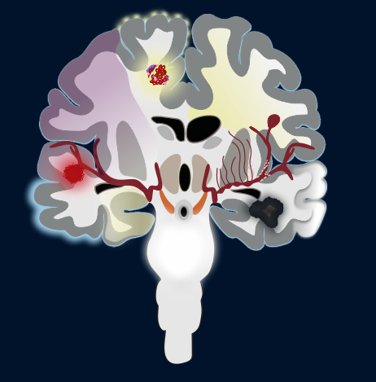

Imaging Findings of Neurologic Complications In Oncologic Patients
Autors: G. A. Bandeira, L.P Teixeira , L.L Bezerra, I. C. Alves , L. V. Diniz, N. Fabris, G. T. Santos, J. T. Takahashi, L. F. Godoy, R. A. Moreno, P. C. Pinho, C. M. Rimkus, A. Ayres, M.G.M. Martin, C. da Silva, L. T. Lucato.

Slide 2
Summary
Introduction
Different types of cancer may affect any system in the body and can potentially lead to varied metabolic derangements, structural changes and infection.
Neurologic complications of cancer are common and has being increasingly seen as patients survive longer with better systemic disease control. Most of oncologic patients will experience a neurological complication at some point during disease.
Central nervous system (CNS) involvement may occur as a direct or indirect result of tumor may still be a consequence of cancer therapy (radiation, chemotherapy, biological agents, and hormone therapy). Some complications, such as metabolic and cerebrovascular are multifactorial and can be caused either by the systemic effect of the cancer in combination with treatment.
Introduction.
Neurological complications of cancer:
  Direct effects.
Indirect effects.
Treatment related.
Multifactorial.
Illustrative cases with imaging findings of neurologic complications in oncologic patients.
Take-home messages.
References.

Slide 3
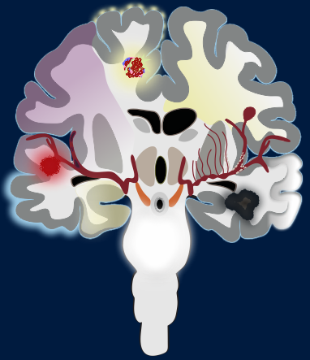

CNS involvement in Oncology Patients
MENINGEAL CARCINOMATOSIS
LEUKOENCEPHALOPATHY
DIRECT EFFECTS
METASTASIS
HYDROCEPHALUS
ISCHEMIC
STROKE
ANEURYSM
INDIRECT EFFECTS
HEMORRHAGIC
STROKE
MINERALIZING ANGIOPATHY
SMART
TREATEMENT RELATED
ASEPTIC
MENINGITIS
RADIATION NECROSIS
LIMBIC ENCEPHALITIS
MULTIFACTORIAL
RCVS
BRAINSTEM ENCEPHALITIS

Slide 4

Direct Effects
Metastatic involvement of cranioencephalic region represents the most common direct damage caused by neoplastic disease. Brain and medullary metastasis, neoplastic meningitis, and bone metastasis are the three forms of secondary cranioencephalic involvement.
Acute spinal cord compression and hydrocephalus may be consequences of such metastatic involvement and are considered neurological emergencies.
  Regarding bone involvement, special attention should be given to the clivus, pterion and mandibular condyles, frequently affected and underdiagnosed in the initial assessment.
  Hyperviscosity syndrome (HSV) is another direct complication of cancer usually related to hematologic neoplasms such as macroglobulinaemia, non-Hodgkin lymphoma, multiple myeloma and leukaemia.
Headache, seizures, cognitive deficits and/or focal neurologic symptoms are the main symptoms of the direct effect of cancer on the CNS.
DIRECT EFFECTS

Slide 5
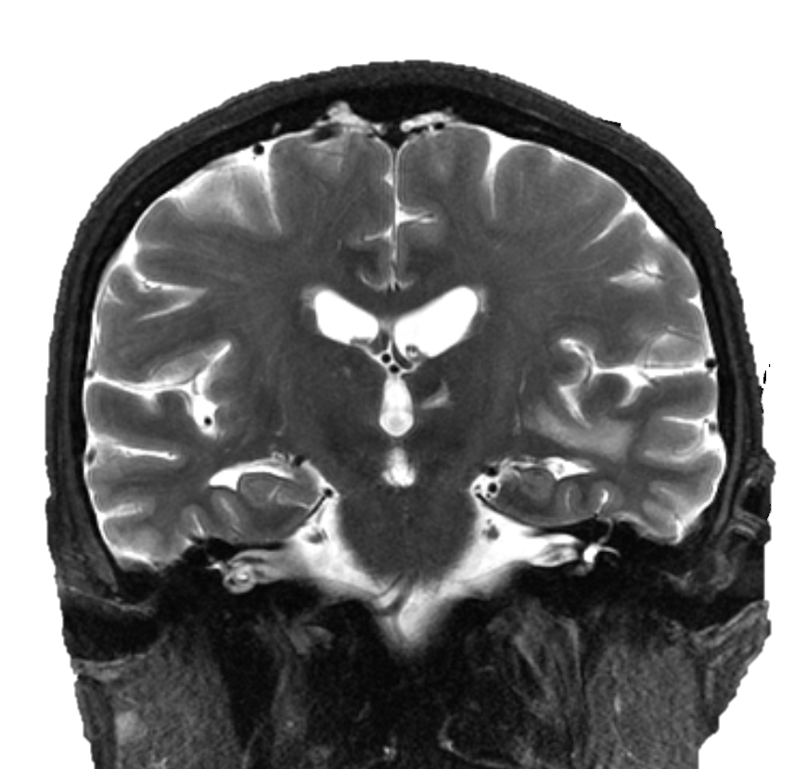
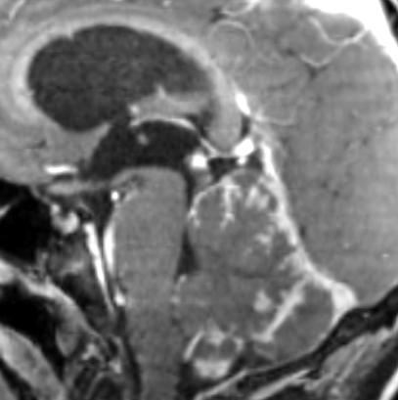
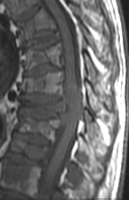
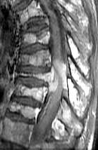
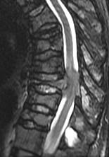
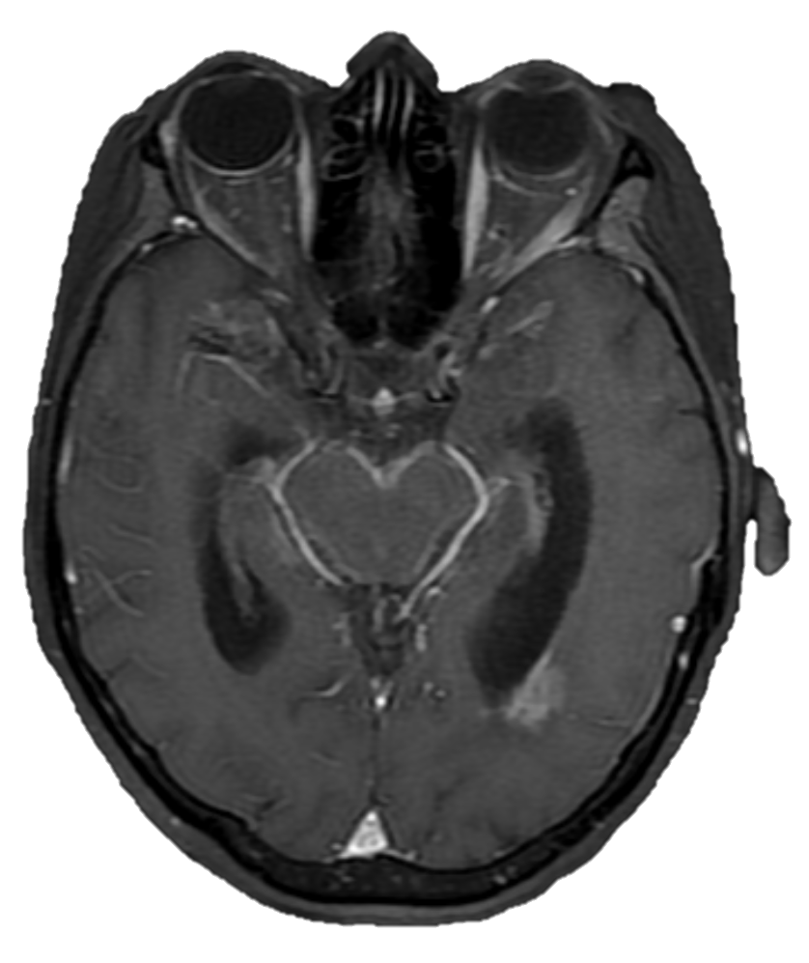
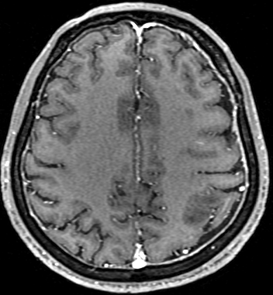
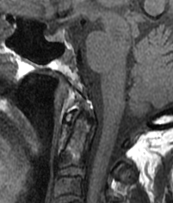
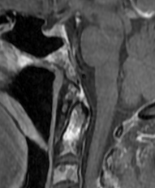

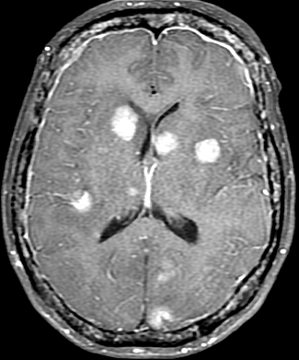
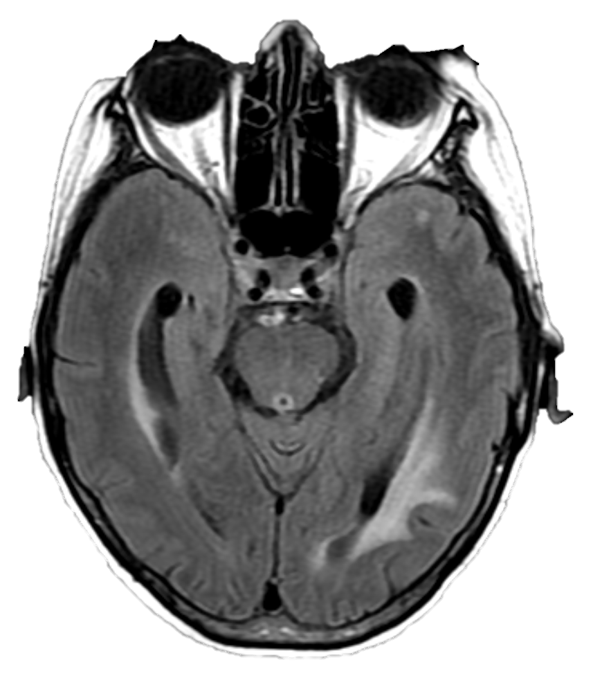
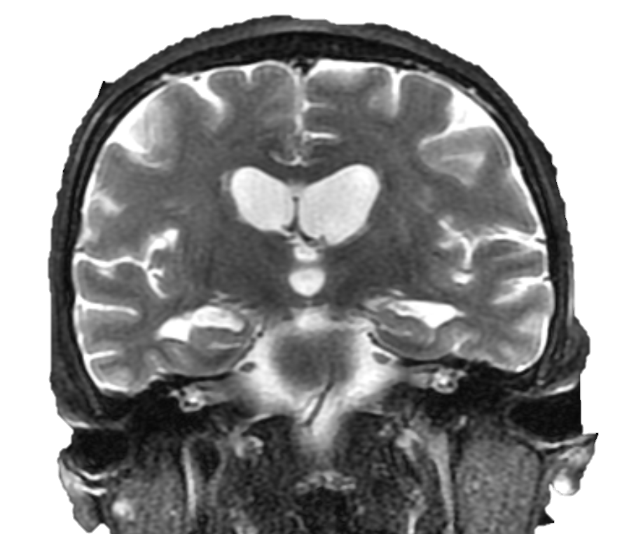
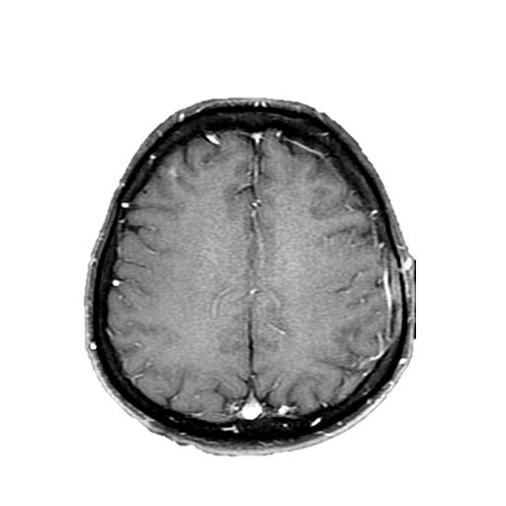
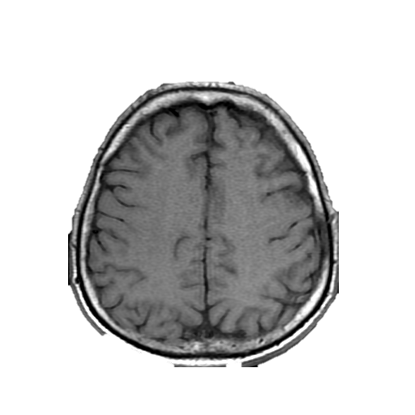
Direct Effects: Metastatic Involvement
Acute Spinal Cord Compression and Hydrocephalus
71 years old woman with breast cancer (A and B).
Sagittal T1WI (A) and T1W-Gd image (B) shows clivus and odontoid bone metastases (yellow dots).
E
F
D
E
A
B
49 years old man with lung cancer (E and F). Sagittal (E) and axial T1W-Gd (F) shows leptomeningeal (E-arrow) and pachymeningeal (F-arrows) metastases.
52 years old woman with breast cancer (G). T1W-Gd shows metastatic involvement of pachymeninges (arrow), brain parenchyma (red arrow) and cranial bones (arrowheads).
A
B
C
52 years old man with metastatic oral cavity carcinoma (C and D).
51 years-old man with multiple myeloma (A,B and C) presenting with subacute onset lower limbs paraplegia. T1WI (A-red arrow), T1W-Gd image (B-red arrow) and T2 STIR (C-yellow arrow) shows acute spinal cord compression.
Axial T1WI (C) and T1W-Gd image (D) shows left parietal bone metastases (arrows).
59 years-old woman with breast cancer (D,E,F,G). Axial T1W-Gd image (D) and coronal T2WI (E) show leptomeningeal metastases along the surface of the brain stem (D-arrow) and mild ventricular ectasia (E-arrows). One month after, control MRI show development of communicating hydrocephalus (F and G-arrows).
C
D
F
G
G

Slide 6
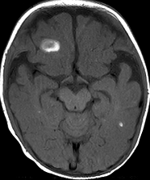
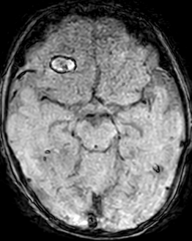
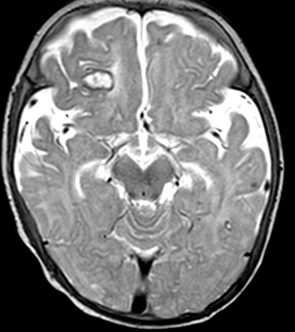
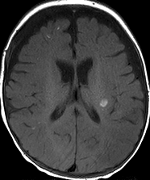
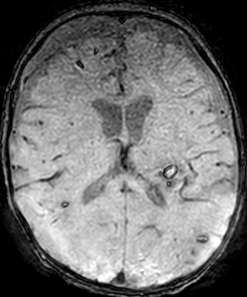
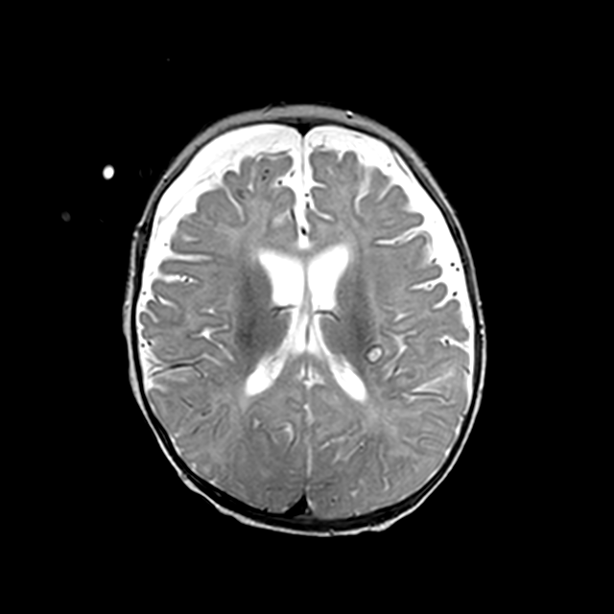
Direct Effects: Hyperviscosity Syndrome
When the serum viscosity rises, blood flow is delayed and peripheral circulation disturbance occurs. The classic triad for HVS consists of bleeding, neurological symptoms and visual disturbances. However, in addition to these symptoms, a variety of end organ damage can be observed. Multiple myeloma and primary macroglobulinaemia are the most common related neoplasms, but patients with other hematologic cancers like leukemia and some lymphomas may also present HSV.
The most frequent symptom is bleeding, and it can result from blood vessel wall abnormality caused by an intravascular friction phenomenon due to the increased blood viscosity.
MRI may show multifocal parenchymal microhaemorrhages or haematoma.
A 4-months-boy with Infant B-cell acute lymphoblastic leukemia whose white blood cell count reached 960,000, presenting with vomiting.
T1WI (A and E) shows multiple bilateral hyperintensity areas in brain parenchyma (arrows). These lesions show hyperintensity with a hypointensity rim on SWI (B and F) and T2WI (D and G), indicating haemorrhage in the subacute phase.
A
B
D
E
F
G

Slide 7
Indirect Effects: Paraneoplastic Syndromes
Paraneoplastic syndromes are the remote effects of the primary tumor and encompass various disorders that can not be attributed to identifiable mechanisms, such as direct invasion of the nervous system by the neoplasm, infections, coagulopathy, or side-effects of cancer treatment.
Many paraneoplastic neurological disorders are immune-mediated and lead to clinical symptoms like memory loss, cognitive dysfunction, dementia, anxiety, depression, hallucinations and seizures. Neurologic symptoms preceding tumor diagnosis occurs in about 70% of the patients.
The main paraneoplastic neurological syndromes are:
INDIRECT EFFECTS
BRAIN AND CRANIAL NERVES
SPINAL CORD
PERIPHERAL NERVES
NEUROMUSCULAR JUCNTION
Limbic encephalitis
Paraneoplastic myelitis
Hypertrophic polyneuropathy
Lambert-Eaton myasthenic
syndrome
Striatal encephalitis or chorea
Stiff-person syndrome
Autonomic neuropathies
Brainstem encephalitis
Necrotising myelopathy
Myasthenia gravis
Cerebellar degeneration
Optic neuritis

Slide 8
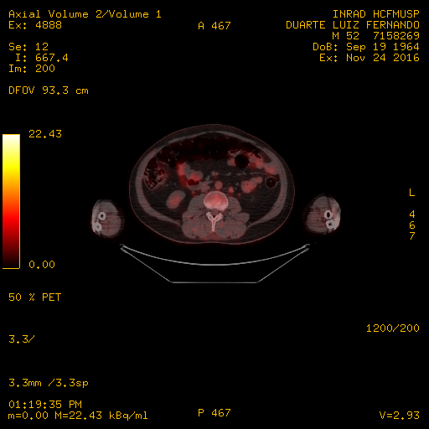
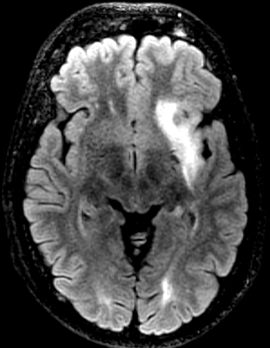
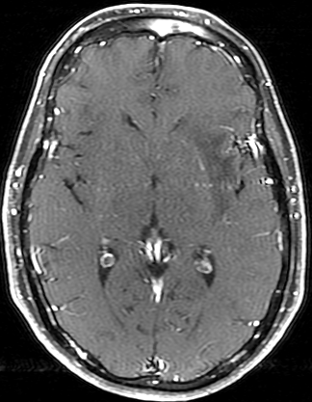
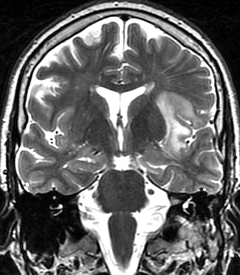
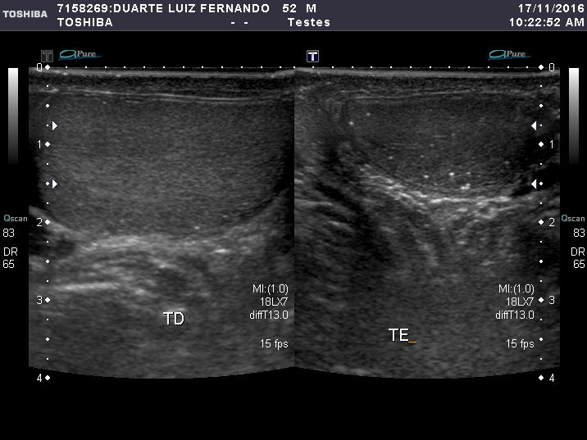
Indirect Effects: Limbic Encephalitis
The malignancies most commonly associated with paraneoplastic limbic encephalitis are small cell lung cancer, testicular germ cell neoplasms, thymoma, teratoma, and Hodgkin lymphoma.
MRI usually shows bilateral and asymmetric increased T2 and FLAIR signal in the amygdala, hippocampal formation and other mesial temporal lobes structures. On follow-up, the T2 hyperintense signal decreases and focal, temporal, or generalized cerebral atrophy ensues.
F
An FDG-PET scan can shows hypermetabolism in the affected areas and the tracer uptake on FDG-PET is shown to increase simultaneously with increase in the level of oncoantibodies. Hence the tracer uptake in these patients may also help to assess response to the treatment.
B
C
A 55 years old man presented in an acutely confused state. His examination and basic blood tests were unremarkable. Coronal T2WI (A), axial FLAIR (B) and axial T1W-Gd images (C) show expansile T2 and FLAIR hyperintensity, in left insula and left frontal lobe (A,B-arrows) without enhancement (C-arrows).
He underwent whole body cancer screening and testicular microlithiasis was visualized on ultrasound (D) as increased 18F-FDG uptake in a left paraaortic lymph node (arrow on F). This patient had a occult testicular germ cell tumor.
A
D
Notes:
DUARTE, LUIZ FERNANDO : PID: 7158269, Sex: M, D.O.B: 19/09/1964
LINFONODO PARA-AORTICO ESQUERDO HIPERCAPTANTE. USG COM MICROLITIASE TESTITULAR. Era um tumor de cels germinativas oculto já com meta para linfonodo, levando a encefalite límbica. Colhido liquor com anti-ma2 positivo.

Slide 9
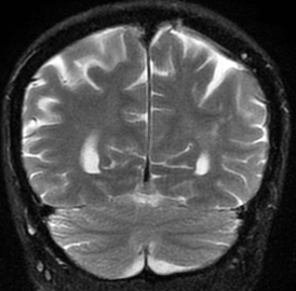
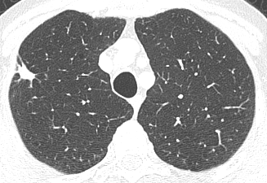
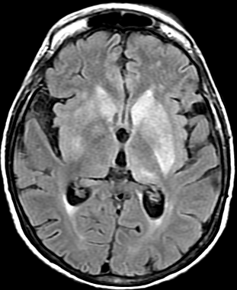
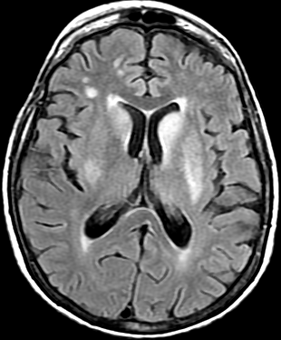
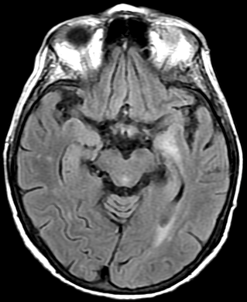
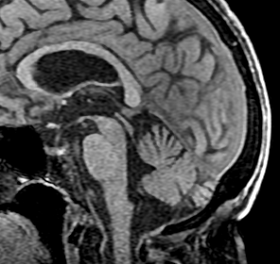
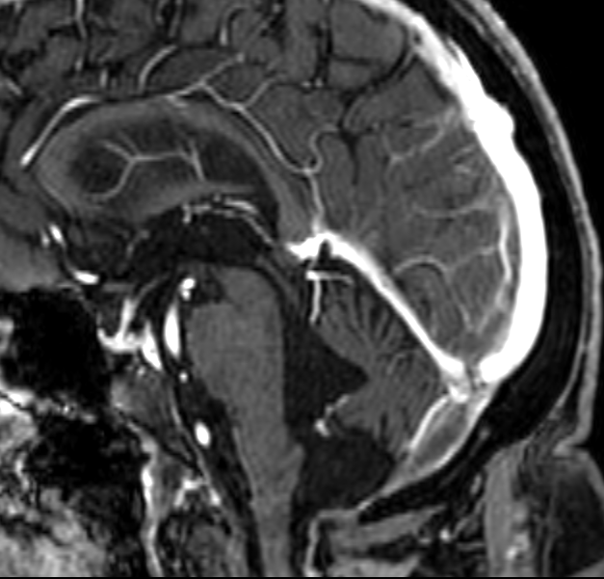
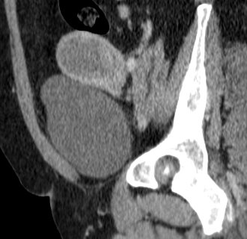
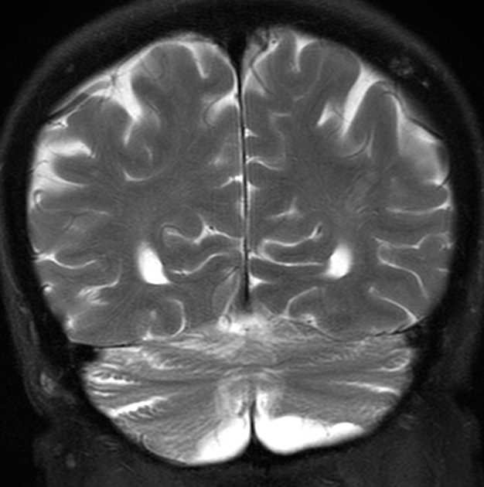
Indirect Effects: Cerebellar Degeneration
Indirect Effects: Striatal Encephalitis or Chorea
Paraneoplastic cerebellar degeneration is commonly associated with small cell lung cancer, gynecological and breast cancers, as well as Hodgkin lymphoma.
Paraneoplastic striatal encephalitis is most often seen in patients with small cell lung cancer and thymoma and is commonly associated with presence of anti-CV2/CRMP-5 antibodies.
Brain MRI in these patients is often abnormal and may show T2WI and FLAIR hyperintensity in bilateral caudate nuclei and putamen. The signal abnormality may also extend into the adjacent white matter.
This disorder is usually associated with the presence of anti-Yo, anti-Hu, or anti-Tr antibodies in the cerebrospinal fluid. The loss of Purkinje cells in the cerebellum is the pathognomonic finding on histology.
Though the clinical manifestations (ataxia, diplopia, and dysarthria) are disabling, neuroimaging in the early stage of disease is usually unremarkable.
D
D
A
B
B
C
C
E
65 years old woman presenting with headache and chorea. Axial FLAIR images (A, B and C) show bilateral striatal and mesial temporal hyperintensity, more evident at left (arrows). Cerebrospinal fluid (CSF) with anti-CV2 positive. Chest CT (D) demonstrated a suspected spiculated pulmonary nodule (D- red dots). She had a small-cell lung cancer with a paraneoplastic striatal encephalitis.
82 years old woman, with rotational vertigo and nausea. Initially diagnosed with labyrinthitis. She evolved with imbalance and incoordination. Baseline MRI shows normal cerebellar volume (A-yellow dots and D-arrowheads) and absence of acute events. Suspected paraneoplastic etiology led to identification of an endometrial neoplasm (C-red arrow). Cerebrospinal fluid (CSF) with anti-yo positive. One year later, control MRI (B and E): sagittal T1-Gd image (B) and coronal T2WI show diffuse cerebellar atrophy. Coronal T2WI reveal vermis atrophy (E-arrow) and opening of cerebellar fissures (E-arrowheads).
A
Notes:
PERES, MARIA JOSE MIGLIORANZA : PID: 6045451, Sex: F, D.O.B: 24/08/1948 – caso degeneração cerebelar. 1 EXAME NO MOMENTO DO ATENDIMENTO E SEGUNDO EXAME COM 1ANO E 6 M APOS. Tc MOSTRA UTERO AUMENTADO COM LESOES ENDOMETRIAIS SÓLIDAS.
HISTORIA: HA 4 MESES com vertigem rotatória e náuseas. Inicialmente diagnosticada com labirintite. Procurou PS por piora dos sintomas evoluindo com desequilíbrio e incoordenacao ha 3 semanas. Historia completa esta no MV. TC e RM de crânio incial sem eventos agudos. Suspeitado etiologia paraneoplasica que identificou neoplasia de endométrio. Coletado liquor com anti – yo positivo.
Rm inicial normal, RM de controle com atrofia cerebelar difusa. Seta aponta para atrofia do vermis, abertura das fissuras cerebelares, etc
Outro caso anti yo
paciente com TUMOR DE OVARIO. DIAS, ZILDA FERNANDES hipersinal em t2 do cerebelo no coronal.. QUADRO DE ATAXIA RAPIDAMENTE PROGRESSIVA. TUMOR DE OVARIO AVANÇADO. VER SE CONFIRMOU ANTICORPO
MRN : 11609669 Sex : F primeiro exame 02 fevereiro 2019 e segundo exame 07 março 2019, evolucao de 2 meses. TUMOR DE OARIO.

Slide 10


Treatment related
Treatment related: Chemotherapy
Compared with radiation-induced CNS complications, the neurotoxic effects of chemotherapy are less well-characterized, but are increasingly being recognized.
Chemotherapy related neurotoxicity can manifest in many ways, including encephalopathy syndromes and confusional state, visual loss, cerebellar dysfunction, and myelopathy.
The toxicity of a given drug depends mainly on total dose, route of administration, interactions with other drugs, presence of structural brain lesions, exposure to prior or concurrent RT, and individual patient vulnerability.
Neurotoxicity may occur acutely, during or shortly after administration of chemotherapeutic agent, or in a delayed manner. It may occur following systemic or intrathecal chemotherapy.
It is important to be aware of the agents that can cause neurotoxicity and their associated imaging findings because of potential confusion with other disorders that do not require dose reduction or discontinuation.
Treatment-related neurotoxicity is a frequently observed side effect that has become more prevalent with the increasing number of long-term cancer survivors.
These toxicities can be peripheral or central and can range from minor cognitive issues to encephalopathy or dementia. Toxicities are often dose-limiting, resulting in dose reduction or treatment discontinuation, potentially compromising the therapeutic efficacy.
We will discuss the complications related to the three non-surgical therapeutic modalities of cancer :
The major chemotheray-induced central nervous system complications are listed below.
TREATMENT
RELATED
CHEMOTHERAPY
PRES
Toxic leukoencephalopathy
Neurocognitive deficit (chemo-brain)
Acute basal ganglia toxicity
CLOCCs
Cerebellar toxicity
CHEMOTHERAPY
RADIOTHERAPY
Spinal cord myelopathy
IMMUNOTHERAPY
Aseptic meningitis
Ototoxicity
Mineralizing microangiopathy
Chemoradiation induced multiple sclerosis-like demyelination
Peripheral neuropathy

Slide 11
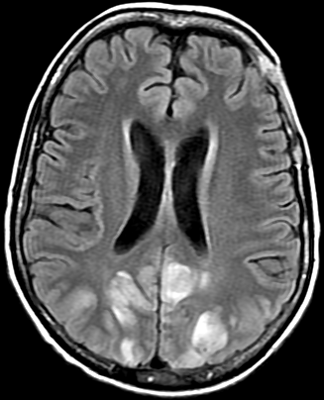
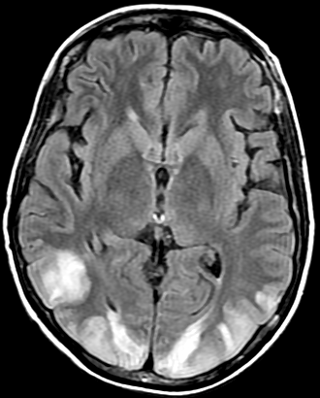
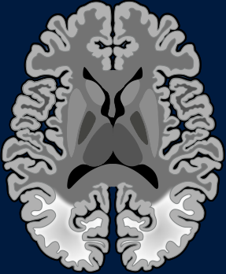
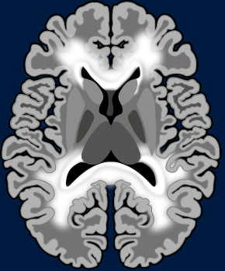
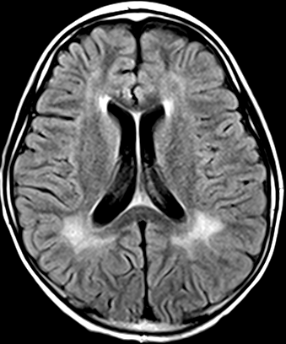
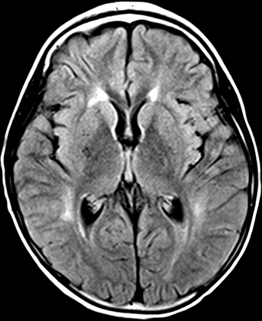
Chemotherapy : PRES and Toxic Leukoencephalopathy
Two main patterns of chemotherapy-related leukoencephalopathy on MRI have been described, including posterior reversible encephalopathy syndrome (PRES) and toxic leukoencephalopathy (TL).
Chemotherapeutic agents most commonly related to toxic leukoencephalopathy include methotrexate, 5-FU, vincristine, cyclosporine, ifosfamide, fludarabine, and cisplatin, particularly methotrexate and 5-FU. Platinum-containing drugs, cyclophosphamide, hydroxydaunorubicin, vincristine, prednisone/ R-CHOP regimens, and gemcitabine were the agents most commonly associated with PRES.
Classic PRES starts from subcortical white matter (WM) (A), whereas TL starts from periventricular WM (B).
C
D
A
B
34 years woman with PRES secondary to 5- FU (“C” and “D”). Axial FLAIR image (C and D- arrows) show bilateral parieto-occipital vasogenic edema. 17 years woman, with TL due to intrathecal methotrexate (“E” and “F”). There are confluent and symmetric periventricular WM hyperintensity on axial FLAIR images (E-F, arrowheads).
E
F
Notes:
PRESS POR QT LAYDNER, RAONA ZANDONA : PID: 5708444, Sex: F, D.O.B: 16/07/1987
Metrotexate: GRANDE, CAROLINA P C : PID: 4511051, Sex: F, D.O.B: 14/03/2003
Outro metrotexate intratecal mais bonito: 11218180 /CRUZ, JACQUELINE NASCIMENTO DOS SANTOS PAZ : PID: 11218180, Sex: F, D.O.B: 26/05/2009
https://www.ncbi.nlm.nih.gov/pmc/articles/PMC5583911/

Slide 12
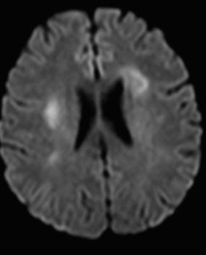
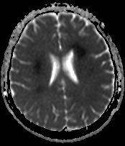
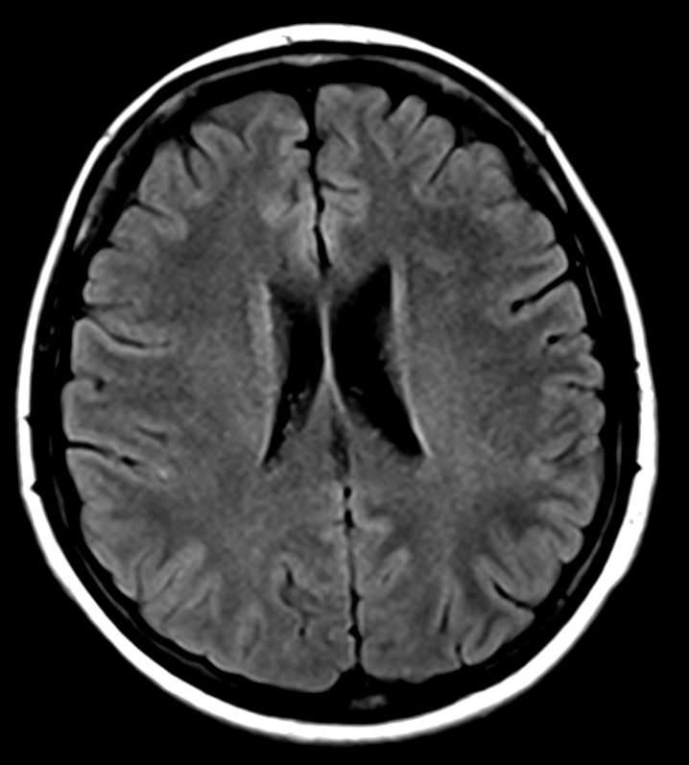
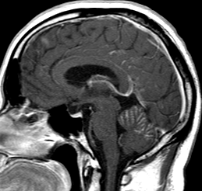
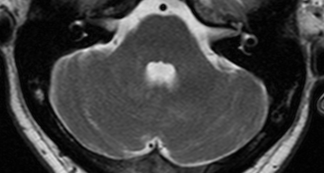
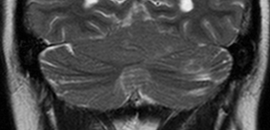
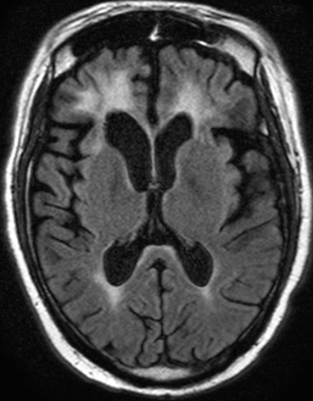
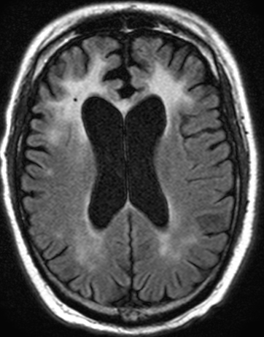






Chemotherapy : AcuteToxic Leukoencephalopathy
Chemotherapy : Cerebellar Toxicity and “Chemo-Brain”
A cerebellar syndrome can occur in up to 10% to 20% of patients undergoing systemic treatment with cytosine arabinoside (ara-C; Cytosar-U or Depocyt). Patients present with ataxia, dysmetria, gait imbalance, and nystagmus.
Toxic leukoencephalopathy (TL) refers a structural alteration of cerebral WM, occurring from a variety of exogenous exposures including cranial irradiation, therapeutic drugs, drugs of abuse, environmental toxins and metabolic conditions.
This can exist in either the acute form as acute toxic leukoencephalopathy (ATL) or in the chronic form as chronic toxic leukoencephalopathy (CTL).
Ara-C is directly toxic to the Purkinje cells of the cerebellum. Most patients recover when the drug is discontinued. Imaging is usually normal initially with cerebellar atrophy developing months after treatment. 5-FU can also cause a cerebellar syndrome.
Chemotherapy-related cognitive impairment is colloquially known as “chemo-brain”. WM abnormalities and reduced brain volume are reported in patients with chemotherapy-related cognitive impairment.
B
Onset of the symptoms
30 years old man with acute lymphoblastic leukemia. Sagittal T1W-Gd image (A-arrows) show diffuse leptomeningeal enhancement. Axial (B-arrowhead) and coronal T2WI (C-arrowhead) demonstrate hyperintense lesions in cerebellar hemispheres. Cerebellar volume was normal.
He received intrathecal cytarabine and shortly thereafter (18 months) presented diffuse cerebellar atrophy (D-arrow, E,F-arrowheads).
A
C
A
B
C
Three days after the onset of the symptoms
33-year-old female undergoing systemic chemotherapy for treatment of acute lymphoid leukemia. She presented sudden-onset aphasia. Diffusion-weighted sequence (DWI) (A and D-arrows) and ADC map (B and C-arrows) show focal areas of restricted diffusion in white matter of both cerebral hemispheres, characterized on FLAIR sequences (C, F- red arrowheads) only three days after the onset of the symptoms. These findings were attributed to chemotherapy with methotrexate, characterizing acute toxic leukoencephalopathy.
E
G
H
After 5 years of the treatment, he presented subtle cognitive dysfunction. Axial FLAIR (G and H) demonstrate cerebral atrophy and compensatory ventricular ectasia (H-arrowhead). There is also symmetric diffuse white matter hyperintensity (G-H-arrowheads). These findings characterize “chemo-brain”.
D
F
D
E
F
Notes:
Caso sírio cedido pela Dra. Graça

Slide 13







Chemotherapy : Chronic Toxic Leukoencephalopathy
A
B
C
G
In addition to the toxicity to oligodendrocytes, chemotherapy also can interrupt hippocampal neurogenesis.
47-year-old female undergoing systemic chemotherapy with 5FU for cecal adenocarcinoma. This patient did not receive radiotherapy. She presented chronic headache and cognitive deficit.
D
E
F
Axial FLAIR images (A,B,C,D,E and F) show parenchyma atrophy and diffuse hyperintensity of white matter of cerebral hemispheres. There are associated bilateral cerebellar and brainstem involvement (A and B-arrowheads) as hippocampal atrophy (C-yellow dots). Coronal T2WI (G) show bilateral hippocampal volumetric reduction (G-red arrows). These findings also characterize “chemo-brain”.
Notes:
SILVA, MARINALVA RODRIGUES DE MACEDO : PID: 5763996, Sex: F, D.O.B: 02/07/1970 LEUCOENCEFALOPATIA POR 5 FU- NÃO FEZ RADIOTERAPIA! Lindo demais! Pegou até cerebelo!
Não fez rt apenas qt com 5 FU vários ciclos e depois o IROTECANO que é o tratamento de sefunda linha para neo de reto. Caso top!
* Adenocarcinoma em ceco pT4B pN0 M1 - KRAS mutado no codon 12 e enzimas de reparo proficientes
- Cirurgia R2 (irressecável por infiltração de retroperitoneo e raiz do mesentério) em 18/01/15 -> Exames de imagem de seguimento sem lesões mensuráveis.
- QUASAR 1a. linha (desde 06/03/2015) - toxicidade em C1D1 com Internação por sepse grave de foco cutaneo + Diarreia G3. C1 inteiro suspenso
- Retomou QUASAR após 1 mês com redução de 20% da dose. PD -em 03/2016 - QUASAR até 05/04/16.
- Paciente com melhora do performanca e necessidade de resposta - mFLOX (PD em região pélvica com hidronefrose a D e piora de função renal): 2 episódios de toxicidade G3 (diarréia) e neurotoxicidade, optando por não mais exposição a oxaliplatina.
Quasar mautenção e de 02/08/2016 a 20/10/2016 -> DE por TCs
Jan/17: PD local -> Nova reexposição a QUASAR de mar/17 a ago/17 --> DE.
Reexposição a 1ª linha com QUASAR (-15%): S1 16/03/17 a S18 17/08/17 -- 23/08/17 TCs com D.E., férias de QT
13/12/17 TCs TAP com P.D. lesão FID e linfonodos.
ATUAL: - Irinotecano 2ªlinha QT desde Janeiro/2018

Slide 14














Chemotherapy: Acute Basal Ganglia Toxicity
Chemotherapy: CLOCCs
Cytotoxic lesions of the corpus callosum (CLOCCs) are secondary lesions associated with various entities such as drug therapy, malignancy, infection, subarachnoid hemorrhage, metabolic disorders and trauma.
Isolated acute basal ganglia toxicity associated with cytarabine therapy is a rare complication of chemotherapy. Brain MRI may show hyperintensity involving the basal ganglia. Lethargy and abnormal movements are reported symptoms.
Chemotherapeutics agents such as 5-FU also have been associated with CLOCCs.
A 12 years old girl with acute lymphocytic leukemia.
She started treatment with methotexate and intrathecal cytarabine, and after 10 days evolved with mental confusion and abnormal movements.
A
B
B
D
F
E
D
E
C
F
G
A
C
A 66 years old woman with anal squamous intraepithelial neoplasia (A,B,C-arrows) on 5-FU treatment . DWI (D-arrow) and ADC map (E-arrow) shows restricted diffusion in the splenium of the corpus callosum. Axial FLAIR image (F-arrow) and coronal T2WI (G-arrow) show hyperintensity in the splenium of the corpus callosum.
Coronal T2WI show highly symmetrical T2 hyperintensity lesions involving the caudate, putamen and globus pallidus (A-arrows). Axial FLAIR image (B and C) reveal bilateral striatal and thalami involvement (B-arrows). There are also hyperintensity on DWI (D and E) without "true" restricted diffusion on ADC-map (F and G).
G

Slide 15





Chemotherapy : Spinal Cord Myelopathy
Transverse myelopathy has been rarely reported after intrathecal methotrexate administrations. Symptoms begin with back or leg pain and can rapidly progress to paraplegia and sensory loss. The onset is between 1 and 48 hours, although there are reports several weeks after administration. Although there is commonly improvement in symptoms, recovery rates vary, and most patients do not return to baseline.
4 years old girl with acute lymphoblastic leukemia and methotrexate-induced myelopathy.
Sagittal T2WI (A,C and D) shows acute phase with symmetric longitudinally extensive myelitis (red arrows). On cervical segment there is preferential involvement of dorsal column (A and B). This appearance is known as inverted “V” sign (B). Sagittal T2WI after 7 months shows atrophy of the all spinal cord, with sequel areas signal abnormalities (E-yellow arrows).
A
B
C
D
E
Notes:
AFFIL, GABRIELA : PID: 11555596, Sex: F, D.O.B: 28/08/2014 HISTORIA: ID: GT, feminino, 4 anos.
HMA: Paciente com quadro de LLA (diagnóstico 12/18). Recebeu MTX IT em agosto e setembro/2019. Quadro agudo de plegia de MID em setembro 2019.
AP: Sd. Down.

Slide 16






Chemotherapy: Reversible Cerebral Vasoconstriction Syndrome
A
B
E
A 8 years old boy with acute lymphocytic leukemia on chemotherapy presenting with acute thunderclap headache. Axial FLAIR image (A-arrow) and axial T2WI (B-arrow) shows T2 and FLAIR hyperintensity without restricted diffusion or gadolinium enhancement in left superior parietal lobule, corresponding to cortical edema. MRI 3D-TOF (E,F-arrows) shows multiple second and third-order cerebral arterial branches followed by abnormally dilated segments.
C
D
F
Notes:
LLA – QT
12818876
RESSONÂNCIA MAGNÉTICA DE CRÂNIO
ANGIO-RM ARTERIAL E VENOSA INTRACRANIANA
TÉCNICA: Sequências T1 antes e após o gadolínio, T2, SWIp, FLAIR e difusão. Angio-RM intracraniana obtida através da técnica 3D-TOF com sequência sensível a fluxo e 3D-MPRAGE após o contraste, reconstruídas com o algoritmo de projeção da intensidade máxima de sinal (MIP).
ANÁLISE:
Sistema ventricular apresenta morfologia e dimensões normais.
Cisternas basais, fissuras encefálicas e sulcos corticais de aspecto normal para a faixa etária.
Zona corticossubcortical predominantemente subcortical com hipersinal em T2/FLAIR no lóbulo parietal superior esquerdo, com discreto efeito tumefativo caracterizado por apagamento de sulcos corticais regionais, sem evidente restrição à difusão ou realce pós-contraste.
Restante do parênquima encefálico com características anatômicas e sinal normal.
Não há evidências de lesões isquêmicas agudas ou de hemorragias intracranianas.
Ausência de realces anômalos pós-contraste.
AngioRM:
Irregularidades esparsas nas artérias intracranianas, por vezes um pouco menos conspícuas, com áreas focais ou segmentares de sutil redução de calibre, intercaladas por áreas de calibre normal ou minimamente ectasiado, mais evidentes nos segmentos M3 e M4 das artérias cerebrais médias e A2 e A3 das artérias cerebrais anteriores.
Demais segmentos intracranianos avaliados com calibre, fluxo, trajeto e contornos preservados.
Variante da normalidade: hipoplasia dos seios transverso e sigmoide à esquerda.
Grandes seios venosos durais e sistema venoso superficial e profundo de drenagem encefálica de calibre e fluxo preservados.
Não há sinais de trombose venosa.
OPINIÃO:
Zona corticossubcortical predominantemente subcortical com anormalidade de sinal e discreto efeito tumefativo no lóbulo parietal superior esquerdo.
Irregularidades esparsas nas artérias intracranianas, por vezes um pouco menos conspícuas, com áreas focais ou segmentares de sutil redução de calibre, intercaladas por áreas de calibre normal ou minimamente ectasiado
O conjunto dos achados, no contexto clínico, favorece a hipótese de distúrbio vasomotor (síndrome da vasoconstrição cerebral reversível) com encefalopatia hipertensiva aguda (PRES).
Não há sinais de trombose venosa recente.

Slide 17











Chemoradiation induced multiple sclerosis-like demyelination
Recent research has shown that chemotherapy depletes oligodendrocyte lineage cells in humans and leads to a persistent try-glial dysregulation via microglial activation and induction of a chronic inflammatory state that disrupts the gliogenic microenvironement and glial homeostasis. This mechanism resembles other neurological diseases featuring myelin dysfunction such as multiple sclerosis (MS).
Demyelination, one of the hallmarks of this radiation-induced neurotoxicity, is presumed to result from the enhanced radiosensitivity of oligodendrocyte precursor cells (OPCs). Chemotheraphy and radiation-induced damage contributing to a pro-inflammatory state and persistent demyelination. MS-like demyelinating plaques have been described as a direct consequence of chemotherapy and/or radiotherapy in non-MS patients.
C
D
E
A 2 years old girl, with pilocytic astrocytoma (C and D- arrows).
F
G
H
A
B
Axial FLAIR images before treatment (E) and 6 months after surgical resection (H) show normal WM. Two years after starting treatment with chemo and radiotherapy the patient presented with paresthesias and headache. Control MRI (A,B,I,J and L) show multiple lesions involving the periventricular WM (A, J-arrows) and centrum semiovale (B and L arrowheads).
I
J
L
Notes:
DESMIELINIZACAO POS RADIO E QUIMIO: https://www.ncbi.nlm.nih.gov/pmc/articles/PMC7851181/
LIMA, KAYLANE DO NASCIMENTO MENEZES : PID: 5725436, Sex: F, D.O.B: 09/02/2012

Slide 18
Treatment related: Radiotherapy
The main radiation-induced central nervous system complications are listed below.
RT to the brain and spinal cord is used to treat a variety of primary and metastatic tumors and may be administered prophylactically to prevent the development of metastases. The brain may also be included in the RT port of patients with other cancers, notably head and neck cancers.
Injury to the CNS can occur after whole brain RT, involved field RT, or focal RT, such as stereotactic radiosurgery and brachytherapy.
Radiation can directly affect the CNS or indirectly induce vasculopathy, endocrinopathy, or carcinogenesis.
Risk factors associated with radiation-induced injury include energy of radiation, total dose, fraction size, time between fractions, treatment volume, and previous or concurrent chemotherapy.
RADIOTHERAPY
Leukoencephalopathy
Necrotizing leukoencephalopathy
Spinal cord myelopathy
Cranial neuropathy
Mineralizing microangiopathy
Cranial arteritis
Spinal cord telangiectasia
Radiation necrosis and pseudoprogression
Strokelike Migraine Attacks after RT (SMART Syndrome)
Endocrinopathy (hypopituitarism)
Brain tumors
Osteoradionecrosis

Slide 19

Treatment related: Radiotherapy
Late: Months to years
The radiological evaluation of complications induced by radiotherapy can be organized as follows:
Chronic leucoencephalopathy
Whitte Matter
Radiation necrosis / pseudoprogression
Gray Matter
Strokelike Migraine Attacks after RT
Occlusive Vasculopathy
Vessels
Aneurysms
Early / Early Delayed: days to weeks
Vascular malformations
Mineralizing microangiopathy
Edema
Whitte Matter
Tumor Induction
Meningioma, sarcoma, glioma
Acute/subacute leucoencephalopathy
Pseudoprogression
Osteoradionecrosis
Others
Endocrinopathy

Slide 20








Radiotherapy : Leukoencephalopathy
Radiotherapy : Disseminated Necrotizing Leukoencephalopathy
Cerebral radiation necrosis is a serious late delayed complication that manifests after a latency period of several months, although the range is broad and cases have been reported more than 10 years after irradiation.
Radiation-induced leukoencephalopathy is the most common neurologic complication of radiation in long-term survivors. Clinically, patients present with cognitive decline and dementia-like symptoms.
Radiation necrosis is more likely to occur when high doses per fraction are administered, and combined use of chemotherapy with RT may play a role in development of treatment-related necrosis.
Disseminated necrotizing leukoencephalopathy (DNL) is an severe and potentially fatal form of leukoencephalopathy. Clinically, DNL is characterized by rapid deterioration of neurologic symptoms after treatment.
57-year-old with locally advanced papillary thyroid carcinoma (A-arrow) and disseminated necrotizing leukoencephalopathy.
B
C
Axial FLAIR image (B) and axial T2WI (C) shows symmetric diffuse white matter hyperintensity (arrowheads). There is also heterogeneous lesion on the left periventricular WM (B-red arrow and C-red dots). Coronal (D) and axial T1W-Gd (E) images shows peripheral enhancing pattern and central necrosis (arrows).
A
B
C
Leukoencephalopathy after wholebrain RT in a 65 years old man with lung cancer. Axial FLAIR images (A,B and C-arrows) shows symmetric diffuse periventricular white matter hyperintensity and parenchyma atrophy.
A
D
E

Slide 21















Radiotherapy : SMART Syndrome
Radiotherapy : Disseminated Necrotizing Leukoencephalopathy
Stroke-like migraine attacks after radiotherapy, known as SMART syndrome, occur within 1–30 years or more after brain radiotherapy. Patients can present with episodic focal neurological symptoms and seizures. MRI can show focal enhancement at the time of the event. Repeated episodes can be prevented by drugs that are effective agents for migraine prophylaxis, such as valproic acid.
Baseline MRI
After 2 months
43 years woman, presenting with headache and right hemianopsia for 2 days. History of long term treatment for posterior fossa tumor (Whole-Brain RT and Chemotherapy).
Baseline MRI (A-F - circles) shows large left temporoccipital hyperintensity on T2 and FLAIR with gyral contrast pattern enhancement and no restricted diffusion. Control MRI after 2 weeks (G) shows complete resolution of gyral enhancement.
4-year-old girl with acute myeloid leukemia (AML) treated 6 months ago with radiotherapy and intrathecal methotrexate, presenting confusional states.
A
B
E
F
A
B
C
Baseline MRI (A-D): Axial FLAIR (A and B) and axial T1W-Gd image s (C and D) show hyperintensity in pons and periventricular WM. After two months, MRI control (E-H) show disseminated necrotizing leukoencephalopathy (G,H-arrows).
G
C
D
F
G
H
D
E

Slide 22









Radiotherapy : Radiation-induced Myelopathy
Radiation to the spine or spinal cord can result in toxicity that presents as an early delayed or late-delayed myelopathy. The disruption of blood–spinal cord barrier leads to edema and demyelination that may progress to necrosis.
Damage to the vasculature also occurs. Acutely, MRI may be normal or show swelling, hyperintensity on T2-weighted images, and enhancement that is often patchy. In later stages the cord appears atrophic.
B
C
G
H
I
J
K
Radiation-induced myelopathy in a 8 years old boy with posterior fossa medulloblastoma who underwent surgery, chemotherapy and radiotherapy. Baseline MRI showed normal spinal cord (sagittal T2WI in A) and hypercellular expansile lesion centered on the cerebellar vermis (DWI and ADC map in B and C). After surgery and chemotherapy, planning for radiotherapy was performed (D and E). 7 months after radiotherapy, myelitis at the C4, C5 and C6 levels is noted with hyperintensity on T2WI (F and G) and contrast enhancement (H) in spinal cord included in the radiation field. After 3 months, cord expansion and extensive T2 hyperintensity changes involving the cervical and upper thoracic cord are noted, with contrast enhancement at the C5 and C6 level (I, J and K).
D
A
E
F

Slide 23






Radiotherapy : Mineralizing Microangiopathy
Radiotherapy : Radiation-induced Tumors
Mineralizing microangiopathy is a distinctive histopathologic process in which extensive microvascular injury occurs brain radiation, usually delivered early in childhood. It is pathologically characterized by hyalinization of the arterial wall with exuberant calcium deposition. Usually, this abnormal calcification is not symptomatic.
Prior radiotherapy to the central or peripheral nervous systems can cause secondary tumours including meningiomas, gliomas, malignant schwannomas, and sarcomas. These malignancies can occur even with low-dose radiation, as they have been seen after treatment of tinea capitits with 100‑ 200 cGy whole-brain
therapy. Secondary tumours are more likely to occur after traditional radiotherapy; however, they can also develop after stereotactic radiosurgery.
The delay to tumour diagnosis is often many years, even decades, after the radiotherapy. The tumours are usually of a high-grade variety, and full treatment of these secondary tumours is often compromised by previous radiotherapy in light of concerns about the total dose of radiation to which the brain is exposed.
Typical imaging findings include calcification at the gray-white junction. The calcification may be arc-like with the open end facing towards the gray matter. Although there can be calcification in the basal ganglia and in the dentate nucleus, these are not the dominant sites of calcification.
22 years old boy, with long term treatment for ALL (Whole-Brain RT and Chemotherapy).
Axial CT (A,B,C) shows multiple bilateral calcifications at the gray-white junction.
A
B
C
41 years old woman with history of prior long term – 80’s- treatment for ALL (Whole-Brain RT and Chemotherapy). Coronal T2WI (A-arrow), axial T2WI (B-arrow) and coronal T1W-Gd image (C-arrow) show extra-axial right frontoparietal lesion with homogeneous contrast enhancement. Histopathologic confirmed meningioma.
A
B
C
Notes:
SANTOS, DANILO B : PID: 2920639, Sex: M, D.O.B: 24/09/1988

Slide 24







Radiotherapy : Radiation-induced Cavernomas
Aside from acceleration of atherosclerosis and cerebrovascular disease, cavernomas and capillary telangiectasias can occur many years after cranial or spinal radiation therapy. These cavernomas have a higher risk of bleeding than those not associated with radiotherapy.
Similarly, radiation to the chest, neck, or spine might cause spinal cord telangiectasias that can result in spinal cord haemorrhage.
A case of radiation-induced cavernoma in a 17 years old female with optic pathway glioma who received irradiation to local field in 2013. Baseline MRI showing glioma affecting the right optic chiasm (axial T2WI, FLAIR and T1W-Gd images in A, B and C). Image study follow-up in 2020 (7 years post-radiotherapy) was normal (T2WI and SWI in D and E). MR images obtained 8 years after the radiation therapy (axial T2WI and SWI in F and G) showed a lobulated lesion of mixed signal intensity with peripheral hypointense rim and area of blooming, compatible with a radiation-induced cavernoma.
A
B
C
D
E
F
G
Notes:
ID: D.R.C, Feminino, 17 anos.
HMA: Acompanhamento de Glioma de vias ópticas à direita. Hemianopsia homonima esquerda.
Realizada Radioterapia em 2013

Slide 25








Radiotherapy: Pseudoprogression
Pseudoprogression is a treatment-related complication characterized by transient increase in vascular permeability and edema, with a reported incidence of 30%. The diagnosis of pseudoprogression is typically made retrospectively on the basis of spontaneous improvement or stabilization of imaging findings without intervention. Pseudoprogression typically develops in the
setting of combined RT and temozolomide therapy for high-grade or low-grade glioma.
54 years old male with glioblastoma IDH WT treated with Stupp Protocol. Post surgery MRI showing complete right temporoparietal tumor ressection (arrow in axial FLAIR and T1W-Gd image in “A” and “B”) and ischemic lesion in the parietal parenchyma (arrow in axial DWI in “C”). The rCBV value at DSC study is near normal parenchyma. MRI after 12 weeks of RT-TMZ completion demonstrates increase of temporoparietal contrast enhancement area, with little expansion effect (arrow in axial T1WI – Gd image in” E”). The rCBV value at DSC study is near normal parenchyma (arrow in “F”). Control MRI 8 months after RT-TMZ demonstrates reduction of contrast enhancement lesion (axial T1W –Gd image and DSC in “G” and “H”).
Pre RT-TMZ
12 weeks after RT-TMZ
8 months after RT-TMZ
A
B
C
D
E
F
G
H

Slide 26
Treatment related: Immunotherapy
The improved understanding of tumor immunology has led to a growing list of immunotherapeutic agents being approved for use against cancer.
Despite novel insight into the mechanics of successful immunotherapy, a number of obstacles hinder optimal clinical performance, including a broad variety of Immune-Mediated Adverse Events (IMAE).
To maintain durability against tumors, immunomodulators must elicit a powerful immune response. Consequently, the heightened immune activity may lead to inflammation, triggering an autoimmune response which results in damage to healthy cells and induces adverse events across the body.
Immunotherapies can impair the regulatory mechanisms in the CNS that protect it from excessive immune responses, which may cause severe neuronal damage.
The main modalities of immunotherapy available today are: immune checkpoint inhibitors, CAR T-cell therapy, vaccines, and NK cell.
The main IMAE described in the SNC are listed below.
IMMUNOTHERAPY
Hypophysitis
Encephalopathy / encephalitis
Aseptic meningitis (“pseudomeningeosis”)
CNS demyelination
Transverse myelitis
Giant Cell Arteritis
Inflammatory demyelinating polyneuropathy

Slide 27






Immunotherapy : Hypophysitis
Immunotherapy : Giant Cell Arteritis
Rheumatologic immune-related adverse events have been less consistently reported in the published literature than other types of IMAEs. The known or suspected rheumatologic IMAEs include inflammatory arthritis, sicca syndrome, inflammatory myopathy, vasculitis (including giant cell arteritis and single-organ vasculitis), polymyalgia rheumatica, eosinophilic fasciitis, sarcoidosis, digital ischemia, and systemic sclerosis.
Secondary hypophysitis is associated with cancer immunotherapy, particularly with monoclonal antibodies blocking CTLA-4 and PD-1 molecules. Althoug the frequency of endocrine dysfunction is not well defined, hypophysitis correspond to one of most common endocrine IMAEs.
A
B
E
MRI prior to immunotherapy (A and C), axial T1WI-Gd (A) and T2WI (C), was normal. Image study follow-up 6 months after immunotherapy (B,D and E) showed thickening and dural enhancement (yellow arrows in B), mural thickening (red arrows in “D”) and bilateral mural contrast enhancement of the superficial temporal arteries (yellow arrows in E).
A
B
20 years old woman, presenting with headache and fatigue about 10 weeks after ipilimumab and nivolumab immunotherapy. Coronal (A) and sagittal T1W-Gd images (B) shows an enlarged pituitary gland and infundibular thickening (arrows), representing immune-related hypophysitis.
C
D
A case of giant cell arteritis in a patient with metastatic melanoma with partial response and stable disease after ipilimumab.
Notes:
MORAIS, GABRIELLI LAZARO DE : PID: 11072841, Sex: F, D.O.B: 23/04/1999

Slide 28


Immunotherapy : Aseptic Meningitis
The condition of ‘pseudomeningeosis’ has already been reported under therapy with modern chemotherapeutics, for example capecitabine and some immunotherapeutic agents like ipilimumab.
A 48 years old man with Hodgkin's lymphoma presenting fever, headache and seizures after 4 days of treatment with Blinatumomabe.
Axial FLAIR image (A-arrows) demonstrates hyperintensity in frontoparietal sulci and axial T1W-Gd image (B-arrows) reveals leptomeningeal enhancement. The patient’s neurologic symptoms markedly improved after suspension of immunotherapy.
A
B

Slide 29






Immunotherapy : Nivolumab-induced Encephalitis
Immunotherapy : PRES
69 years old man with lung cancer treated with pembrolizumab presenting intense headache.
72 years old man with metastatic renal cell carcinoma treated with nivolumab presenting with reduced levels of consciousness and confusion. Axial FLAIR images (A and B) and T2WI (C) show hyperintensity in the bilateral basal ganglia, more evident in the left (red-arrows). Axial T1W-Gd image (D) show absence of contrast-enhanced areas. The patient’s neurologic symptoms improved after suspension of immunotherapy.
Axial FLAIR images (A and B) shows symmetrical and bilateral parieto-occipital vasogenic edema. There is also hyperintensity in both thalami (B-arrows).
A
B
C
D
A
B
Notes:
https://smw.ch/article/doi/smw.2020.20377
https://smw.ch/article/doi/smw.2020.20377
350825
Nivolumab
Surgiu discreta alteração de sinal nos núcleos da base, de predomínio nos núcleos lentiformes, cabeça e corpo dos núcleos caudados, discretamente mais evidente à esquerda, caracterizada por hipersinal em FLAIR, discreto aumento de sinal em T1 e T2, e tênue efeito tumefativo, sem realce pelo meio de contraste ou restrição à difusão.

Slide 30
Vascular Complications
Multifactorial
Metabolic and infectious complications as some vascular complications may be a consequence of the malignancy itself or of the treatment (chemotherapy and radiation therapy).
Patients with cancer have an increased risk of stroke and other cerebrovascular disease due to the underlying hypercoagulability associated with malignancy as well as the treatments side effects; chemotherapeutic agents that include l‑ asparaginase, cyclosporine, doxorubicin, estramustine, methotrexate, and platinum-based treatments all slightly increase the risk of stroke.
In addition to arterial thrombosis, chemotherapeutic agents such as l‑ asparaginase increase the risk of venous sinus thrombosis, which can lead to stroke, intracranial haemorrhage, and seizures.
Bevacizumab substantially increases the risk of cerebrovascular thrombosis as well as intracranial haemorrhage. The proposed pathophysiology of these events is the endothelial-cell changes induced by inhibition of VEGF that lead to increased permeability and thrombosis of newly formed tumour-associated blood vessels.
VASCULAR
METABOLIC
INFECTIOUS
MULTIFACTORIAL
Ischemic stroke
Hyponatremia
Viral infections
Trousseau’s syndrome
Cobalamin deficiency
Bacterial infections
Cerebral venous thrombosis
Lactic acidosis
Fungal infections
Hemorrhagic stroke
Hypoglycaemia
Protozoal infections
Intracranial aneurysm
Wernicke encephalopathy

Slide 31













Vascular : Trousseau’s syndrome
Vascular : Cerebral Venous Thrombosis (CVT)
Trousseau syndrome (TS) is a hypercoagulable state, associated with cancer, that includes various disorders probably involving multiple overlapping mechanisms. It has been suggested the term “Trousseau syndrome” be restricted to unexplained thrombotic events that either precede the diagnosis of an occult visceral malignancy or appear concomitantly with the tumor. Cerebral infarction, mostly caused by in situ thrombosis in medium and small vessels, is thought to be related to the prothrombic state of TS.
Cerebral venous thrombosis in oncologic patients is multifactorial, due to direct tumoral compression, venous sinuses invasion, hypercoagulability chemotherapy-related.
DWI infarcts involving 3 specific vascular territories, in the absence of an identifiable embolic source or other disease associated with such lesions, are highly suggestive of cancer-associated hypercoagulation stroke.
A
B
C
A
B
C
G
57 years old woman presenting with headache and vomiting. She resected a large basal cell carcinoma from right frontotemporal scalp. Axial NECT (A,B,C - arrows), MR Venography (D-arrows) and axial T1W-Gd image (E,F -arrows) demonstrate an extensive dural venous sinus thrombosis compromising superior sagittal straight and right transverse sinuses.
80 years old man with lung cancer presenting with rigth hemiplegia and multiple brain infarctions caused by Trousseau syndrome. Axial DWI (A, B and C) and ADC map (D, E and F) show multiple restricted diffusion areas in the cerebral hemispheres involving both cortical (external) and deep (internal) border zones compatible with cerebral infarctions.
Chest CT (G-red dots) show an expansive lesion in the left lower lobe and lingula associated with pleural effusion.
D
A
E
B
F
C
Notes:
Caso CAMPOS, ABEL : PID: 1401391, Sex: M, D.O.B: 10/02/1941 CAMPOS, ABEL : PID: 1401391, Sex: M, D.O.B: 10/02/1941 TROUSSEU

Slide 32









Vascular : Neoplastic Aneurysm
Metabolic : Osmotic Demyelination Syndrome
Hyponatremia is often multifactorial. SIADH (ectopic production by tumor, chemotherapy Induced—alkylators), renal loss (cisplatin-induced) and atrial natriuretic peptide secretion are frequent causes of hyponatremia.
Intracranial aneurysm in oncology patients can be neoplastic or induced by radiotherapy. Intracranial neoplastic aneurysm is a rare entity described in patients with lung cancer, cardiac myxoma, or choriocarcinoma.
In malignancy-related SIADH, tumours secrete ectopic arginine vasopressin or vasopressin-like peptides. SIADH is most frequently associated with small cell lung cancer or carcinoid tumours but has also been described in pancreatic, esophageal, prostatic and haematological malignancies. Overly rapid correction may lead to osmotic demyelination syndrome.
The neoplastic aneurysm is usually seen in small peripheral arteries due to infiltration of the vessel wall by the tumor cells and resultant weakening of the internal elastic lamina.
Neoplastic aneurysms can be very small. CT and MRI play a primary role in diagnosis of parenchymal/subarachnoid hemorrhage due to these aneurysms. However, these small peripheral aneurysms are best diagnosed by conventional catheter angiography.
D
A
B
C
B
C
D
A 45 years old woman with a background history of recurrent left atrial myxoma with tumor excision (in 2011, 2018 and 2020) presenting with right hemiparesis. CT (A) and MRI (axial FLAIR in “B” and T2WI in “C”) show left frontoparietal hemorrhagic lesion surrounded by edema, compatible with brain metastase of myxoma. Digital subtraction angiography of the left internal carotid artery (D and E) shows multiple fusiform neoplastic aneurysms (yellow arrows) in the territory of the middle cerebral artery.
E
A 73 years old man with non-Hodgkin lymphoma. F-18 FDG PET-CT (A) demonstrate diffuse lymph node involvement in the abdomen, chest and cervical region. Coronal T2WI (B-red dots) and axial FLAIR (C-arrow) show hyperintensity in pons. Axial T1W-Gd image (D-arrow) shows hypointensity in the same region, without contrast enhancement.
A
Notes:
LENA, SILVIA CRISTINA : P
ID: 3055618, Sex: F, D.O.B: 21/09/1975

Slide 33

















Infectious : Herpetic Encephalitis
Metabolic : Wernicke’s Encephalopathy
Patients with cancer are at risk of thiamine deficiency for various reasons: decreased availability of thiamine (eg, due to anorexia, vomiting, malabsorption, malnutrition); accelerated use of thiamine by rapidly growing tumours (eg, haematological malignancies) or in hypermetabolic states (eg, secondary to infections, critical illness, steroid use); impaired function of thiamine-dependent enzymes due to cofactor deficiency (hypomagnesaemia) or inactivation by breakdown products of chemotherapy (eg, fl uorouracil); and increased loss by the kidneys (eg, due to diabetes or renal disease).
59 years old man with Diffuse Large B Cell Lymphoma (DLBCL) presenting with confusional state. FGG PET-CT (A) demonstrated diffuse lymph node involvement in the chest, abdomen and cervical region.
Baseline MRI (B,C) shows a left thalami capsular expansile lesion (B-arrow) with anelar contrast enhancement and central necrosis (C-arrow) empirically treated as neurotoxoplasmosis.
The classic clinical triad is altered mental status, ocular findings, and ataxia, with the periventricular structures in the brain stem, hypothalamus, and thalamus demonstrating petechial hemorrhage, neuronal loss, and gliosis. Typical MRI findings include T2-FLAIR hyperintensity in these locations, including the region of the mammillary bodies. There may be enhancement in the acute phase.
B
C
Control MRI three weeks latter (D-K) shows bilateral asymmetric temporal mesial areas of diffusion restriction (D-I, red arrows) and hyperintensity on T2-FLAIR images (J and K-arrows). PCR on CSF confirmed herpetic encephalitis.
68-year-old female with peritoneal carcinomatosis and suboptimal total parenteral nutrition presenting with altered mental status and nystagmus.
A
B
C
Coronal T2-weighted (A) and axial FLAIR image (D) show hyperintensity in the mammillary bodies (A,D-arrows), which exhibit restricted diffusion on DWI (B-red dots) and ADC map (C-red-dots). There are also blood-brain barrier breakdown as seen in axial (E-arrowhead) and sagittal (F-arrowhead) T1W-Gd images. These findings are consistent with the diagnosis of Wernicke’s encephalopathy.
D
E
F
A
D
E
F
J
K
G
H
I

Slide 34







Infectious: Listeria Rhombencephalitis
Infectious: Neurotoxoplasmosis
Brain stem encephalitis, or rhombencephalitis, refers to inflammation predominantly involving the brain stem, though the cerebellar peduncles and hemispheres can be affected too.
Listeria monocytogenes, an anaerobic bacterium, is cited as the most common etiology for rhombencephalitis. It is typically seen in the elderly, and resulting in significant morbidity and mortality.
This infection is often misdiagnosed initially due to a nonspecific prodrome (fever, headache, nausea and vomiting) and unusual meningeal signs.
A middle-age woman presenting confused mental state during chemotherapy regimen due to breast cancer. MRI shows multiple expansive bilateral nucleocapsular lesions, showing hyperintensity on T1WI (A-arrow) “eccentric target sign” on T1W-Gd image (C-circle) and concentric target sign on T2WI (B-circle). CSF analysis confirmed neurotoxoplasmosis.
B
A
B
C
D
A 17 years old man with non-Hodgkin's lymphoma presenting fever and headache. Axial FLAIR image (A and B) and axial T2WI (C) shows hyperintensity in the medulla oblongata (A-arrow) and the dorsal pons (B,and C-arrows). Sagittal T1W-Gd image (D- red dots) demonstrate hypointensity and lack of contrast enhancement in the same region. CSF analysis confirmed listeria monocytogenes infection.
A
C
Notes:
SILVA, ROGERIO DE JESUS : PID: 11055930, Sex: M, D.O.B: 23/10/1993 LINFOMA COM ROMBENCEFALITE POR LISTERIA.
Redução volumétrica da pequena coleção alongada na cisterna pré-bulbar, de conteúdo espesso e discretamente heterogêneo, exibindo restrição à difusão, compatível com abscesso. Houve aumento Aumento do hipersinal em T2/FLAIR no bulbo, na transição bulbomedular e no aspecto dorsal do segmento inferior da ponte, sem sinais de restrição à difusão ou realce pelo contraste

Slide 35
Take-home messages
References
Chemotherapy-related neurotoxicity. Curr Neurol Neurosci Rep 2016; 16:.
Methotrexate-induced neurotoxicity and leukoencephalopathy in childhood acute lymphoblastic leukemia. J Clin Oncol 2014; 32: pp. 949-959.
Clinical and imaging features of fludarabine neurotoxicity. J Neuro-ophthalmol 2010; 30: pp. 37-41.
5-FU-induced leukoencephalopathy with reversible lesion of splenium of corpus callosum in a patient with colorectal cancer BMJ Case Rep 2019
Recognizing Radiation-induced Changes in the Central Nervous System: Where to Look and What to Look For. RadioGraphics 2021 41:1, 224-248
Is a picture worth a thousand (forgotten) words?: neuroimaging evidence for the cognitive deficits in ‘chemo-fog’/’chemo-brain’. Journal of Clinical Pharmacy and Therapeutics, 2010 35: 1-9.
Chemoradiation induced multiple sclerosis-like demyelination, eNeurologicalSci 2021, Volume 22, 100315, 2405-6502.
Imaging Review of Paraneoplastic Neurologic Syndromes. American Journal of Neuroradiology Oct 2020
Paraneoplastic syndromes of the CNS. Lancet Neurol. 2008;7(4):327-340.
Wernicke-Korsakoff syndrome in patients with cancer: a systematic review. The Lancet Oncology, 17(4), e142–e148.
“Acute basal ganglia necrosis associated with cytarabine therapy.” Medical and pediatric oncology 30 5 (1998): 308 .
Cancer-treatment-induced neurotoxicity--focus on newer treatments. Nat Rev Clin Oncol. 2016 Feb;13(2):92-105.
Neurotoxicity of radio/chemotherapy in children: pathologic and MR correlation. AJNR Am J Neuroradiol. 1992 Mar-Apr;13(2):761-76
MR imaging findings in some rare neurological complications of paediatric cancer. Insights Imaging 9, 313–324 (2018).
Nivolumab induced encephalopathy in a man with metastatic renal cell cancer: a case report. J Med Case Rep. 2018 Sep 15;12(1):262
The involvement of the central and peripheral nervous system in cancer patients is diverse.
Direct effects, such as metastatic involvement, and indirect effects such as paraneoplastic encephalitis are often known.
Other complications such as those related to treatment and those with a multifactorial cause are little known and can be a diagnostic challenge.
With increasingly long survival after treatment, CNS complications have become more common. The knowledge of the wide range of radiological findings in the oncology patients is extremely important for radiologists, as it may help to differentiate progression of cancer into the nervous system from other complications.
Radiologists plays an essential role in recognition and proper management of neurological complications of cancer.

