Slide 1



When what goes around comes round to the lungs - a pictorial review of the different radiological presentations of pulmonary metastases.
Camila S. Franco, Murillo Polizelli, Adriana Kumagai, Melody T. Lebouche, Felipe S. Amorim, Ana B. Duarte, Kleber P. Silva, Marcio V. Sawamura, Bruna M. Loureiro, Eduardo K. U. N. Fonseca, Yuri C. S. Neves

Slide 2

The role of different imaging techniques in evaluating pulmonary metastases
RADIOGRAPHY
COMPUTED TOMOGRAPHY
PET-CT
MAGNETIC RESONANCE
Pathophysiology of tumor spread to the lungs
TUMOR EMBOLI
AEROGENOUS METASTASES
PLEURAL SEEDING
LYMPHATIC SPREAD
HEMATOGENOUS SPREAD
Different presentations of lung metastasis
HEMORRAGIC METASTASES
MILIARY METASTASES
CAVITATED METASTASES
SPONTANEOUS PNEUMOTHORAX
CANNONBALL METASTASES
CALCIFIED METASTASES
Post treatment changes

Slide 3
The role of different imaging techniques in evaluating pulmonary metastases
recommendations for CT vary accordingly to the type of primary tumor
initial evaluation for patients with sarcomas, melanoma and head and neck carcinoma
recommended for patients with primary renal cell or testicular carcinoma accordingly to the presence of metastatic disease elsewhere
patients with extra-thoracic malignant (ETM) disease when CXR identify a solitary pulmonary nodule or an equivocal finding
recommended if negative CXR in patients ETM with a high propensity for lungs dissemination (breast, melanoma, renal cell, colon and bladder carcinoma)
planning of: biopsies, ablative therapies, systemic treatment or metastasectomy
evaluation of intravascular pulmonary metastatic disease
evaluation of response to therapy
more sensitive method for detecting pulmonary nodules and other abnormalities (lymphadenopathy, pleural involvement, chest wall and endobronchial lesions, intravascular involvement)
Factors to consider when choosing imaging methods:
biological behavior of the tumor
the sensibility and specificity of the chosen imaging technique
radiation dose
cost-effectiveness
RADIOGRAPHY
posteroanterior and lateral views
initial imaging test for patients with unknown or suspected thoracic metastases
if CXR detects images that are very suggestive of metastasis, no further imaging beyond CXR follow up is needed
  exceptions: biopsy planning, preoperative evaluation (metastasectomy) , assessment of the response to chemotherapy or systemic radiation therapy
COMPUTED TOMOGRAPHY
detection of nodal involvement and possible distant metastasis in patients with bronchogenic carcinoma
recommended before metastasectomy in patients with pulmonary metastatic melanoma
the use of 18-FDG PET alone does not negate the need for CT in evaluating pulmonary metastasis
a negative 18-FDG PET doesn’t exclude metastatic disease (low sensitivity for small nodules)
CT is more sensitive in evaluating pulmonary metastases < 1 cm in diameter
PET-CT
considered an alternative to CT scanning foi detecting pulmonary metastases
but it is generally accepted that MRI does not currently have a role in the screening for pulmonary metastasis
MAGNETIC RESONANCE

Slide 4
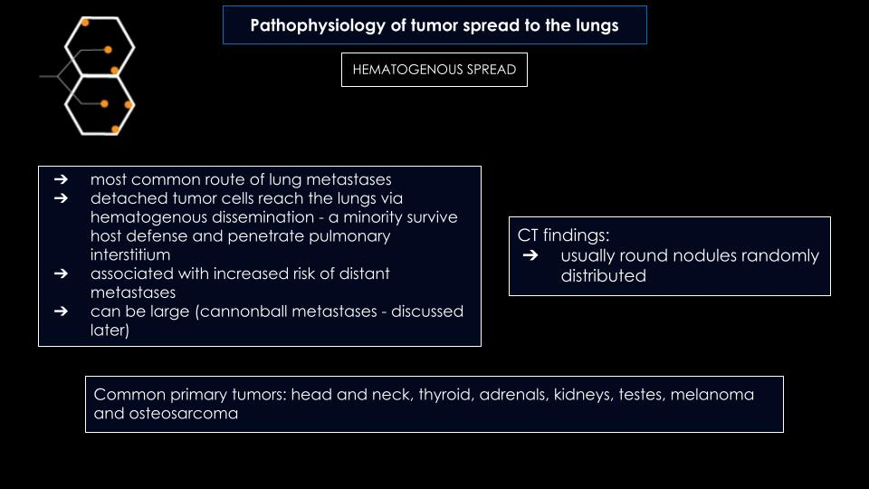
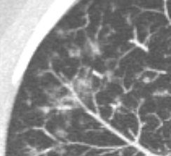

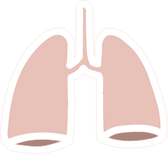


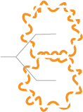


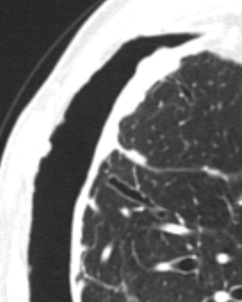
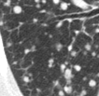
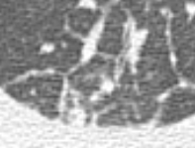
Pathophysiology of tumor spread to the lungs
TUMOR EMBOLI
AEROGENOUS METASTASES
PLEURAL SEEDING
LYMPHATIC SPREAD
HEMATOGENOUS SPREAD

Slide 5
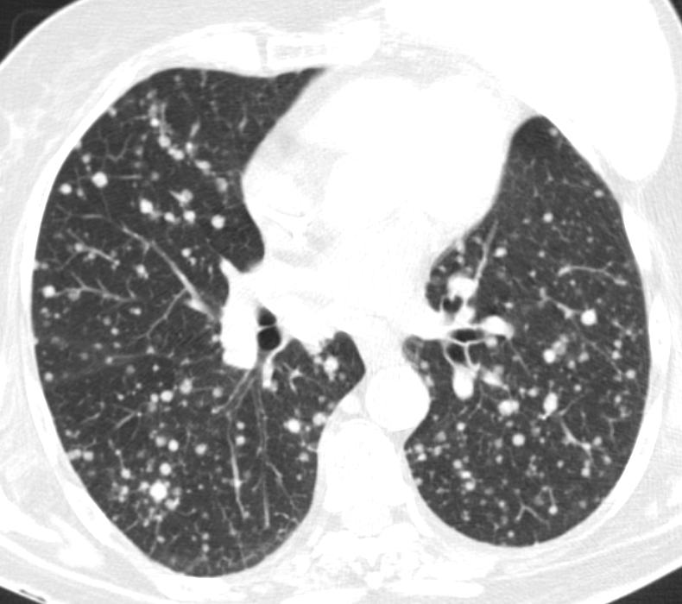
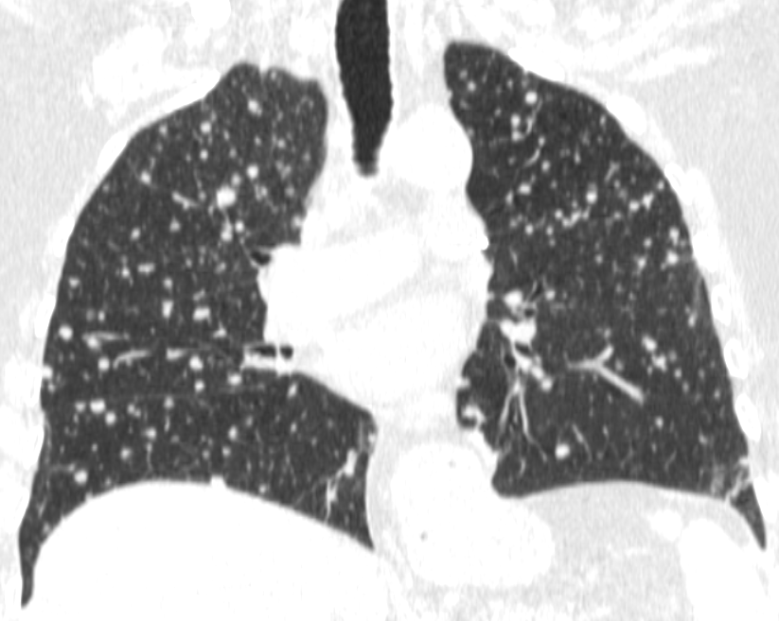
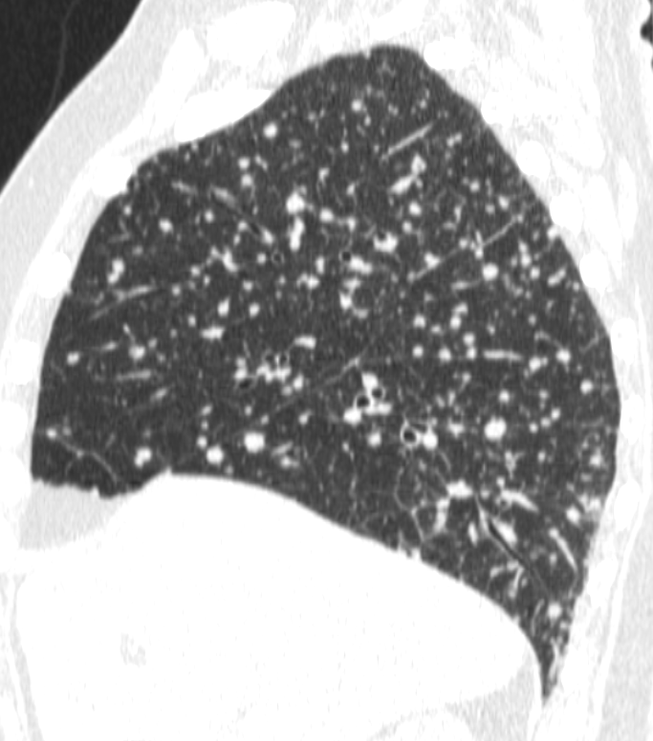
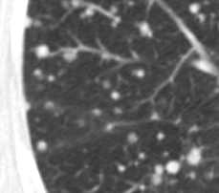
Pathophysiology of tumor spread to the lungs
HEMATOGENOUS SPREAD
Note the random distribution of lesions in all lung fields, with nodules in both centrilobular (circle) and perilymphatic (dashed circle) compartiments.
A)
B)
C)
Female, 67 years old (yo), with lung cancer. Figure A) to C) - computed tomography (CT) image in axial, coronal and sagittal sections respectively. Note multiple bilateral nodules and micronodules with both centrilobular (arrows) and perilymphatic (dashed arrows) distribution. This pattern is compatible with hematogenous dissemination of metastases.

Slide 6
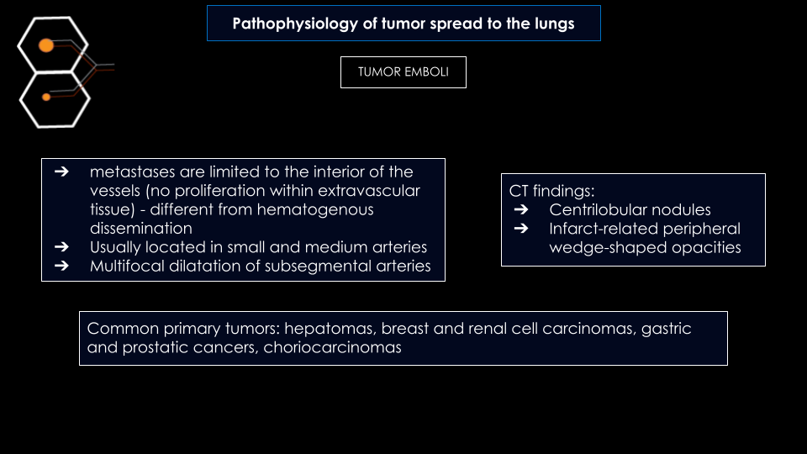
Pathophysiology of tumor spread to the lungs
TUMOR EMBOLI
AEROGENOUS METASTASES
PLEURAL SEEDING
LYMPHATIC SPREAD
HEMATOGENOUS SPREAD

Slide 7
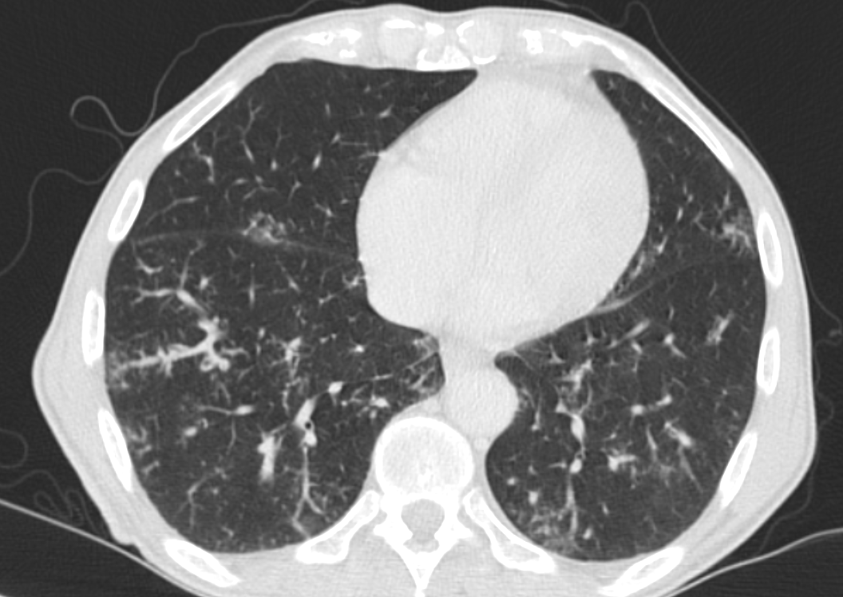
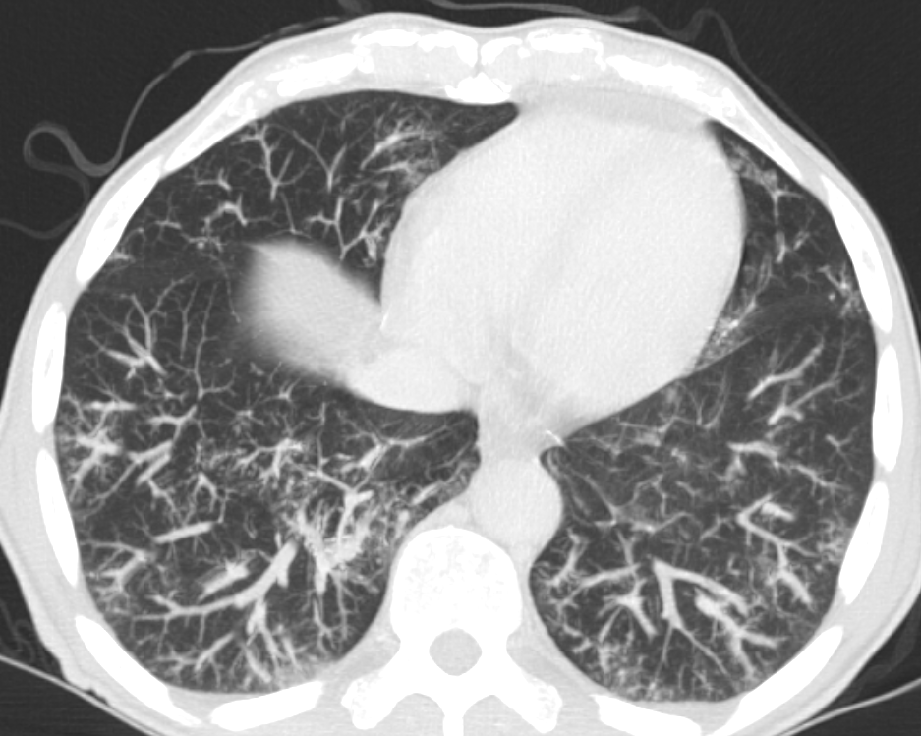
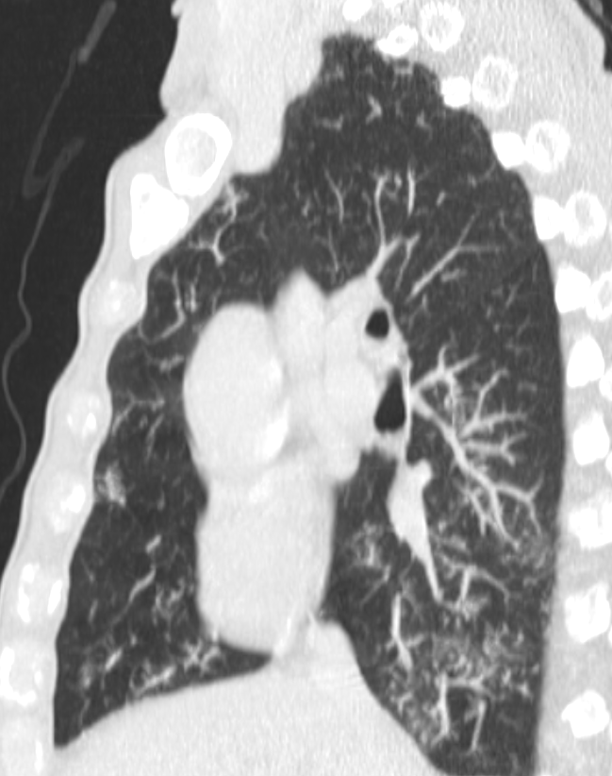
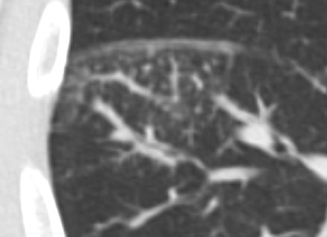
Pathophysiology of tumor spread to the lungs
TUMOR EMBOLI
Centrilobular micronodules, some of them with “tree-in-bud” appearance.
A)
B)
C)
Male, 72 years old (yo), with gastric cancer. Figure A) axial computed tomography (CT) axial image, figure B) maximum intensity projection (MIP) axial CT image and figure C) MIP sagittal image showing centrilobular micronodules, some of them with “tree-in-bud” appearance, probably related to tumor embolization of gastric cancer.

Slide 8
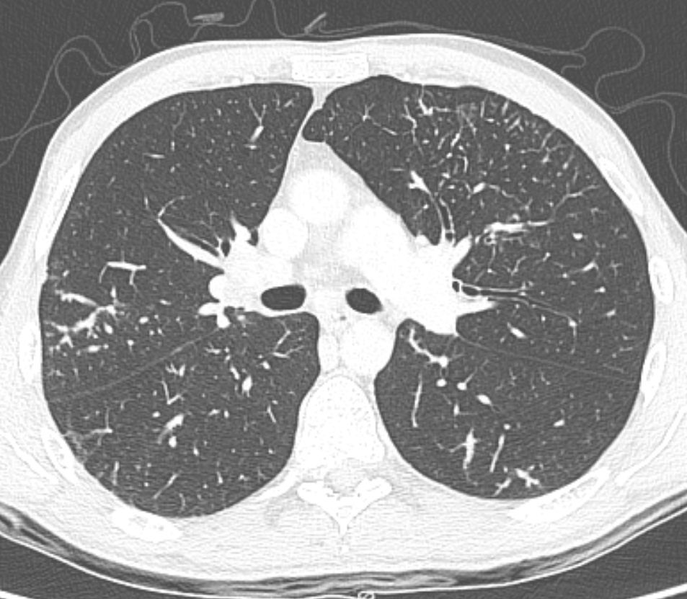
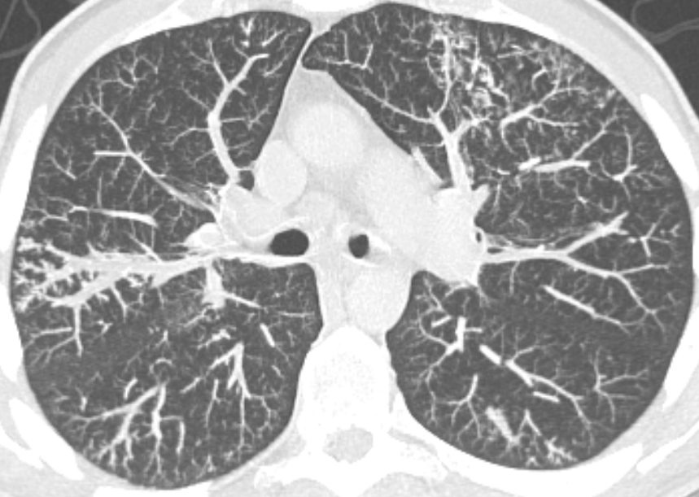
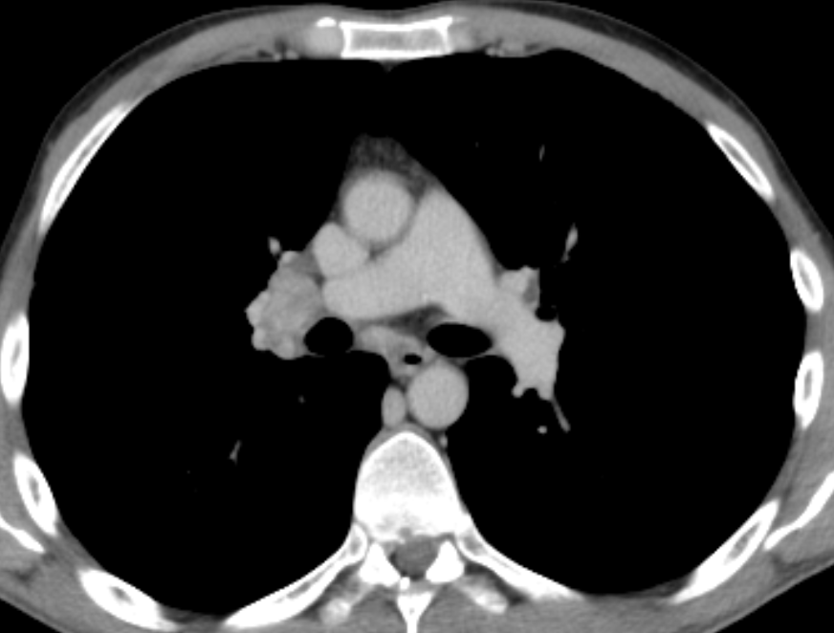
Pathophysiology of tumor spread to the lungs
TUMOR EMBOLI
Centrilobular micronodules, some of them with “tree-in-bud” appearance
A)
B)
C)
Male, 49 years old (yo), with colon cancer. Figure A) axial computed tomography (CT) axial image, figure B) maximum intensity projection (MIP) axial CT image showing centrilobular micronodules, some of them with “tree-in-bud” appearance (circle). Figure C) axial CT image in mediastinal window showing mediastinal lymph nodes metastasis near to right pulmonary artery (arrow). The imaging are suggestive of tumoral embolization.

Slide 9
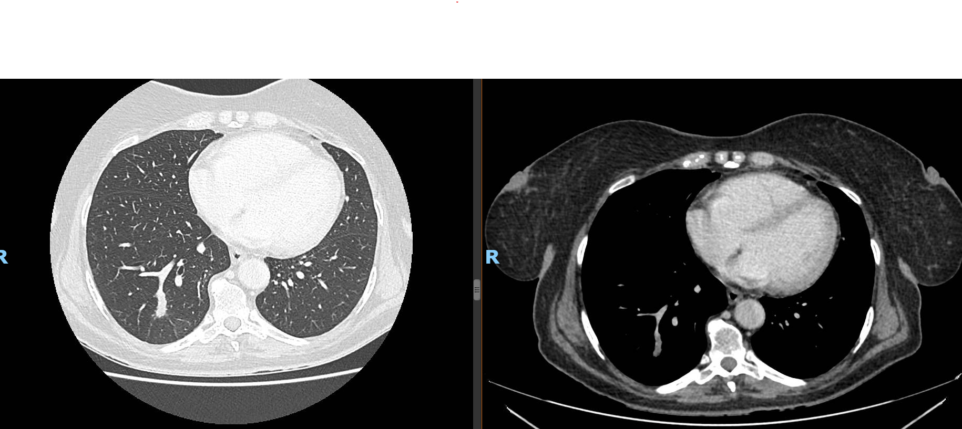
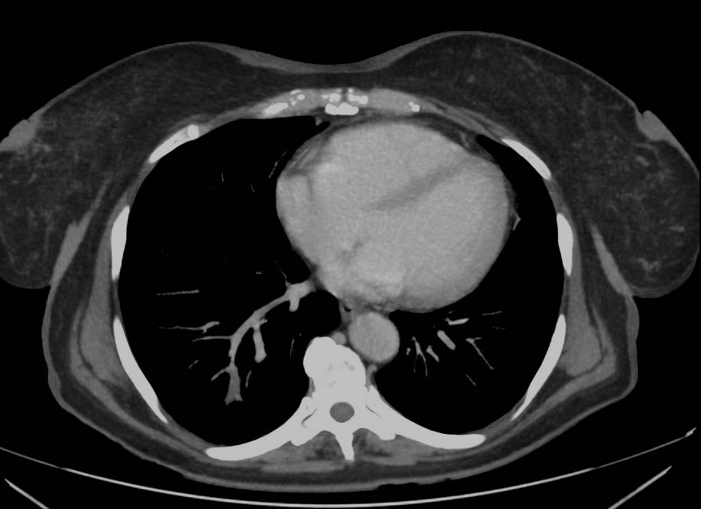
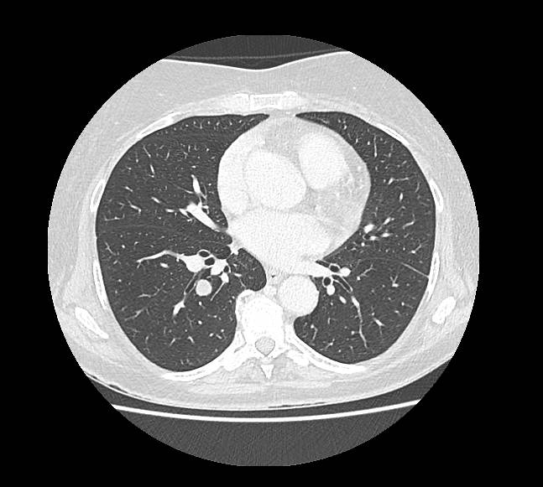
Pathophysiology of tumor spread to the lungs
OTHER VASCULAR MANIFESTATIONS
Female, 49 yo, with rectal cancer. Figure A) to D) CT images. Note tumor invasion of the pulmonary vein (circle). Also note metastatic nodules in lung parenchyma (arrow).
A)
B)
C)
D)

Slide 10
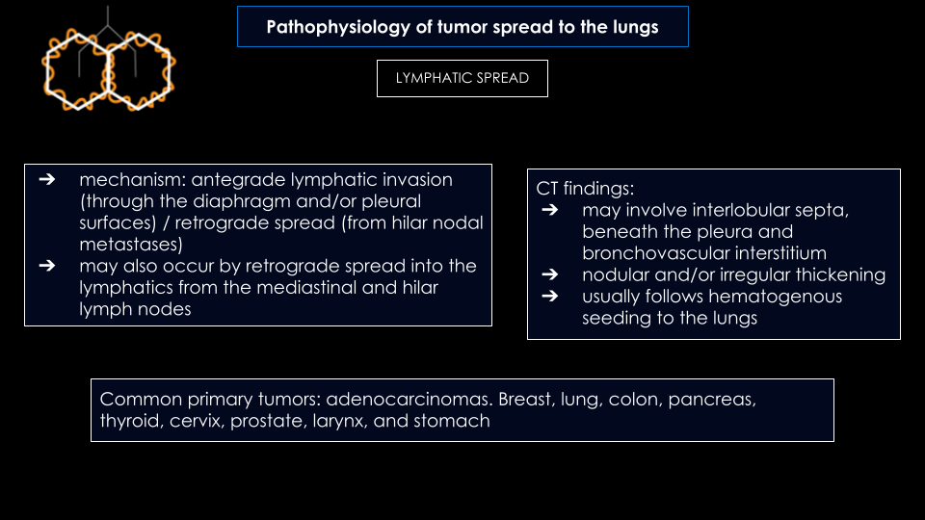
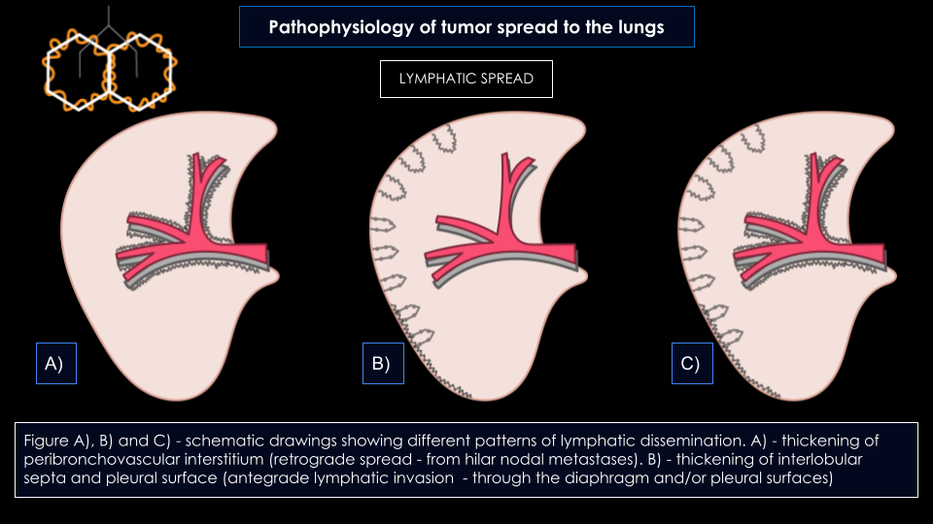
Pathophysiology of tumor spread to the lungs
TUMOR EMBOLI
AEROGENOUS METASTASES
PLEURAL SEEDING
LYMPHATIC SPREAD
HEMATOGENOUS SPREAD

Slide 11
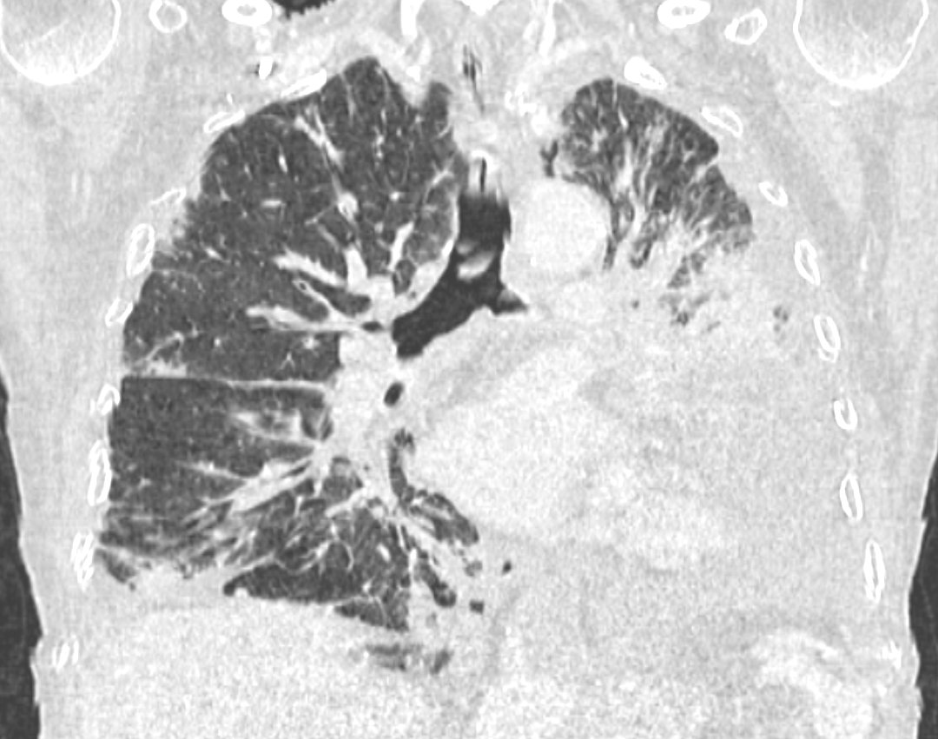
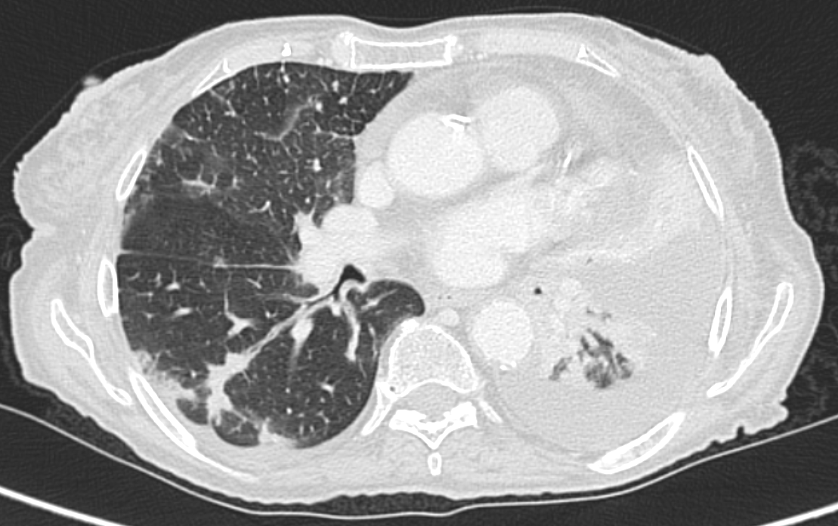
Pathophysiology of tumor spread to the lungs
LYMPHATIC SPREAD
Irregular thickening of interlobular septa
Irregular thickening of peribronchovascular interstitium
A)
B)
Male, 75 yo with an agressive basal cell carcinoma of the skin. Figure A) - MIP coronal CT image shows thickening of peribronchovascular interstitium. Figure B) axial CT image shows peribronchovascular nodules and irregular thickening of interlobular septa, suggesting lymphatic carcinomatosis.

Slide 12
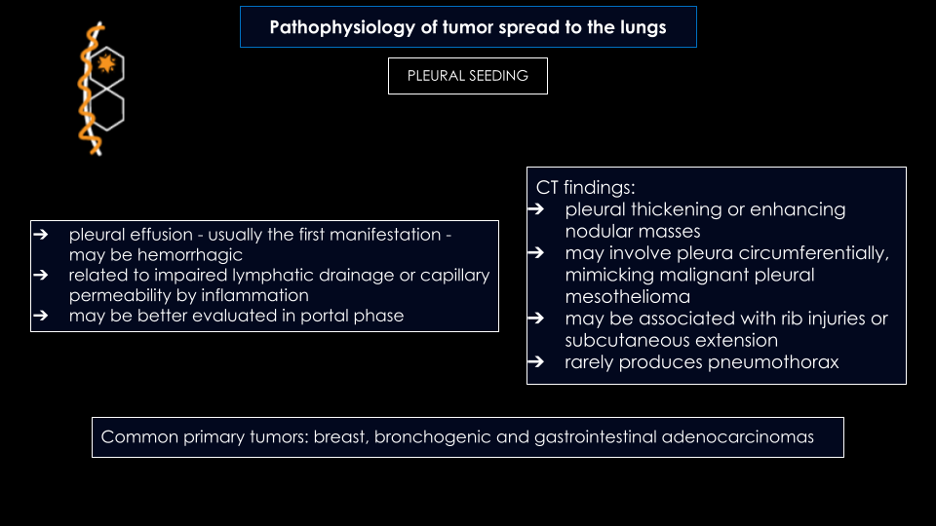
Pathophysiology of tumor spread to the lungs
TUMOR EMBOLI
AEROGENOUS METASTASES
PLEURAL SEEDING
LYMPHATIC SPREAD
HEMATOGENOUS SPREAD

Slide 13
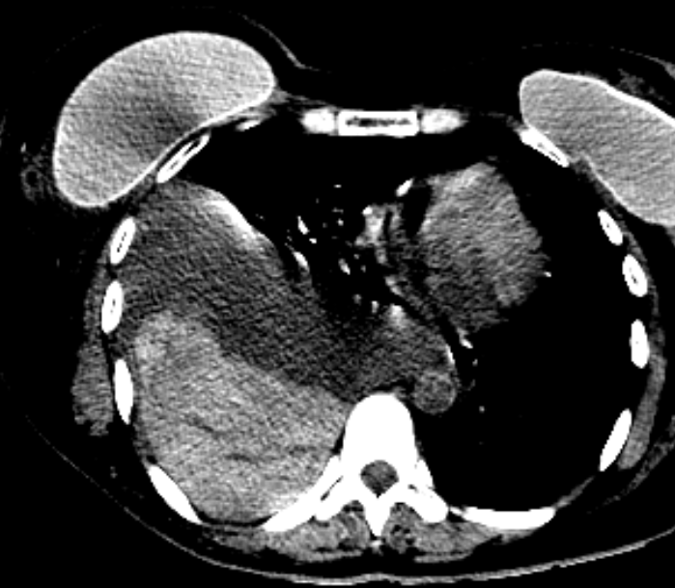
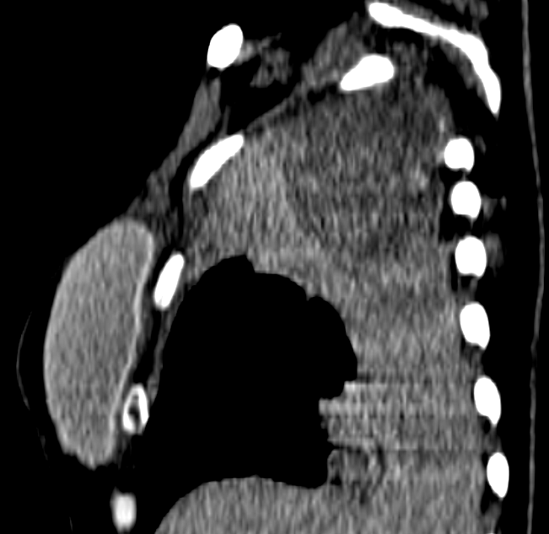
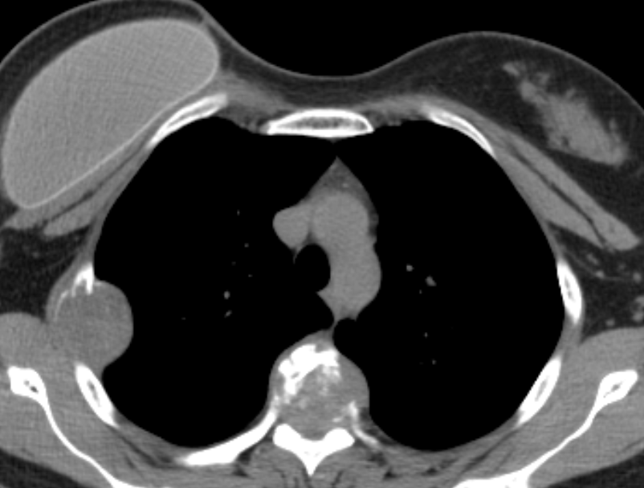
Pathophysiology of tumor spread to the lungs
PLEURAL SEEDING
Teaching Point
pleural effusions are usually the first manifestation of pleural seeding and may be hemorrhagic
A)
B)
C)
Female, 61 yo with breast cancer. Figure A) - axial CT image shows silicone breast implant on the right in a mastectomized patient. Note metastases in a vertebral body (arrow) and on a right rib (dashed arrow). Figure B) and C) axial and sagittal CT images respectively 6 months later. Note large hemorrhagic pleural effusion due to pleural seeding of breast metastases (circle).

Slide 14
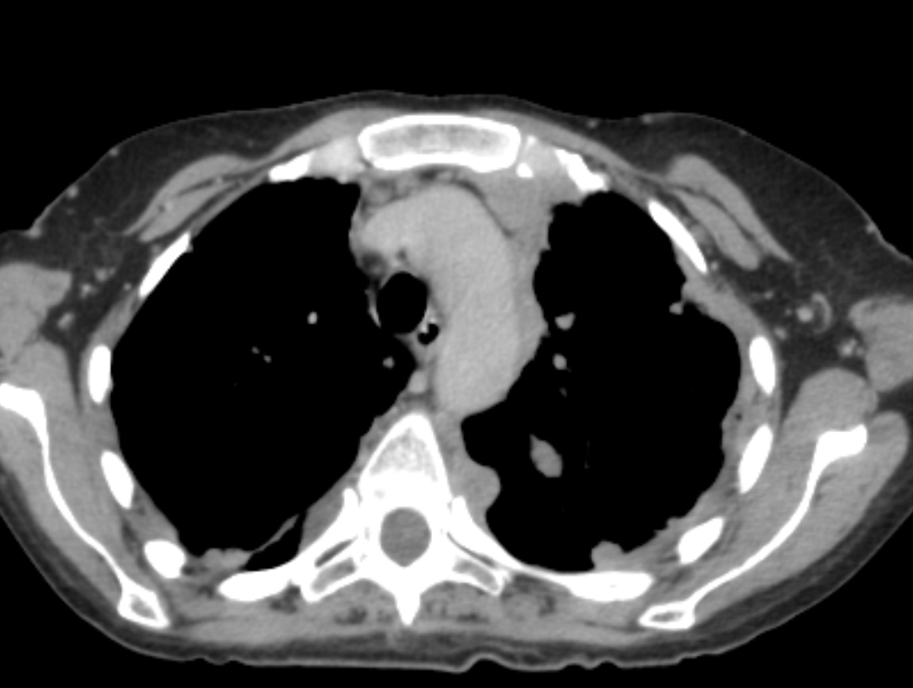
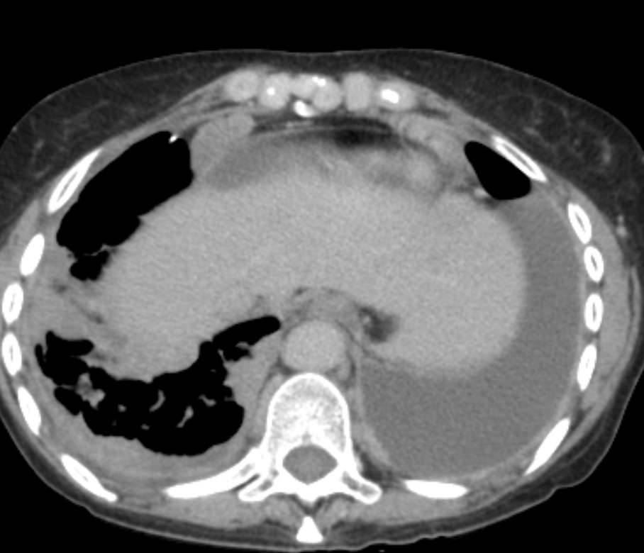
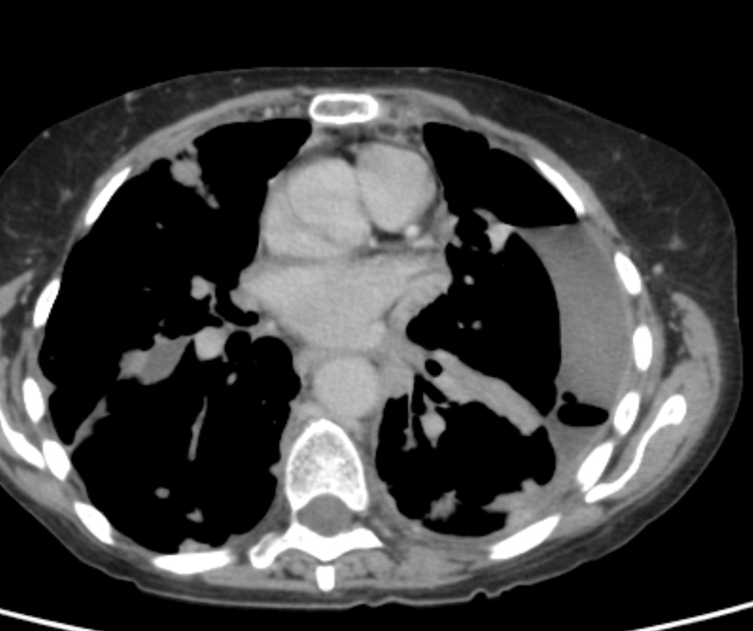
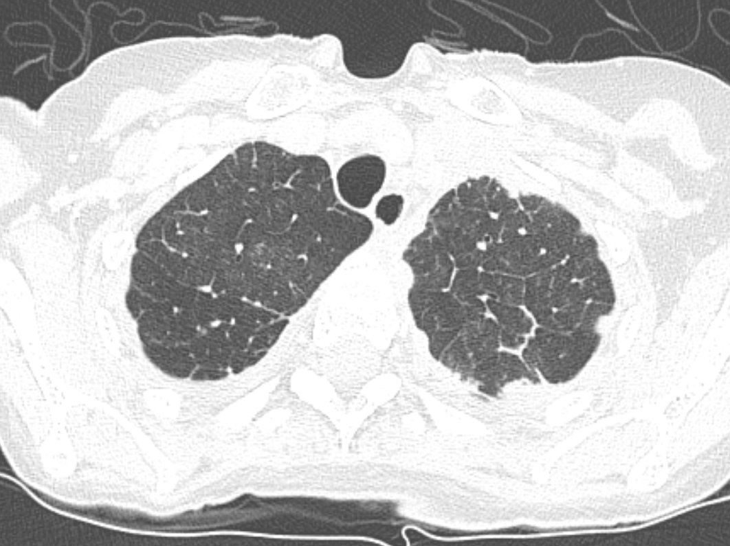
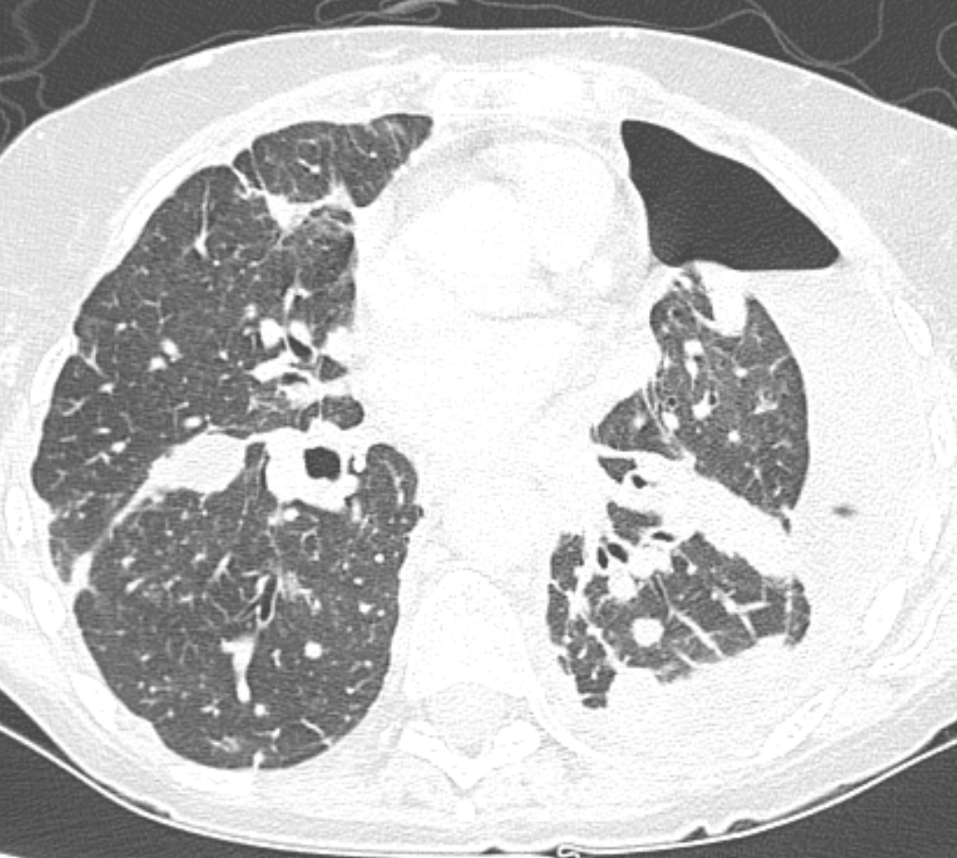
Pathophysiology of tumor spread to the lungs
PLEURAL SEEDING
Female, 59 yo with lung cancer. Figure A) to E) - axial CT image. Note the moderate loculated pleural effusion and a small pneumothorax on the left, due to previous drainage (arrow). There is also bilateral nodular and irregular circumferential pleural thickening (dashed arrows), suggesting bilateral pleural carcinomatosis.
Teaching Point
A)
B)
C)
Small pleural fluid collections in an ipsilateral lung cancer usually means pleural dissemination (even if implants are not visible)
C)
D)
E)

Slide 15
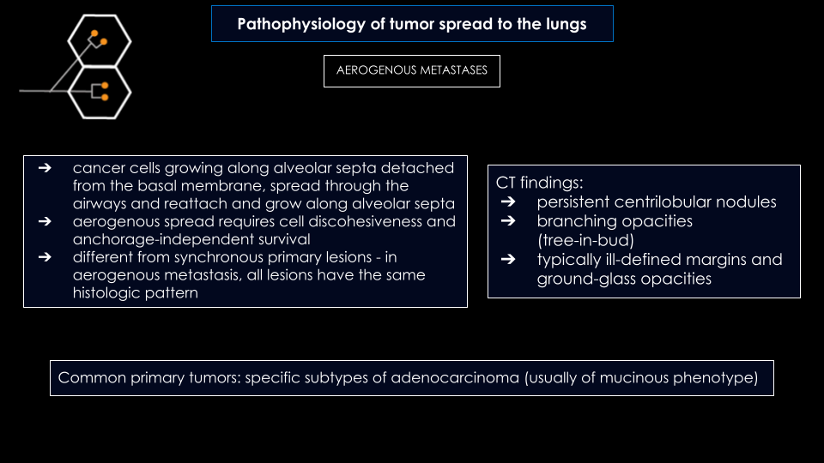
Pathophysiology of tumor spread to the lungs
TUMOR EMBOLI
AEROGENOUS METASTASES
PLEURAL SEEDING
LYMPHATIC SPREAD
HEMATOGENOUS SPREAD

Slide 16
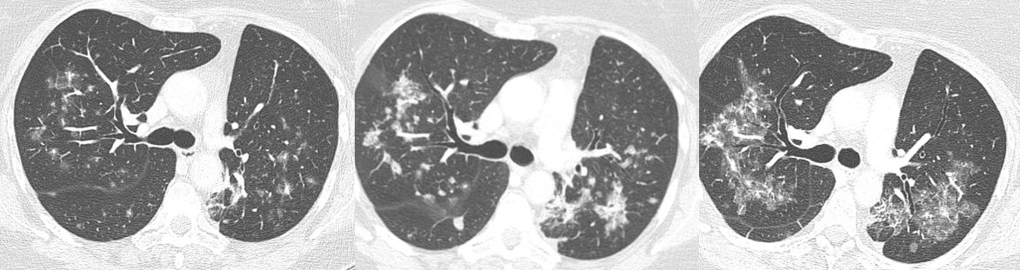
Pathophysiology of tumor spread to the lungs
AEROGENOUS METASTASES
Centrilobular hazy nodular opacities, some of them with “tree-in-bud” appearance, related to aerogenous dissemination of mucinous adenocarcinoma.
A)
B)
C)
Male, 58 yo, with mucinous adenocarcinoma of the lungs. Figures A) to C) show temporal changes in disease progression. Axial CT images acquired over 7 months (A to C) reveal increase in extension of bilateral pulmonary infiltrates (circles) corresponding to mucinous adenocarcinoma dissemination through airways and alveolar spaces.

Slide 17
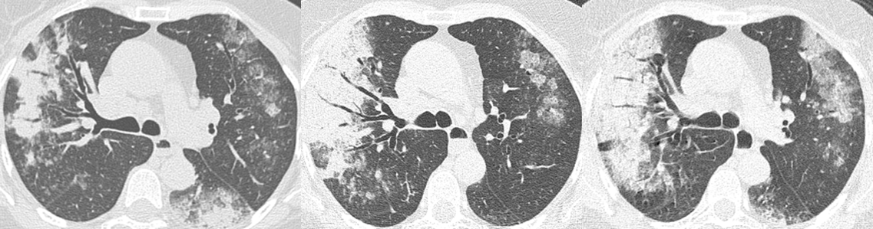
Pathophysiology of tumor spread to the lungs
AEROGENOUS METASTASES
A)
B)
C)
Male, 54 yo, with mucinous adenocarcinoma of the lungs. Axial CT images acquired over 2 months (A to C) reveal progressive increase in extension of pulmonary infiltrates (circles) with marked consolidations and air bronchograms, corresponding to the classic appearance of a pneumonic-type lung cancer. This is the result of aggregates of cells and mucin propagating through airways and along alveolar walls in a lepidic fashion. Infection was ruled-out.

Slide 18
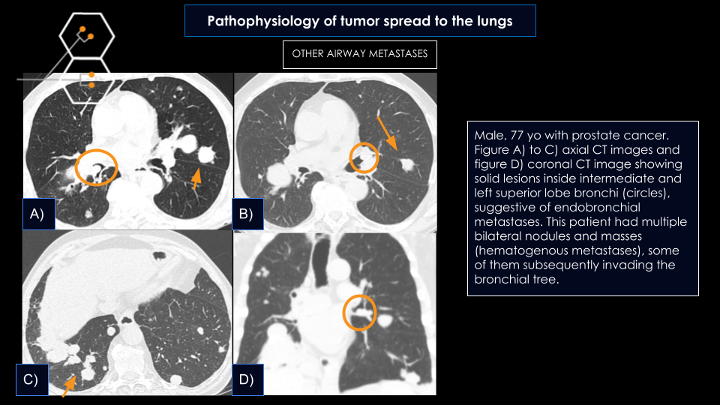
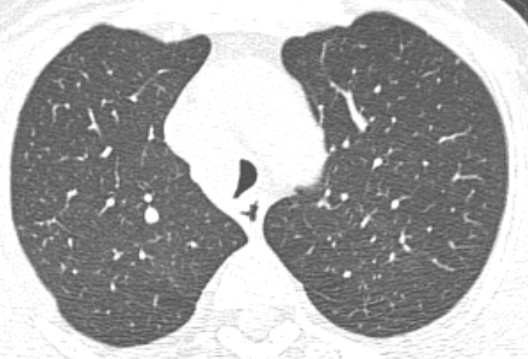
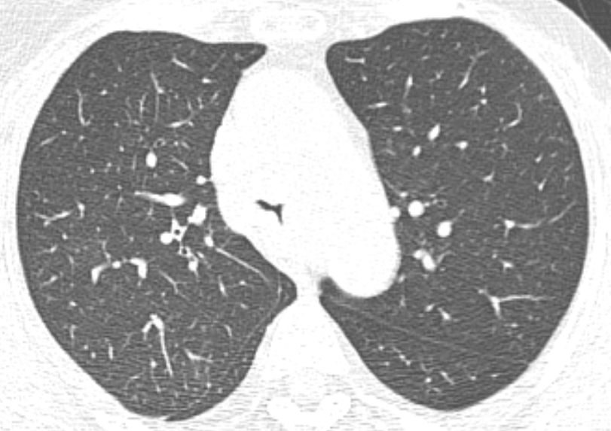
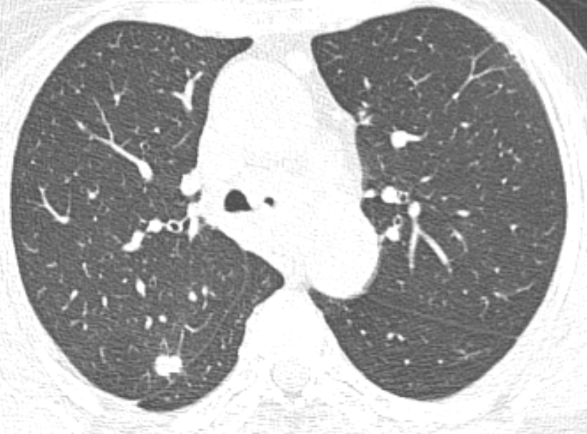
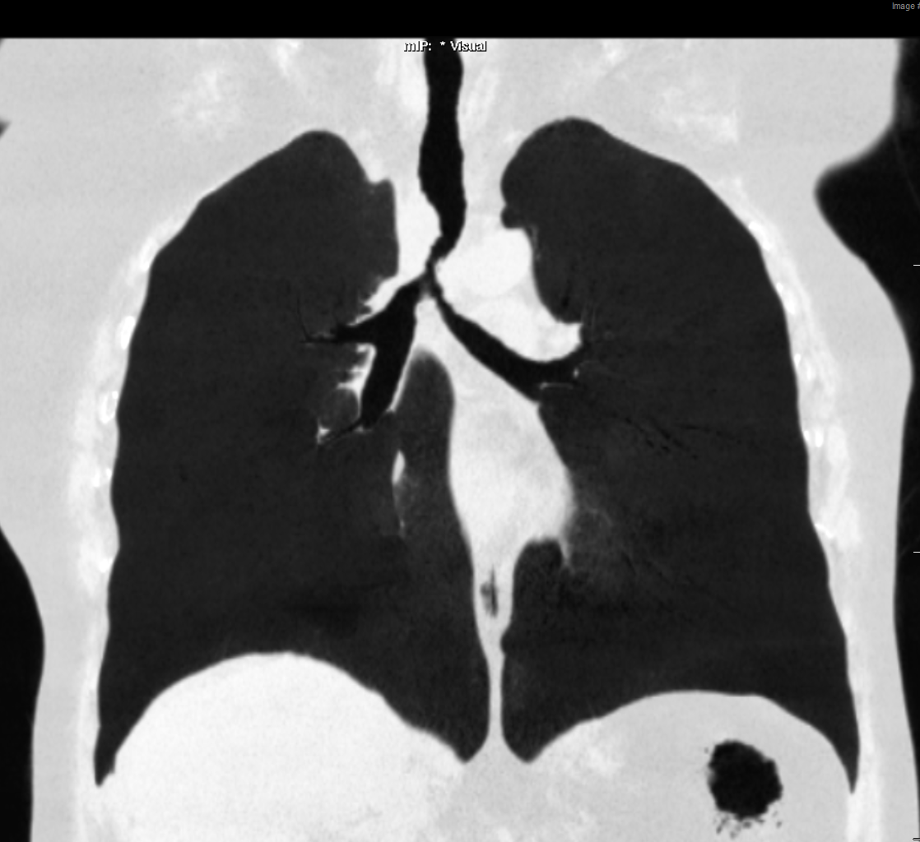
Pathophysiology of tumor spread to the lungs
OTHER AIRWAY METASTASES
Female, 48 yo with breast cancer. Figure A), B) and C) axial CT images and figure D) minimum intensity projection coronal CT image showing a solid and infiltrative lesion (circle) that surrounds and narrows distal trachea and proximal main bronchus. Note multiple bilateral centrilobular nodules, suggestive of metastatic dissemination to the airway (arrows), probably due to combined lymphatic and hematogenous spread.
A)
B)
C)
D)

Slide 19
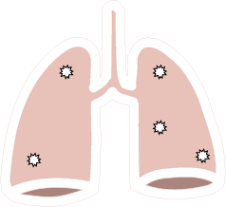
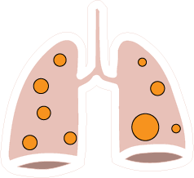

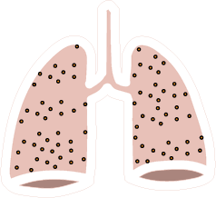
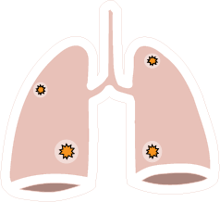

Different presentations of lung metastasis
CALCIFIED METASTASES
CANNONBALL METASTASES
CAVITATED METASTASES
MILIARY METASTASES
HEMORRAGIC METASTASES
SPONTANEOUS PNEUMOTHORAX

Slide 20
Different presentations of lung metastasis
CALCIFIED METASTASES
Mechanisms:
bone formation in tumors with osteoid origin
calcification or ossification of tumor cartilage
dystrophic calcification
mucoid calcification
osteosarcoma, chondrosarcoma
papillary carcinoma of the thyroid, synovial sarcoma, giant cell tumor of the bone, treated metastases
mucinous adenocarcinomaof the gastrointestinal tract or breast
Common primary tumors:
Sarcomas (osteosarcoma, synovial sarcoma, chondrosarcoma)
Mucinous type carcinomas (colon, ovarian and breast cancers)
Giant cell tumor of the bone
CT cannot differentiate benign calcifications and ossifications from metastases (one should have caution with calcified nodules in patients with those tumor types)
Differential diagnosis:
granuloma, hamartoma

Slide 21
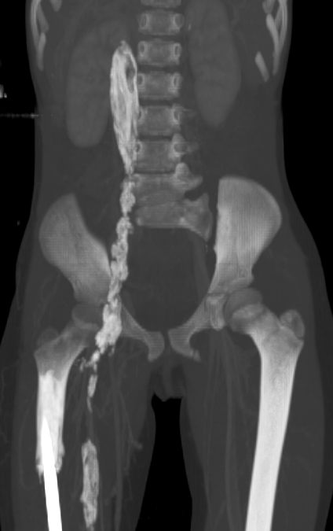
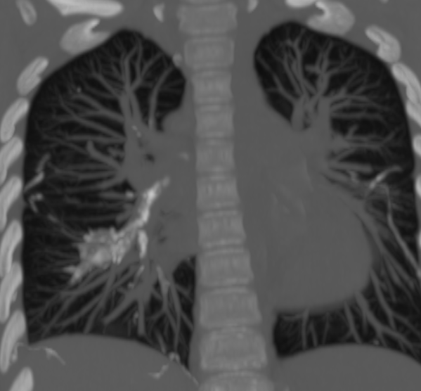
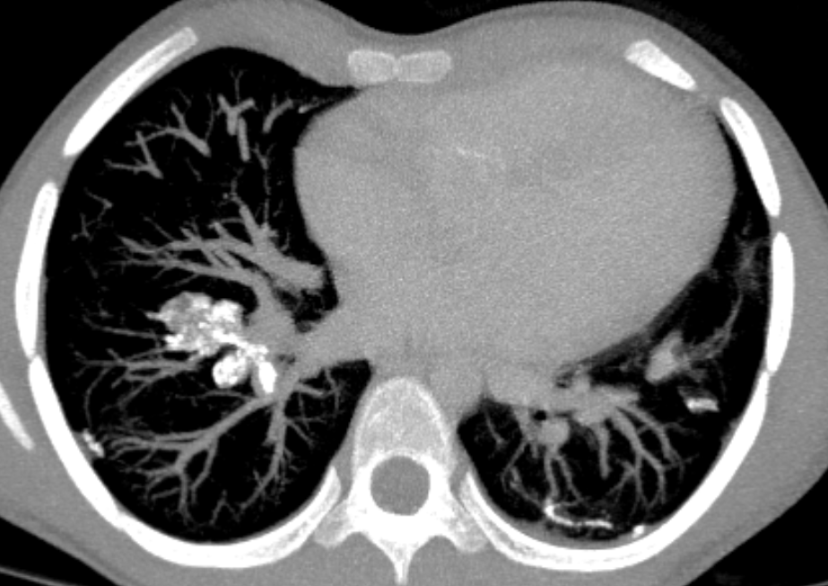
Different presentations of lung metastasis
CALCIFIED METASTASES
A)
B)
C)
14-year old woman with right femur osteosarcoma. (A) Coronal maximum intensity projection (MIP) CT image shows extensive tumor thrombus with osteoid matrix in right femoral and iliac veins and inferior vena cava (arrow). Coronal (B) and axial (C) MIP CT reconstruction demonstrating lung metastases with similar characteristics within pulmonary arterial vasculature (dotted arrow)

Slide 22




Different presentations of lung metastasis
CALCIFIED METASTASES
Female, 65 yo with breast cancer. Figure A), B), C) and D) - axial CT images. Figure A) and C) show mastectomy of the right breast and calcified nodules on the left lung (arrow and dashed arrow respectively). Figures B) and D) show control 6 months later with nodules growth, suggesting their metastatic nature.
A)
B)
C)
D)

Slide 23




Different presentations of lung metastasis
CALCIFIED METASTASES
Teaching Point
In a patient with osteosarcoma, calcified images should raise suspicion for the possibility of metastatic lesions.
B)
A)
B)
C)
D)
Male, 60 yo with femoral osteosarcoma. Figure A) to D) - sagittal CT images (A and B), coronal image (C) and MIP coronal reconstruction (D). Note calcified tumor emboli inside segmentary left pulmonary artery (circle) and bilateral calcified nodules (arrows). In a patient with osteosarcoma, calcified images should raise suspicion for the possibility of metastatic lesions.
Notes:
ótima foto a esquerda, já meio que mata calcificada e endovasc hehe

Slide 24

Different presentations of lung metastasis
CAVITATED METASTASES
Mechanisms:
tumor necrosis
check valve effect in adjacent bronchi
walls usually are thick and irregular - different from cystic metastasis
Differential diagnosis:
septic pulmonary emboli, granulomatosis with polyangiitis, pulmonary tuberculosis
Common primary tumors:
Squamous cell carcinomas are the most common type of cavitation detected in radiographies (69%)
CTs - cavitations in adenocarcinoma metastasis are also common
Sarcomas can cavitate
Chemotherapy can induce cavitation

Slide 25


Different presentations of lung metastasis
HEMORRAGIC METASTASES
Mechanisms:
fragility of neovascular tissue that leads to a rupture of the vessel
nodule surrounded by a halo of ground-glass opacity or ill-defined fuzzy margins
Differential diagnosis:
invasive aspergillosis, candidiasis, granulomatosis with polyangiitis, tuberculoma associated with hemoptysis, adenocarcinoma with lepidic features, lymphoma
Common primary tumors:
angiosarcoma
choriocarcinoma
renal cell carcinoma
melanoma

Slide 26

Different presentations of lung metastasis
CANNONBALL METASTASES
multiple large, circumscribed, round pulmonary nodules and masses
Common primary tumors:
renal cell carcinoma
choriocarcinoma
prostate carcinoma, endometrial carcinoma, synovial sarcoma, adrenal carcinoma
most common

Slide 27


Different presentations of lung metastasis
MILIARY METASTASES
uncommon pattern of hematogenous pulmonary metastases
associated with highly vascular tumors
innumerable diffuse and basal predominant micronodules - randomly distributed
Differential diagnosis:
miliary tuberculosis, fungal diseases (histoplasmosis, blastomycosis and coccidioidomycosis, cryptococcosis)
Common primary tumors:
melanoma
renal cell carcinoma
thyroid carcinoma
primary lung adenocarcinoma

Slide 28

Different presentations of lung metastasis
SPONTANEOUS PNEUMOTHORAX
Mechanism:
may result from tumor necrosis of subpleural metastases
spontaneous pneumothorax in a patient with sarcoma should raise suspicion of pulmonary metastases
Common primary tumors:
osteosarcoma
angiosarcoma
other sarcomatous tumors
Notes:
Nodules with small cavitated focus.

Slide 29
Post treatment changes
Wedge resection
Segmentectomy
SURGICAL PROCEDURES
Lobectomy
Pneumonectomy
Metastasectomy
RADIOTHERAPY MODALITIES
ABLATION TECHNIQUES

Slide 30


Post treatment changes
Segmentectomy
SURGICAL PROCEDURES
A)
B)
59-year old woman with breast cancer and a lung metastatic lesion at the apicoposterior segment of the left lung (arrow in Figure A - axial CT image). The patient underwent surgical resection of the lesion (segmentectomy). Figure B) shows post procedure axial CT image. The lesion was totally resected. Note reduction of lung volume and compensatory mediastinal dislocation to the letf.

Slide 31
Post treatment changes
SURGICAL PROCEDURES
Conventional radiation therapy (2D)
Intensity-modulated radiation therapy (3D)
RADIOTHERAPY MODALITIES
Proton therapy (3D)
Three-dimensional conformal radiation therapy (3D)
Stereotactic body radiation therapy (3D)
ABLATION TECHNIQUES

Slide 32




Post treatment changes
Lungs
3–4 weeks after the radiation therapy - ground-glass opacities or consolidations are seen, while some septal thickening over these opacities may occur later - “crazy paving” pattern.
Migratory opacities outside of the radiation field may occur 2–9 months after the radiation therapy.
Radiation lung fibrosis manifests 6–12 months after the radiation therapy ends and usually stabilize within 2 years.
Sharply defined lung consolidation with a geographic distribution, volume loss, architectural distortion, traction bronchiectasis, and eventually hilar vascular displacement with a possible ipsilateral mediastinal shift.
Pleura
Pleural effusions are characteristically seen within 6 months after the RT
Chronic changes - linear and smooth pleural thickening.
RADIOTHERAPY MODALITIES
Lymph nodes
May calcify
Pericardium
Pericardial effusion is common in acute pericarditis
Constrictive pericarditis is the most worrisome chronic pericardial complication, consisting of pericardial wall thickening with calcifications, systemic venous dilatation and septal flattening.
Great vessels
Wall thickening and enhancement - acute phase.
Long, smooth, diffuse vascular stenotic segment is a typical finding of postirradiation vasculitis.
Chronic setting - vascular wall calcifications, vascular occlusion, and pseudoaneurysms.
A)
B)
C)
62-year old man with neuroendocrine small cell lung carcinoma and multiple metastases who underwent radiotherapy of mediastinal lesions. Coronal (A) and axial (B) CT images show dense fibrotic changes with volume loss and traction bronchiectasis in both lungs. Both affected regions have straight lateral margins.

Slide 33
Post treatment changes
SURGICAL PROCEDURES
RADIOTHERAPY MODALITIES
Interstitial laser-induced thermotherapy (LITT)
Radiofrequency ablation
ABLATION TECHNIQUES
Microwave ablation
Cryoablation

Slide 34






Post treatment changes
ABLATION TECHNIQUES
Late Phase (>2 Months)
Ablation zone undergoes further involution.
Patchy areas of hyperattenuation may be seen within the ablation zone at unenhanced CT imaging.
The cavities eventually disappear and undergo scarring, with minimal architectural distortion of the surrounding lung parenchyma.
At 3 months, the size of the ablation zone should be the same size as the baseline tumor
at 6 months, the size of the ablation zone should be smaller than the tumor before ablation.
Intermediate Phase (>1 Week–2 Months)
Surrounding ground-glass opacities have involuted.
The ablation zone will continue to be larger, compared with the original tumor, but should be smaller relative to the early phase as a result of regressing parenchymal edema, inflammation, and hemorrhage.
A)
B)
C)
Early phase (≤1 Week)
cone-shaped sectoral hyperemia or rim of hyperemia characterized by ground-glass opacity and intralesional bubbles.
Immediately after RFA, the ablation zone appears larger than the original tumor because the zone consists of both tumor and the perilesional ground-glass opacity corresponding to the safety zone
D)
E)
46-year old woman with lung cancer and isolated right lung metastasis who underwent radiofrequency ablation. Axial CT images obtained before (A) and after (B to E) the procedure. Figure B) and C) were obtained 1 day after the procedure. Treated zone is depicted as a large cone-shaped ground-glass opacity surrounding the previously observed nodule (coagulative necrosis). Figure D) - CT done 2 months after the procedure. Ablation zone is smaller and appears as an area of hyperattenuation. Figure E) - 4 months after the procedure. There is involution of ablation zone and minimal architectural distortion of the surrounding lung parenchyma.

Slide 35
References
Mohammed, Tan-Lucien H., et al. "ACR Appropriateness Criteria® screening for pulmonary metastases." Journal of thoracic imaging 26.1 (2011): W1-W3.
Sabloff, B. (2012). Thoracic metastatic disease. In Oncologic Imaging: A Multidisciplinary Approach (pp. 555-562). Elsevier Health Sciences. https://doi.org/10.1016/B978-1-4377-2232-1.00030-9
Johkoh, Takeshi, et al. "CT findings in lymphangitic carcinomatosis of the lung: correlation with histologic findings and pulmonary function tests." AJR. American journal of roentgenology 158.6 (1992): 1217-1222.
Biswas, Abhishek, and Peruvemba S. Sriram. "Getting the whole picture: lymphangitic carcinomatosis." The American journal of medicine 128.8 (2015): 837-840.
Schueller, G., and C. J. Herold. "Lung metastases." Cancer imaging 3.2 (2003): 126-128.
Gerull, William D., Varun Puri, and Benjamin D. Kozower. "The epidemiology and biology of pulmonary metastases." Journal of thoracic disease 13.4 (2021): 2585.
Kimmig, Lucas, and Juliana Bueno. "Miliary nodules: not always tuberculosis." Annals of the American Thoracic Society 14.12 (2017): 1858-1860.
Benveniste, Marcelo F., et al. "Recognizing radiation therapy–related complications in the chest." Radiographics 39.2 (2019): 344-366.
Abtin, Fereidoun G., et al. "Radiofrequency ablation of lung tumors: imaging features of the postablation zone." Radiographics 32.4 (2012): 947-969.
Higashiyama, Masahiko, et al. "Pulmonary metastasectomy: outcomes and issues according to the type of surgical resection." General thoracic and cardiovascular surgery 63.6 (2015): 320-330.

