Slide 1



A DIDACTICAL RADIOLOGIC APROACH TO TESTICULAR E PARATESTICULAR LESIONS
Valdrighi, J.T.; Santiago, C.C.F.; Cardili, L; Gusmão, M.M.; Mota, D.A.M; Viana, P.C.C.; Guimarães, C.T.S.; Yamauchi, F.I.

Slide 2
LEARNING OBJECTIVES
The purpose of this exhibit is:
To review imaging appearances of the normal scrotum.
Discuss the role of the different imaging methods in evaluation testicular and paratesticular masses.
Identify and discuss radiological findings of benign and malignant extratesticular and testicular lesions.
Propose an algorithm to narrow the diagnosis of testicular and paratesticular masses.
INTRODUCTION | ANATOMY | TESTICULAR LESIONS | PARATESTICULAR LESIONS | OTHERS

Slide 3
INTRODUCTION
Testicular cancer is the most common malignancy in young / middle-aged men, mostly between 15–35 yo.
Most cases are curable because of advances in therapy (chemotherapy, radiotherapy, and surgery.)
Radiologists play an important role in the diagnosis, staging, and follow-up.
It is crucial establishing benign differential diagnoses that change the therapeutic approach.
INTRODUCTION | ANATOMY | TESTICULAR LESIONS | PARATESTICULAR LESIONS | OTHERS

Slide 4
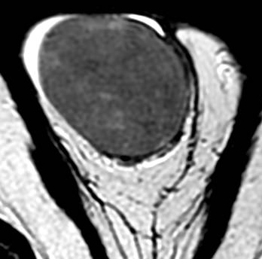
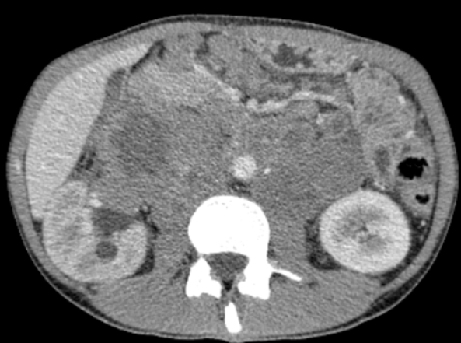
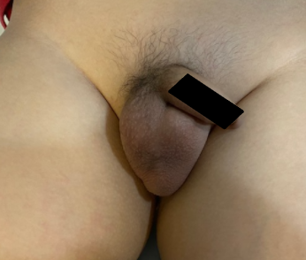
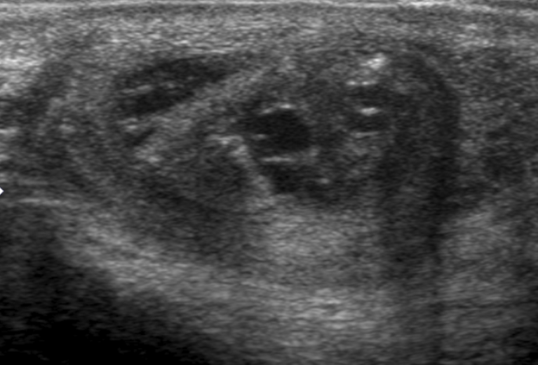
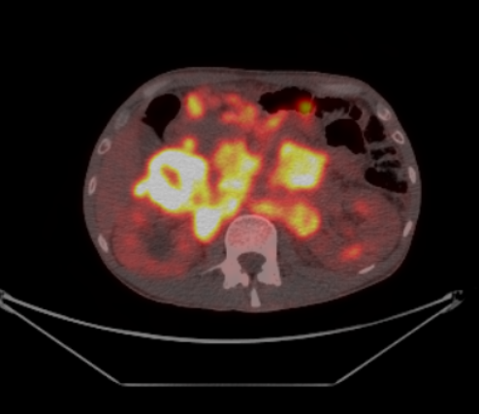
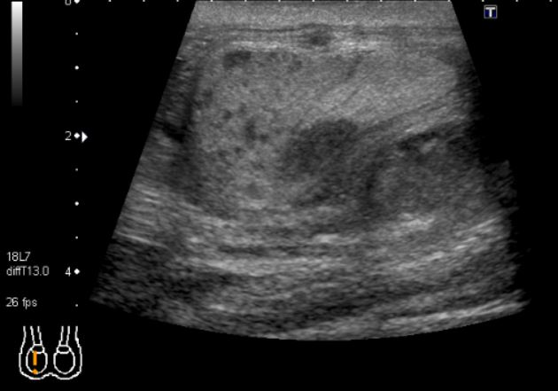
IMAGING METHOD
Magnetic Ressonance (MR)
Ultrasound (US)
High cost
Indicated when US findings are inconclusive
Wider field-of-view
High accuracy to differentiate benign vs malignant and extra vs intra-testicular disease
Allows tissue characterization as fat, blood, and fibrosis.
US can be inconclusive because of discordant clinical and findings or a wide differential diagnosis
High accuracy
Excellent depiction of scrotal anatomy
Low cost
Wide availability
Method of choice
FLOWCHART
Inconclusive or discordant clinical findings
Wide differential diagnosis
Staging
Magnetic Ressonance
Staging
Palpaple mass, pain and edema
Ultrasound
CT and / or PET-CT
INTRODUCTION | ANATOMY | TESTICULAR LESIONS | PARATESTICULAR LESIONS | OTHERS

Slide 5
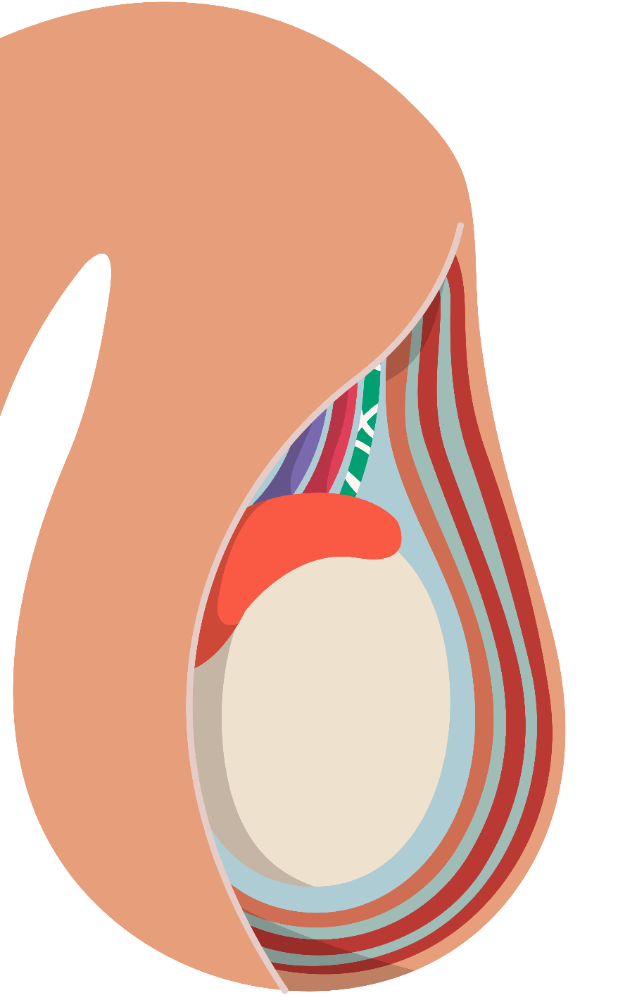










ANATOMY
Spermartic cord
Skin
Vas Deferens
Testicular Artery
Testicular Vein
Epididymis
Tunica Vaginalis (visceral)
Tunica Vaginalis (parietal)
Internal Spermatic Fascia
Cremaster Muscle
Testis
External Spermatic Fascia
Dartos Muscle
INTRODUCTION | ANATOMY | TESTICULAR LESIONS | PARATESTICULAR LESIONS | OTHERS

Slide 6



ANATOMY
Paratesticular Lesions
Testicular Lesions
Benign conditions:
Adenomatoid tumor of the epididymis
Spermatic cord lipoma
Scrotum hemangioma
Fibrous pseudotumor of the scrotum
Malignant conditions:
Embryonal rhabdomyosarcoma
Spermatic cord leiomyosarcoma
Spermatic cord lipossarcoma
Malignant conditions:
Germinative cell tumors
Sex cord tumors
Lymphoma
Others: leukemia, metastasis, and vascular tumors
Benign conditions:
Tuberculosis
Adrenal rests
Inflammatory conditions
Ischaemia and hematomas
Testicular torsion
Spermartic cord
Epididymis
Tunica Vaginalis (visceral)
Tunica Vaginalis (parietal)
Testis
INTRODUCTION | ANATOMY | TESTICULAR LESIONS | PARATESTICULAR LESIONS | OTHERS

Slide 7
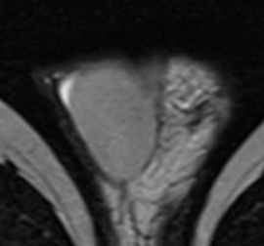
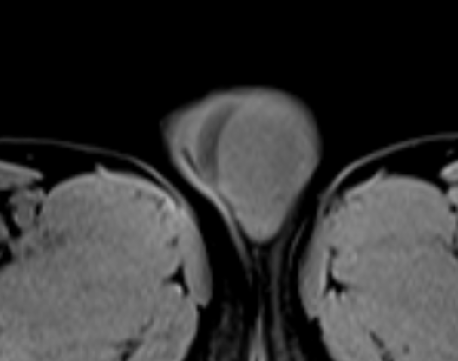
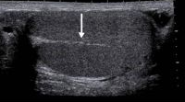
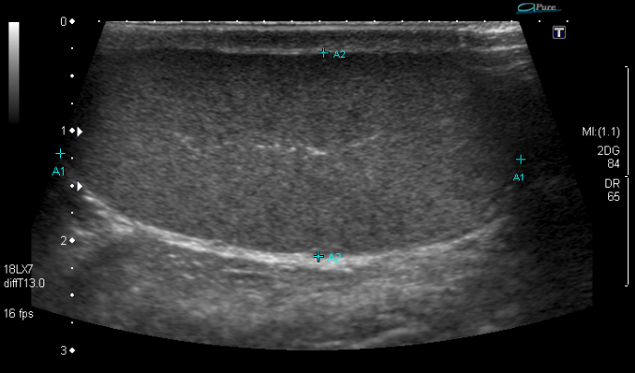
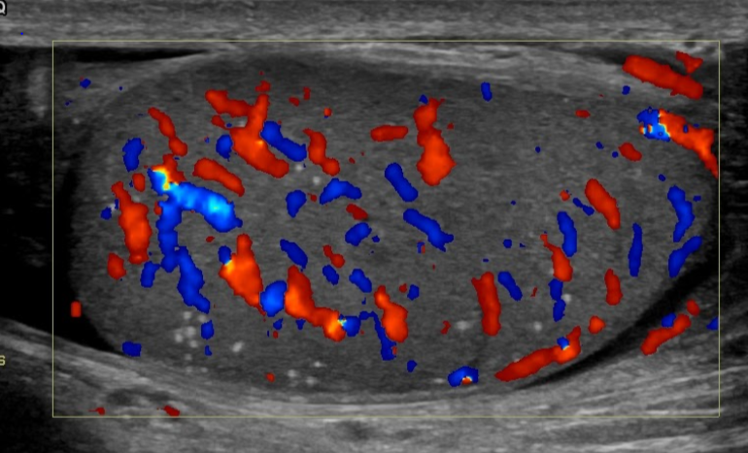
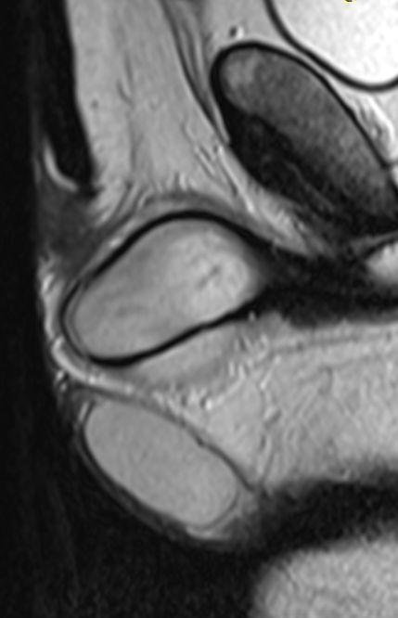
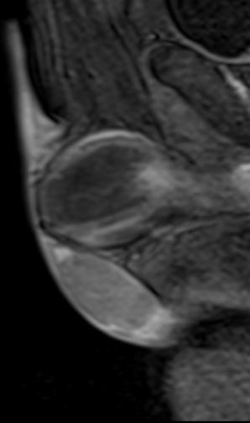
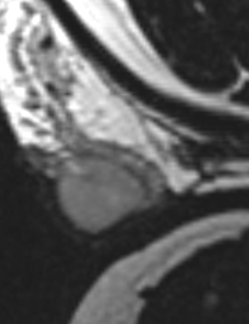
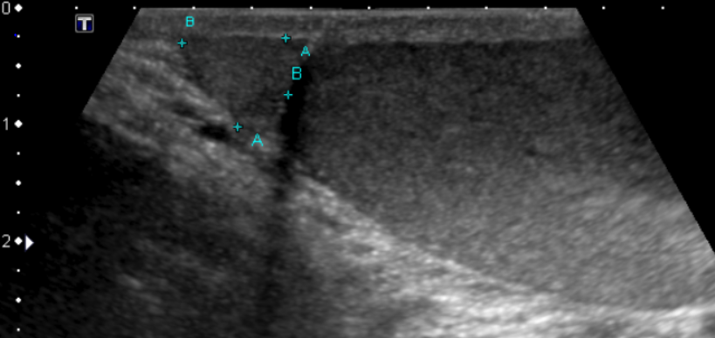
NORMAL ANATOMY
Magnetic Ressonance (MR)
Ultrasound (US)
Axial - T2WI
Axial – T1WI
Normal testis flow
Oblique - T2WI
Testis has low to medium homogeneous echogenicity
Tunica albuginea: thin echogenic line around the testis.
Mediastinum testis: echogenic band of variable thickness and length extending in a caudocranial direction
Epididymis: isoechoic to the testis, and its echotexture may be coarser than that of the testis
Sagittal - T2WI
Sagittal – T1WI post contrast
Testis has low to intermediate SI on T1WI and high SI on T2WI images
Tunica albuginea: low SI on T1WI and T2WI.
Epididymis is slightly heterogeneous and isointense to the testis on T1WI and T2WI.
INTRODUCTION | ANATOMY | TESTICULAR LESIONS | PARATESTICULAR LESIONS | OTHERS

Slide 8
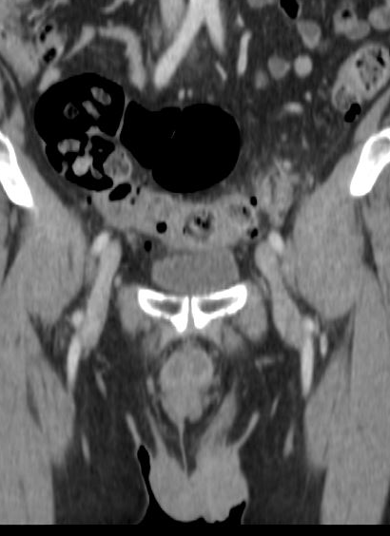
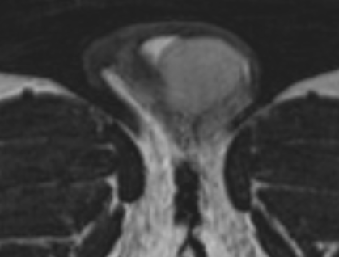
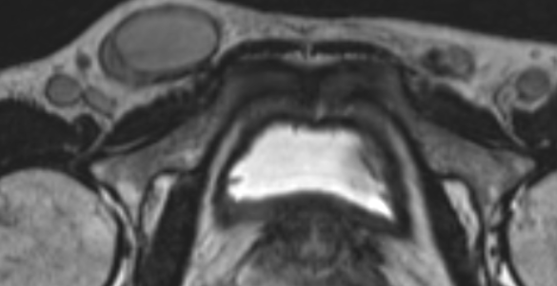
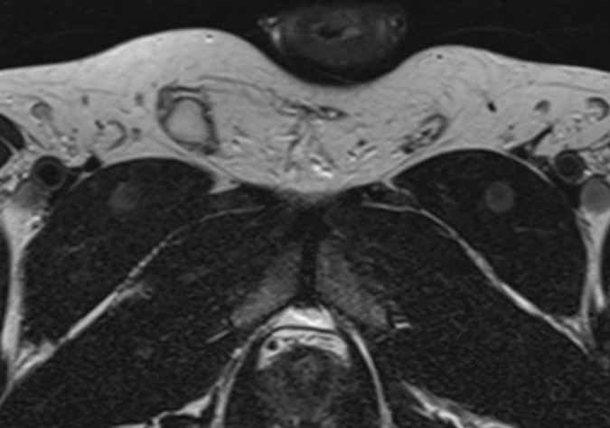
EMBRIOLOGY
Undescended testis . MR images show testis in the inguinal canal or the abdominal cavity with signal characteristics similar to those of the contralateral testis.
No testis in the scrotum sac
Right testis in the inguinal canal
Testes initially form in the lumbar region of the abdomen.
After 21 weeks of the conception, the testes begin to migrate into the inguinal canal
By 30 weeks after conception, nearly all testes have reached the scrotum
In some cases, the testicle may be atrophic or uncharacterized.
In some individuals, the testes fail to descend into the scrotum, a condition termed cryptorchidism / maldescension testis
Risk factor for testicular cancer
Atrofic testis in the inguinal canal
INTRODUCTION | ANATOMY | TESTICULAR LESIONS | PARATESTICULAR LESIONS | OTHERS

Slide 9

Palpable scrotum mass
Clinical History
Age
Acute symptoms
Trauma
Risk factors - family history of testicular cancer, personal history of tumor in the contralateral testis, and cryptorchidism
Physical examination
Unilateral, bilateral and flogistic signs.
US /MRI
Inconclusive or discordant clinical findings
Wide differential diagnosis
Intratesticular Lesion
Extratesticular Lesion
US
Modality of choice
MRI
Narrow the differential diagnosis
Considered malignant until proven otherwise
Most extratesticular masses are benign, and radical orchiectomy may be avoided
Malignant conditions
Benign conditions
Benign conditions
Malignant conditions
Germinative cell tumors
Sex cord tumors
Lymphoma
Others: leukemia, metastasis, and vascular tumors
Adrenal rests
Tuberculosis
Inflammatory conditions
Hematomas
Testicular torsion and ischaemia
Adenomatoid tumor of the epididymis
Spermatic cord lipoma
Scrotum hemangioma
Fibrous pseudotumor of the scrotum
Embryonal rhabdomyosarcoma
Spermatic cord leiomyosarcoma
Spermatic cord lipossarcoma

Slide 10
Palpable scrotum mass
Intratesticular Lesion
Malignant conditions
Malignant conditions
Benign conditions
Benign conditions
Germinative cell Tumors
Adrenal rests
Tuberculosis
Inflammatory conditions
Hematomas
Testicular torsion and ischaemia
Germinative cell tumors
Sex cord tumors
Lymphoma
Others: leukemia, metastasis, and vascular tumors
Seminomatous:
  More common
  AFP/ BHCG usually normal
  Commonly homogenous mass on US e MRI
Non-seminomatous:
AFP/ BHCG ↑
Heterogenous appearance at US and MR
Sex cord Tumors
30% of all testicular tumors in children
Lymphoma
> 60 yo
Others: leukemia, metastasis, and vascular tumors
Rare

Slide 11
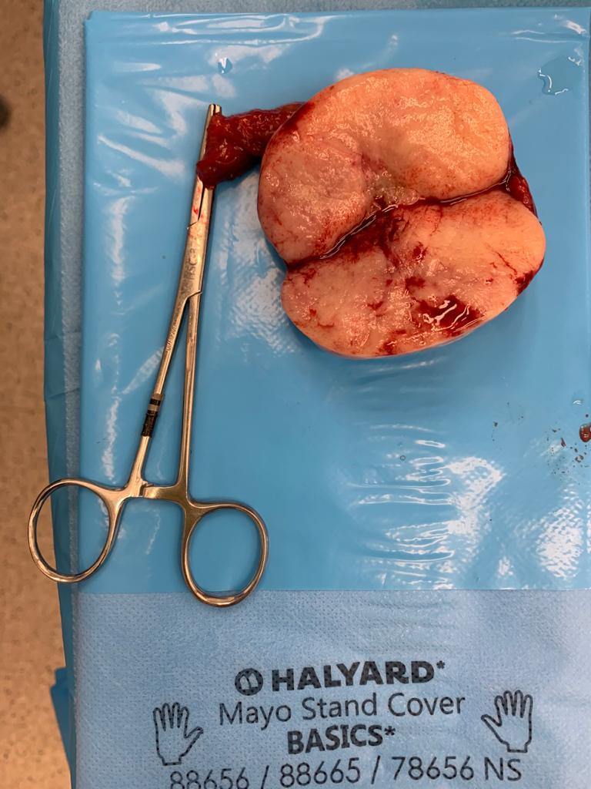
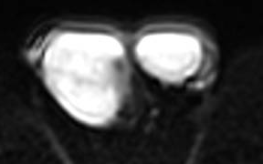
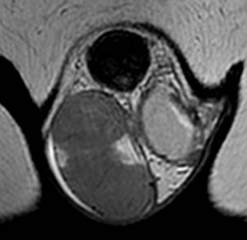
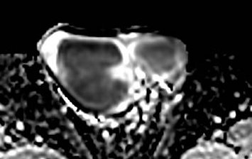
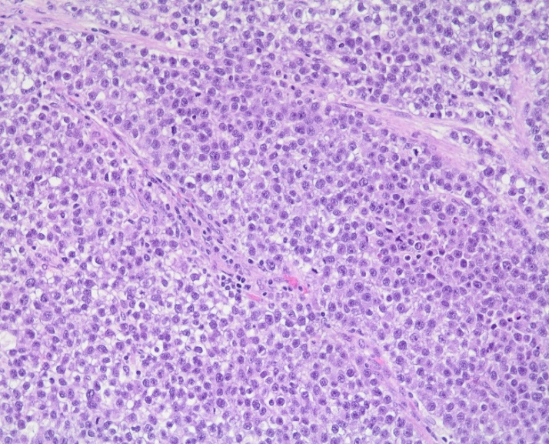
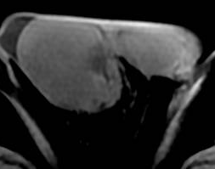
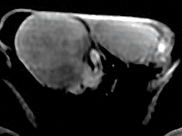
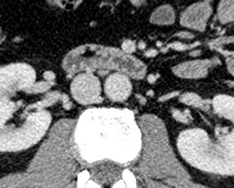
GERM-CELL TUMORS
A 52 years-old man presented with pain and a palpable mass in the right testicle.
After staging, a right orchiectomy was performed.
The surgical specimen shows the right testicular lesion sectioned (yellow arrow)
DWI
Histopathology examination: Solid sheets of monomorphic round-polygonal tumor cells showing clear cytoplasm. Some thin fibrous septa containing lymphomonocytic inflammatory infiltrate may be seen (blue arrows). Medium power view, H&E.
ADC MAP
Axial - T2WI
Coronal - T2WI
Teaching Points
90-95% of testicular carcinoma
Two groups: seminomas and non-seminoma
In general prognosis is better in seminomatous tumor
Pure seminomas are commonly homogenous mass on US e MRI
Serum concentrations of β-hCG and LDH may be elevated in patients with seminoma
AFP levels should be normal in seminoma
T1WI - PRE CONTRAST
T1WI - POST CONTRAST
CT - POST CONTRAST
Seminoma tumor. MRI images show enlarged right testicle due to mass with low signal intensity (red arrow) on axial and coronal T2W images, restriction diffusion (green arrow) on DWI and ADC map, and mild heterogeneous enhancement (yellow arrow). The lesion was confined to the testicle. Staging tomography had no retroperitoneal metastasis.
INTRODUCTION | ANATOMY | TESTICULAR LESIONS | PARATESTICULAR LESIONS | OTHERS

Slide 12
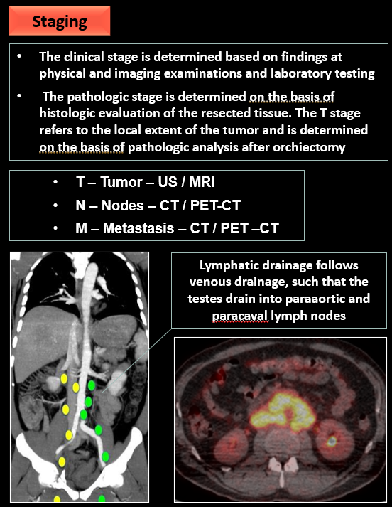
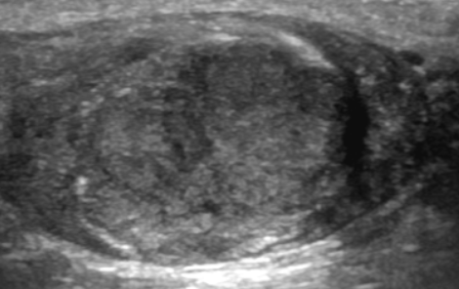
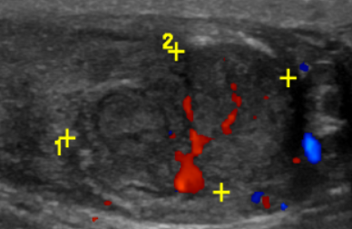
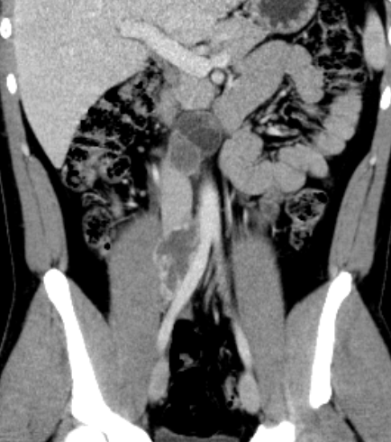
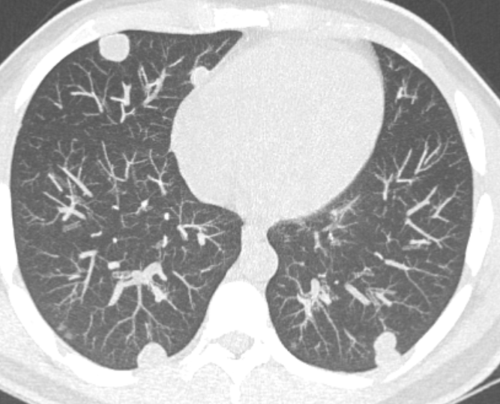
GERM-CELL TUMORS
TESTICULAR LESIONS
A 26-year-old man investigating severe weight loss and pain in the right inguinal region and elevated alpha-fetoprotein
Mixed non-seminoma. US images show a heterogenous mass in the right testicle with internal flow (red arrow). Staging tomography shows multiple pulmonary nodes (yellow arrow) and retroperitoneal lymph nodes enlargements with necrotic areas (green arrow), suggestive of metastasis
Teaching Points
Most common of non-seminomatous tumors are mixed (40%), composed of pure embryonal carcinomas, teratomas, yolk sac tumors, and choriocarcinomas
The classic testicular tumor marker alpha-fetoprotein (AFP) is associated with non-seminomatous germ cell tumors.
Heterogenous appearance at US and MR
CT - POST CONTRAST
CT - POST CONTRAST
INTRODUCTION | ANATOMY | TESTICULAR LESIONS | PARATESTICULAR LESIONS | OTHERS

Slide 13
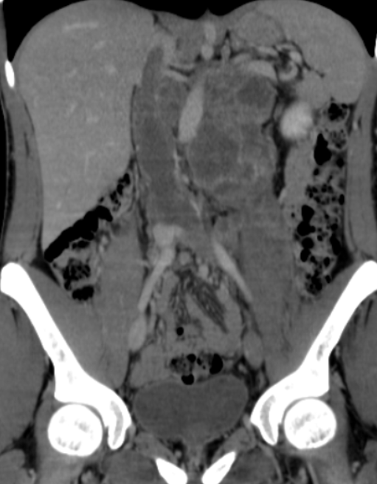
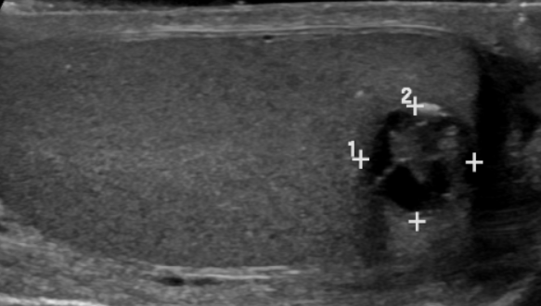
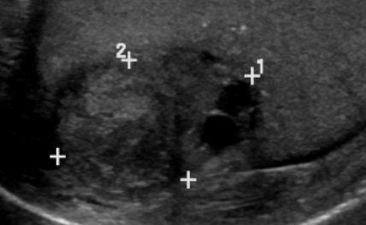
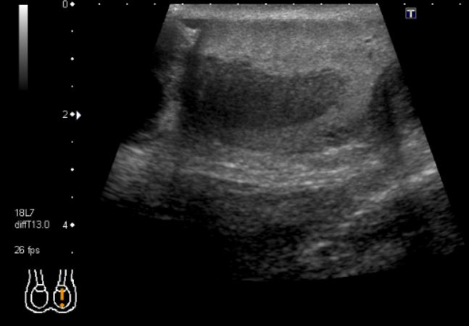
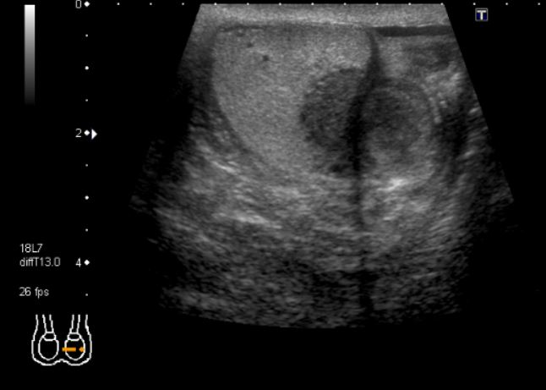
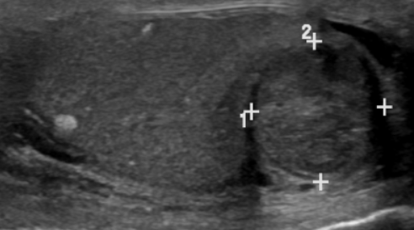
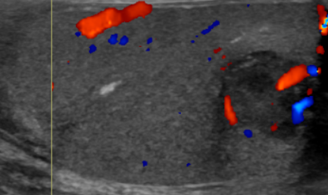
SEX-CORD STROMAL TUMORS
Additional finding: extensive thrombosis of the inferior vena cava
Staging CT reveals multiples lymph nodes necrotic metastasis (blue arrow).
CT - POST CONTRAST
Teaching Points
Teratoma is the 2nd most common testicular tumor in children, and in its pure form is rare in adults
Types: mature x immature x malignant areas
Well-circumscribed complex masses
In prepubertal, pure teratomas are considered benign even when they are histologically immature
Every element in a postpubertal testicular teratoma can metastasize, irrespective of its histologic characteristic, so treatment is conservative (orchiectomy).
20 yo man with teratoma on left testis . US shows a heterogeneous lesion (red arrow) with internal flow on Doppler (green arrow).
INTRODUCTION | ANATOMY | TESTICULAR LESIONS | PARATESTICULAR LESIONS | OTHERS

Slide 14
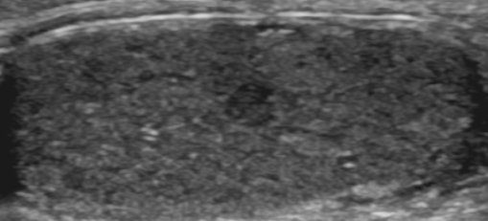
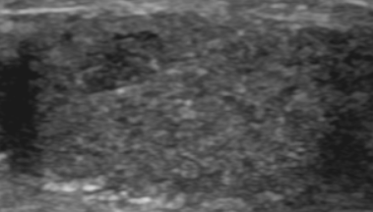
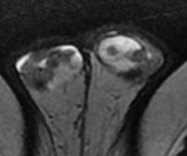
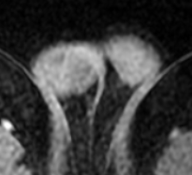
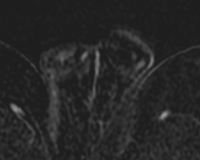
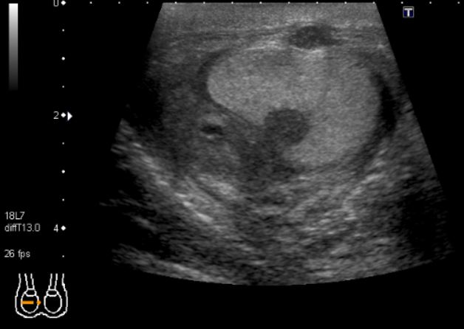
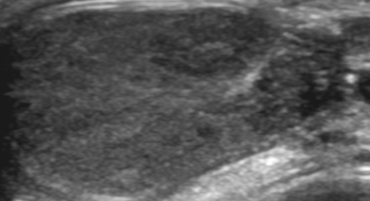
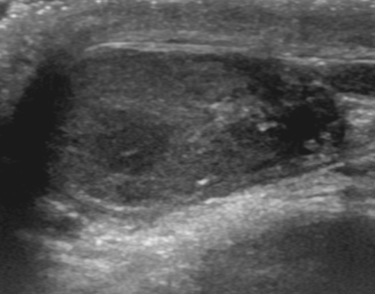
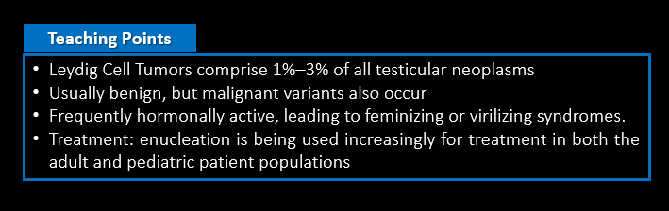
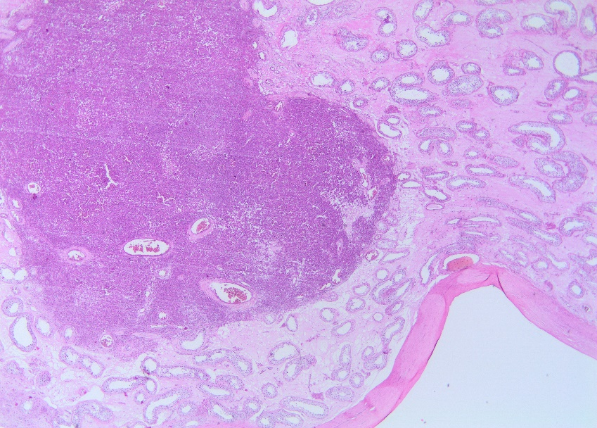

SEX-CORD STROMAL TUMORS
A 32-year-old man with a history of Klinefelter syndrome underwent examinations to investigate infertility.
T1WI - POST CONTRAST
SUBTRACTION
Axial - T2WI
T1WI - PRE CONTRAST
Leydig Cell Tumor. US images show reduced dimensions testes with heterogeneous echotexture and small hypoechoic solid nodules (red arrows). Axial MRI reveals small masses with low signal intensity on T2WI / T1WI (green arrows) and homogeneous enhancement (yellow arrow).
Histopathology examination: (A) Low power view showing the general eosinophilic appearance of the tumor and its relation with the seminiferous tubules and the albuginea. H&E. (B) Polygonal cells with abundant eosinophilic cytoplasm and uniform round nuclei. Medium power view, H&E.
Features associated with malignant potential include:
Size > 5 cm
Infiltrative borders, cytological atypia,
Frequent mitoses (> 3/10 high power fields)
Vascular invasion and necrosis
A
B
INTRODUCTION | ANATOMY | TESTICULAR LESIONS | PARATESTICULAR LESIONS | OTHERS

Slide 15






SEX-CORD STROMAL TUMORS
After staging, a right orchiectomy was performed.
39-year-old man with a 5-year history of a palpable nodule in the right testicle.
Sclerosing Sertoli cell tumor. US shows a small hypoechoic solid node in the right testicle (red arrow) with internal flow (yellow arrow).
Histopathology examination: This stromal tumor presents cordonal and tubular architecture intermingled by sclerotic intercellular matrix. Some residual non-tumoral seminiferous tubules may be seen. Medium power view, H&E.
Teaching Points
Sertoli cell tumors represent approximately 1% of testicular tumors and typically occur in the first 4 decades of life.
Most are benign
Sclerosing Sertoli cell tumor is a rare variant, composed of varying degrees of features of fetal, prepubertal, or adult Sertoli cells
Treatment: enucleation is being used increasingly
T2WI
T1WI - POST CONTRAST
T1WI - POST CONTRAST
SUBTRACTION
Sclerosing Sertoli Cell tumor. MRI reveals a lesion with low signal intensity (green arrow) on T2WI image and intense enhancement (blue arrow) on post-contrast T1WI.
INTRODUCTION | ANATOMY | TESTICULAR LESIONS | PARATESTICULAR LESIONS | OTHERS

Slide 16





LYMPHOMA
AXIAL CT – POST CONTRAST
AXIAL CT – POST CONTRAST
AXIAL CT – POST CONTRAST
Teaching Points
Lymphoma is the most common testicular malignancy over 60 yo
1%–9% of testicular neoplasms and 1% of non-Hodgkin lymphomas
Commonly occurs in the course of an established lymphoma elsewhere in the body
AXIAL CT – POST CONTRAST
AXIAL PET - CT FDG
Lymphoma. US and CT show infiltrative heterogeneous lymphoid tissue (red arrow) on right testis. Staging CT / PET – CT reveals neoplastic tissue on mediastinum (green arrow), retroperitoneum (yellow arrow), and lungs (blue arrow).
INTRODUCTION | ANATOMY | TESTICULAR LESIONS | PARATESTICULAR LESIONS | OTHERS

Slide 17





METASTASES
Teaching Points
Metastases to the testes are uncommon
Most common: prostate, lung, kidney, and colon; melanoma; and leukemia
Bilateral in 8%–15%, and the mean age was 55 yo
AXIAL CT – arterial phase
AXIAL CT – late phase
Hepatocellular carcinoma – infiltrative lesion with washout characterized in the arterial and late phase on CT (red arrow)
Hepatocellular carcinoma metastases on left testis. US shows a heterogeneous infiltrative mass (green arrow) with internal flow (blue arrow)
INTRODUCTION | ANATOMY | TESTICULAR LESIONS | PARATESTICULAR LESIONS | OTHERS

Slide 18
Palpable scrotum mass
Intratesticular Lesion
Malignant conditions
Malignant conditions
Benign conditions
Trauma history
Acute pain
Cystic lesion
Inflammatory conditions
Benign conditions
Adrenal rests
Tuberculosis
Inflammatory conditions
Hematomas
Testicular torsion and ischaemia
Adrenal Rests
Congenital adrenal hyperplasia (CAH)
Germinative cell tumors
Sex cord tumors
Lymphoma
Others: leukemia, metastasis, and vascular tumors
Adrenal rests
Tuberculosis
Inflammatory conditions
Hematomas
Testicular torsion and ischaemia
Germinative cell tumors
Sex cord tumors
Lymphoma
Others: leukemia, metastasis, and vascular tumors
Hematomas
Trauma
Testicular torsion and ischaemia
Acute pain
Avoid unnecessary surgery
Inflammatory conditions
Acute pain, fever and swelling
Tuberculosis
Chronic condition

Slide 19







ADRENAL REST
Axial - T2WI
Axial - T2WI
Teaching Points
Commonly associated with congenital adrenal hyperplasia (CAH).
If exposed to elevated levels of adrenocorticotropic hormone, can enlarge to form masses.
Usually bilateral
Although the imaging features of seminoma and adrenal rests may overlap, the clinical history should make differentiation possible.
Adrenal rests in a 25-year-old man with known congenital adrenal hyperplasia who presented with rising laboratory values despite treatment. US and MR images show bilateral masses (red arrows) representing adrenal rests with internal flow (green arrow).
INTRODUCTION | ANATOMY | TESTICULAR LESIONS | PARATESTICULAR LESIONS | OTHERS

Slide 20




HEMATOMA
Subcutaneous edema
Right testicular hematoma in a 52-year-old man who was thrown from a motorcycle. US image shows a heterogeneous echotexture in the right testicle (red arrow), a finding consistent with contusion. Also, US image obtained at a different level shows no discontinuity of the echogenic line surrounding the testicle, indicative of preserved tunica albuginea (green arrow).
Teaching Points
Blunt testicular trauma is often sports- related.
The right testis is injured more frequently than the left because of its superior location and propensity to be trapped against the pubis.
US has high sensitivity for depicting testicular injury
Identifying discontinuity of the tunica albuginea indicates testicular rupture, which is an indication for surgical exploration and repair
INTRODUCTION | ANATOMY | TESTICULAR LESIONS | PARATESTICULAR LESIONS | OTHERS

Slide 21







TESTICULAR TORSION
Teaching Points
Occur at any age; most common in adolescents
Symptoms: pain, swelling, redness, and a palpable mass
US: differentiation between lesions that require urgent surgery (testicular torsion, malignant tumors, and traumatic rupture) and those that can be managed conservatively (epididymo-orchitis, torsion of the testicular appendages)
Testicular torsion in a 12-year-old boy with left-sided scrotal pain of sudden onset. US shows an enlarged left testicle (red arrow) with few vascularization at color Doppler (green arrow). Scan of the left hemiscrotum reveals a round supratesticular mass (blue arrow), which represents an edematous spermatic cord with Whirlpool sign (yellow arrow).
Left testicle slightly elevated
Testicular torsion was confirmed at surgery.
INTRODUCTION | ANATOMY | TESTICULAR LESIONS | PARATESTICULAR LESIONS | OTHERS

Slide 22




EPIDIDYMAL-ORCHITIS
Epididymal-orchitis with testicular necrosis in a 64-year-old man with a 2-week history of symptoms. US image shows mild enlargement of the right testicle and epidydimal tail (green arrow) with heterogeneous echotexture, increased blood flow and a complex mass pyocele (yellow arrow).
Teaching Points
Most common causes of acute scrotal pain
Caused by retrograde bacterial infection from a lower urinary tract infection.
If untreated, may be complicated by abscess formation and testicular infarction
US also may depict findings indicative of abscess, which may require surgical drainage if antibiotic therapy is unsuccessful
heterogeneous echotexture
increased blood flow
INTRODUCTION | ANATOMY | TESTICULAR LESIONS | PARATESTICULAR LESIONS | OTHERS

Slide 23





TUBERCULOSIS
A 35-year old man presented with painless enlargement of the scrotum and history of Acquired Immunodeficiency Syndrome being treated
I
J
D
G
H
Coronal- T2WI
Sagittal - T2WI
T1WI - POST CONTRAST
SUBTRACTION
Tuberculosis. Ultrasound reveals testicular atrophy, with hypoechogenic nodules (red arrows), diffusely enlarged epididymis (green arrows) associated with intense internal flow on color-Doppler.
MR shows low signal intensity of bilateral epididymis (yellow arrows) with peripheral enhancement (blue arrow) .
Teaching Points
The genitourinary tract is the most common site of extra-pulmonary tuberculosis.
Results from retrograde extension from prostate. Hematogeneous spread is rare.
The infection usually begins at the tail of epididymis, and propagate to the entire gland, involving the testis
Genital tuberculosis is rare.
INTRODUCTION | ANATOMY | TESTICULAR LESIONS | PARATESTICULAR LESIONS | OTHERS

Slide 24
Palpable scrotum mass
US /MRI
Intratesticular Lesion
Intratesticular Lesion
Extratesticular Lesion
Malignant conditions
Benign conditions
Benign conditions
Malignant conditions
Malignant conditions
Benign conditions
Adrenal rests
Tuberculosis
Inflammatory conditions
Hematomas
Testicular torsion and ischemia
Adenomatoid tumor of the epididymis
Most common tumor of the epididymis
Germinative cell tumors
Sex cord tumors
Lymphoma
Others: leukemia, metastasis, and vascular tumors
Adenomatoid tumor of the epididymis
Spermatic cord lipoma
Scrotum hemangioma
Fibrous pseudotumor of the scrotum
Embryonal rhabdomyosarcoma
Spermatic cord leiomyosarcoma
Spermatic cord lipossarcoma
Spermatic cord lipoma
Homogeneous fat lesion
Avoid unnecessary surgery
Scrotum hemangioma
MR: hyperintense SI on T2WI with flow voids
Fibrous pseudotumor of the scrotum
MR: markedly low signal intensity on T2WI

Slide 25






ADENOMATOID TUMOR
Sagittal- T1WI
POST CONTRAST
Coronal - T2WI
Sagittal - T2WI
Histopathology examination: This benign tumor is predominantly composed by low cuboidal or flattened cells arranged in solid cords, tubular or cystically dilated slit-like glandular structures. The stroma is scarce and often contains smooth muscle, elastic fibers, and inflammatory cells. Medium power view, H&E.
Axial- T1WI
POST CONTRAST
Teaching Points
Axial - T2WI
Adenomatoid tumors originate from the epididymis, tunica vaginalis, or spermatic cord.
Most common tumor of the epididymis and occur more often in the lower pole than in the upper pole
Unilateral
Adenomatoid tumor in a 40yo man with a palpable nodule in the right side of the scrotum. MRI shows a lesion on the epididymal head (red arrow) with low signal intensity on T2WI images and homogeneous enhance on T1-WI post-contrast (green arrow).
INTRODUCTION | ANATOMY | TESTICULAR LESIONS | PARATESTICULAR LESIONS | OTHERS

Slide 26







LIPOMA
Lipoma in a 65yo man with a right-sided scrotal mass. MRI shows a large uniform lesion with fat signal intensity with all sequences (red arrow), including fat-suppressed sequences (green arrow)
Teaching Points
Axial - T2WI
Most common benign tumor of the spermatic cord
Can occur at any age
Can mimic common affections such as an inguinoscrotal hernia, hydrocele, or a testicular tumor
Enhancement of the septa and solid nodules are findings that help differentiate the lesion from an aggressive liposarcoma.
Coronal - T2WI
Axial - T2WI
Sagittal - T2WI
Liposarcoma in a 50yo man. CT shows a heterogenous mass with fat contains, septa and solid nodules.
Axial - T2WI FAT SAT
Axial- T1WI FAT SAT POST CONTRAST
INTRODUCTION | ANATOMY | TESTICULAR LESIONS | PARATESTICULAR LESIONS | OTHERS

Slide 27






HEMANGIOMA
Hemangioma. MRI shows well circumscribed lesion, with high signal on T2WI (red arrow), enhancement on post-contrast T1WI (blue arrow) and small areas of flow void (green arrow).
Oblique- T2WI
Axial- T2WI
Oblique – T1WI PRE CONTRAST
Teaching Points
Testicular hemangiomas are rare
Usually manifest in infants and are asymptomatic
MRI: hyperintense SI on T2WI with flow voids
Oblique- T2WI
Sagittal - T2WI
Axial – T1WI POST CONTRAST
INTRODUCTION | ANATOMY | TESTICULAR LESIONS | PARATESTICULAR LESIONS | OTHERS

Slide 28







FIBROUS PSEUDOTUMOR
Fibrous pseudotumors. US images show paratesticular hypoechoic solid masses (red arrow). MRI reveals lesions with markedly low signal intensity on T2WI (green arrow), no diffusion restriction (blue arrow) and mild enhancement (yellow arrow) on post-contrast T1WI, favoring the fibrous nature. The testes and the epididymis were with habitual aspects.
No significant internal flow
Teaching Points
Rare. Commonly results from a reactive and fibrous proliferation of paratesticular tissue
Usually arising from tunica vaginalis. Remainder from epididymis, spermatic cord, and tunica albuginea.
Nodular form is the commonest.
About 30% have history of trauma or orchiepididymitis.
DWI
Axial – T1WI POST CONTRAST
Coronal - T2WI
ADC MAP
INTRODUCTION | ANATOMY | TESTICULAR LESIONS | PARATESTICULAR LESIONS | OTHERS

Slide 29








OTHERS BENIGN CONDITIONS
Epididymal cyst
Torsion of the hydatid of Morgagni / testicular appendix. 5yo boy with pain, erythema, and enlarged right hemiscrotum for 8 hr. US shows a nodule with low echogenicity, adjacent to the epididymis, without internal flow.
Normal appendix testis
Varicocele
INTRODUCTION | ANATOMY | TESTICULAR LESIONS | PARATESTICULAR LESIONS | OTHERS

Slide 30
Palpable scrotum mass
US /MRI
Extratesticular Lesion
Benign conditions
Malignant conditions
Malignant conditions
Benign conditions
Embryonal rhabdomyosarcoma
First 2 decades of life, with the median age at diagnosis being 7 years of age
Adenomatoid tumor of the epididymis
Spermatic cord lipoma
Scrotum hemangioma
Fibrous pseudotumor of the scrotum
Embryonal rhabdomyosarcoma
Spermatic cord leiomyosarcoma
Spermatic cord lipossarcoma
Spermatic cord leiomyosarcoma
Rare
Spermatic cord lipossarcoma
MR: heterogeneous fat lesion with septa and enhancing solid nodules

Slide 31






RHABDOMYOSARCOMA
Right testicle
Internal blood flow
Rhabdomyosarcoma in a 20yo man with right-sided scrotal swelling. US and CT images demonstrate a large heterogeneous paratesticular mass (red arrow) evolving the right testis, which shows internal vascularity. The biopsy results were consistent with a diagnosis of rhabdomyosarcoma (alveolar subtype). Staging CT reveals a metastatic retroperitoneal lymph node (green arrow).
Rare. Occur mainly in the first 2 decades of life
Histogenesis is related to the embryonic development of the spermatic cord, epididymis, testis, and connective tissue coverings
Subtypes:
  Alveolar (worst prognosis)
  Embryonal (most common)
  Pleomorphic
Teaching Points
INTRODUCTION | ANATOMY | TESTICULAR LESIONS | PARATESTICULAR LESIONS | OTHERS

Slide 32








LEIOMYOSARCOMA
DWI
Axial- T2WI
restricted diffusion
ADC MAP
Right testicle
Internal blood flow
Sagittal - T2WI
Axial – T1WI POST CONTRAST
Teaching Points
Rarely occurs in spermatic cord, where it arises from the smooth muscle
Locoregional recurrence is common
Treatment consists of transinguinal radical orchiectomy, with adjuvant radiation therapy to reduce recurrence and chemotherapy for high-grade lesions and metastases
Spermatic cord sarcoma. US shows a large paratesticular mass (red arrow) in the right testis with the internal flow.
MRI demonstrates a predominantly homogeneous mass (green arrow) that arises from the spermatic cord and has a signal on T2 similar to muscle.
INTRODUCTION | ANATOMY | TESTICULAR LESIONS | PARATESTICULAR LESIONS | OTHERS

Slide 33








OTHERS LESIONS
Assessment of abdominal pain in a 13yo child with a female phenotype and a history of complete androgen insensitivity syndrome (CAIS)
Right gonad – Sex cord-Stromal tumor.
Histopathology examination: Solid architecture with uniform cuboidal or columnar cells with moderate pale to lightly pink cytoplasm. A nest with hyaline globules is shown (blue arrow). Medium power view, H&E.
Left gonad - Sertoli cell Adenoma
Histopathology examination: Unencapsulated nodules composed of immature Sertoli cells arranged in well formed tubules and cords. The stroma is sclerotic without Leydig cells. (A) Low power view, H&E. (B) Medium power view, H&E.
Absence of the uterus and upper third of the vagina
US, and axial, coronal and sagittal T2WI MRI images show a cystic lesion with thick septa (red arrow) and mural nodules (yellow arrow) in the right gonad located in the pelvis. The left gonad was normal at image. The patient was submitted to a bilateral gonadectomy.
A
B
INTRODUCTION | ANATOMY | TESTICULAR LESIONS | PARATESTICULAR LESIONS | OTHERS

Slide 34






OTHERS LESIONS
Anemone-like mass
25 yo patient with complete androgen insensitivity syndrome investigating pelvic mass
Sagittal and axial MR images show left solid-cystic mass with slight hyperintensity (red arrow) and internal branching architecture detected as low signal branch-like structure (blue arrow) on T2W. DWI, ADC map, and post-contrast images revealing diffusion restriction (yellow arrow) and mild enhancement on solid parts (purple circle). Right gonad (green arrow) inside the abdominal cavity. Borderline serous tumor confirmed by surgery.
Teaching Points
Androgen insensitivity syndrome is the most common cause of disorder of sex development in 46 XY individuals.
Phenotype is variable.
Patients have undescended testes with solid immature tubules and markedly decreased or absent germ cells.
Incidence of testicular tumors is higher and increases with age
The most common subtype of tumor is germ cell tumors (gonadoblastomas, seminoma, and non-seminomas).
Absence of the uterus and upper third of the vagina
INTRODUCTION | ANATOMY | TESTICULAR LESIONS | PARATESTICULAR LESIONS | OTHERS

Slide 35
TAKE HOME MESSAGE
BIBLIOGRAPHY
Testicular Tumors: What Radiologists Need to Know—Differential Diagnosis, Staging, and Management - Courtney Coursey Moreno, William C. Small, Juan C. Camacho, Viraj Master, Nima Kokabi, Melinda Lewis, Matthew Hartman, Pardeep K. Mittal .
MR Imaging of Scrotal Tumors and Pseudotumors - Fiona Hughes Cassidy , Kevin M. Ishioka, Colm J. McMahon, Pauline Chu, Kyoko Sakamoto, Karen S. Lee, Lejla Aganovic.
Imaging of Testicular and Scrotal Masses: The Essentials - Andreas G. WibmerHebert Alberto Vargas.
Color Doppler Sonography of Normal and Torsed Testicular Appendages in Children - Matteo Baldisserotto, João Carlos Ketzer de Souza, Ana Paula Pertence and Marcelo Dourado Dora.
Sonographic appearances of torsion of the appendix testis and appendix epididymis in children -Mikahl Lev, Jacob Ramon, Yoram Mor, Jeffrey M Jacobson, Michalle Soudack.
Differential diagnosis of nonpalpable testicular lesions: qualitative and quantitative contrast-enhanced US of benign and malignant testicular tumors - Andrea M Isidori, Carlotta Pozza, Daniele Gianfrilli, Elisa Giannetta, Andrea Lemma, Riccardo Pofi, Federica Barbagallo, Lucia Manganaro, Giovanni Martino, Francesco Lombardo, Vito Cantisani, Giorgio Franco, Andrea Lenzi.
The Morphologic Spectrum of Sertoliform Cystadenoma of the Rete Testis: A Series of 15 Cases - Swetha Paluru, Thomas M Ulbright, Mahul Amin, Rodolfo Montironi , Jonathan Epstein.
MRI appearance of ovarian serous borderline tumors of the micropapillary type compared to that of typical ovarian serous borderline tumors: radiologic-pathologic correlation - Go Nakai, Takashi Yamada, Kazuhiro Yamamoto, Yoshinobu Hirose, Masahide Ohmichi, and Yoshifumi Narumi.
Ovarian serous surface papillary borderline tumors form sea anemone-like masses - Yumiko Oishi Tanaka, Satoshi Okada, Toyomi Satoh, Koji Matsumoto, Akinori Oki, Masato Nishida, Hiroyuki Yoshikawa, Tsukasa Saida, Manabu Minami.
Multimodality Imaging of Paratesticular Neoplasms and Their Rare Mimics - Syed Ali Akbar, Tawfeeq Amjadali Sayyed, Syed Zafar Hasan Jafri, Farnaz Hasteh, James Simeon Adams Neill
What is the best management for a spermatic cord sarcoma in 2018? - S Carrère , R Tetreau, C Honoré, D Tzanis, J-B Delhorme, M Fau , G Decanter , C Llacer , N Firmin, E Stoeckle, P Meeus, G Ferron, D Cupissol, F Quénet, B Meunier , S Bonvalot, GSF-GETO.
Spermatic cord sarcomas: sonographic and CT features - G Cardenosa, N Papanicolaou, C Y Fung, G A Tung, I C Yoder, A F Althausen, W U Shipley.
Spectrum of Extratesticular and Testicular Pathologic Conditions at Scrotal MR Imaging - Pardeep K. Mittal , Ahmed S. Abdalla, Argha Chatterjee, Deborah A. Baumgarten, Peter A. Harri, Jay Patel, Courtney C. Moreno, Helena Gabriel, Frank H. Miller.
US–MR Imaging Correlation in Pathologic Conditions of the Scrotum - Woojin Kim, Mark A. Rosen, Jill E. Langer, Marc P. Banner, Evan S. Siegelman, Parvati Ramchandani
Gray-Scale and Color Doppler Sonography of Scrotal Disorders in Children: An Update - Celestino Aso, Goya Enríquez, Marta Fité, Nuria Torán, Carmen Piró, Joaquim Piqueras, Javier Lucaya
Radiologists play an important role in the diagnosis, staging, and follow-up of scrotal lesions.
Although US is the first-line imaging modality for investigation of scrotal lesions, MR has proven to be an effective adjunct diagnostic tool in the characterization and localization of masses.
When US findings are inconclusive, MR imaging has been shown to reduce healthcare costs and improve patient management
It is crucial establishing benign differential diagnoses that change the therapeutic approach.

